Slide 1

Spinodal Instability in Baryon-Rich Quark Matter
Feng Li

Slide 2
Outline
Background (What is the spinodal instability (SI)? Why it matters?)
Introduction to the Polyakov-Nambu-Jona-Lasino (PNJL) model
Linear response theory
Quark matter in a box
Quark matter in an expanding spherical fireball
Quark matter in an expanding fireball with AMPT initial condition
Summary
Notes:
Using that model, we will study the instabilities of the baryonic rich quark matter

Slide 3
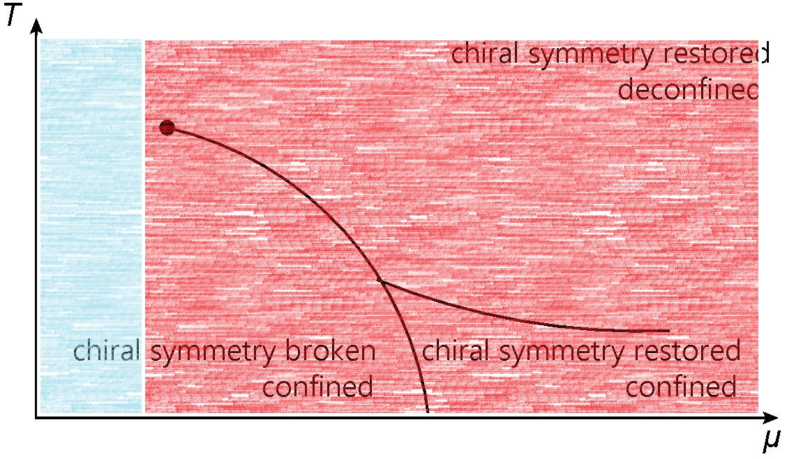
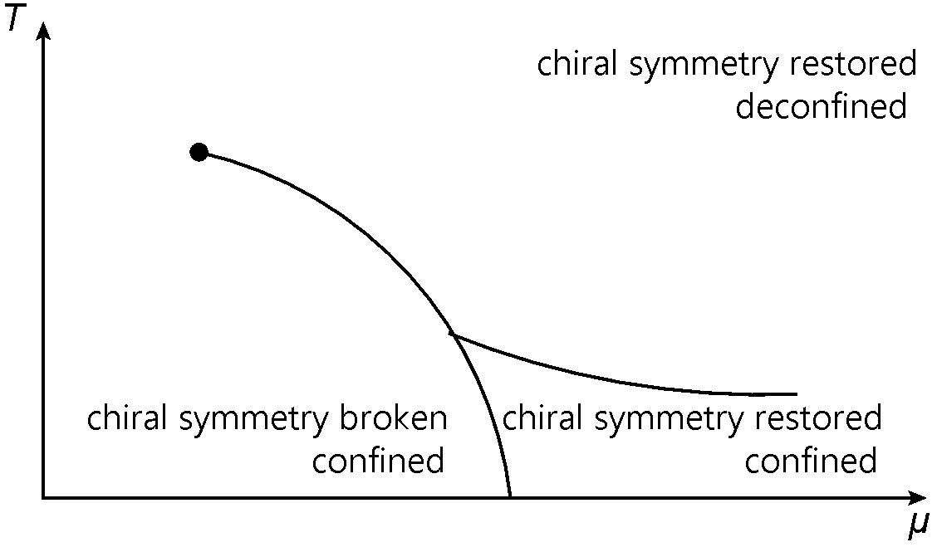
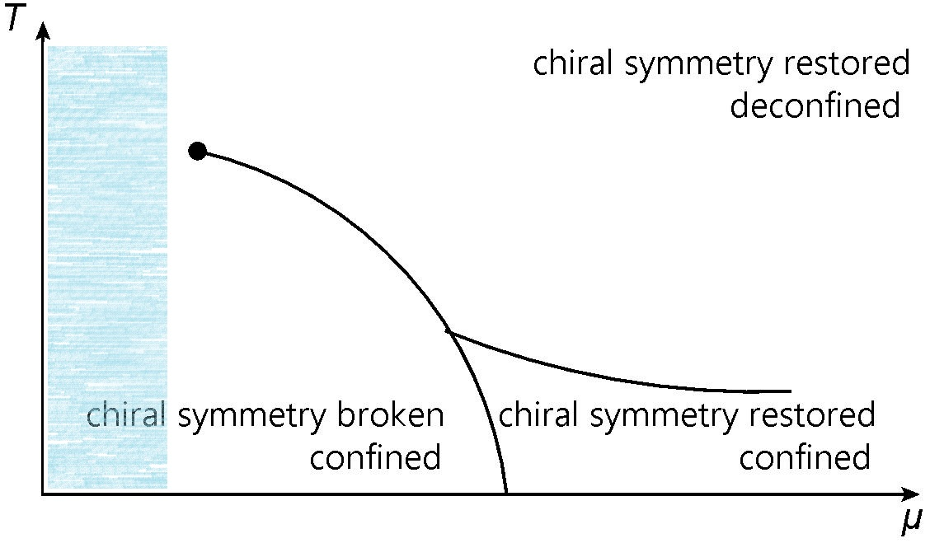
QCD Phase Diagram
Y. Aoki, etc. Nature 443, 675 (2006)

Slide 4
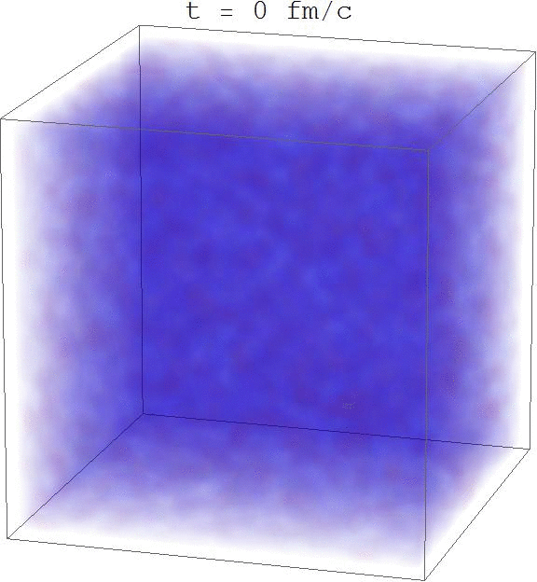


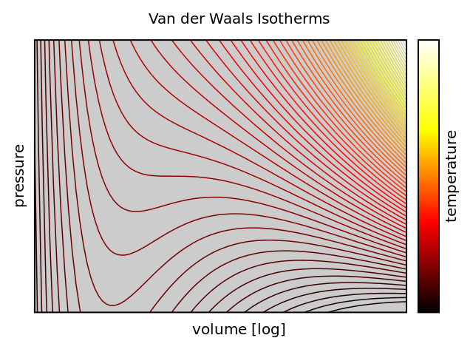
Spinodal Instability
Definition
Criterion
Definition
Criterion
A self-amplified deviation from equilibrium during a first order phase transition
or

Slide 5
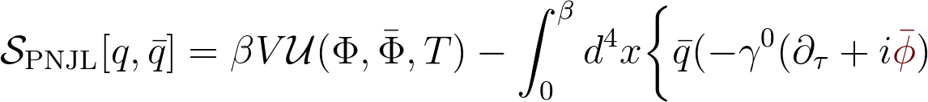
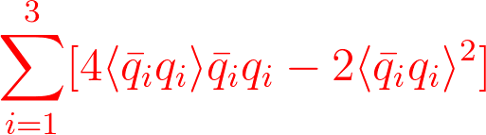
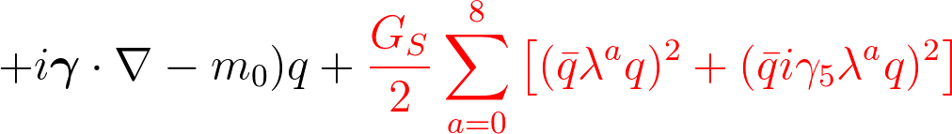
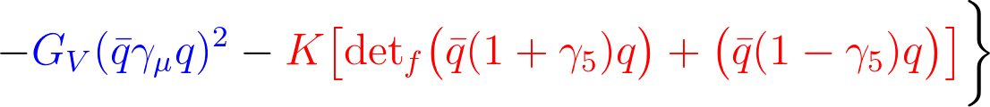
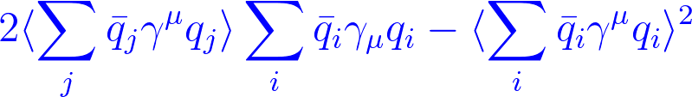

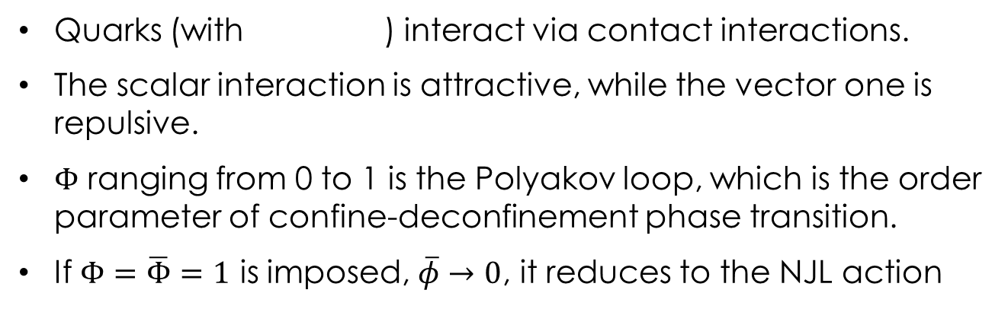
The (P)NJL Model (Action)
Quarks (with ) interact via contact interactions.
The scalar interaction is attractive, while the vector one is repulsive.
$Φ$ ranging from 0 to 1 is the Polyakov loop, which is the order parameter of confine-deconfinement phase transition.
If $Φ=\overline{Φ}=1$ is imposed, $\overline{φ}→0$, it reduces to the NJL action
T. Hatsuda and T. Kunihiro PLB 185, 304 (1987)
K. Fukushima PLB 591, 277 (2004)

Slide 6
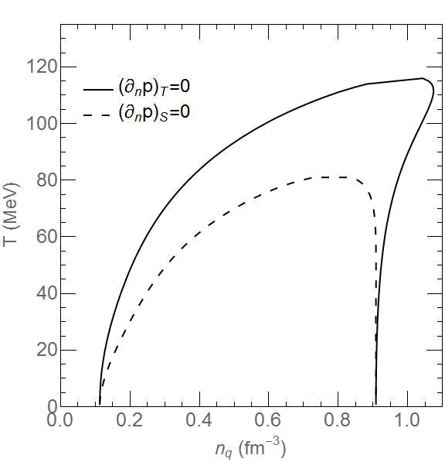
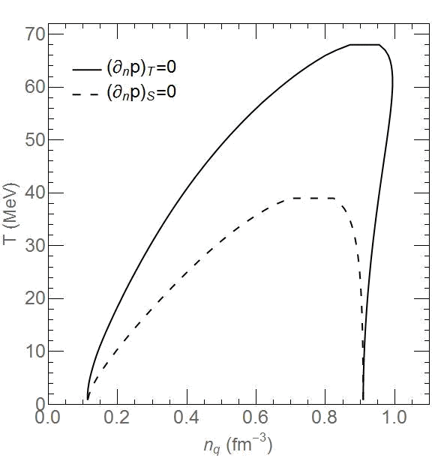
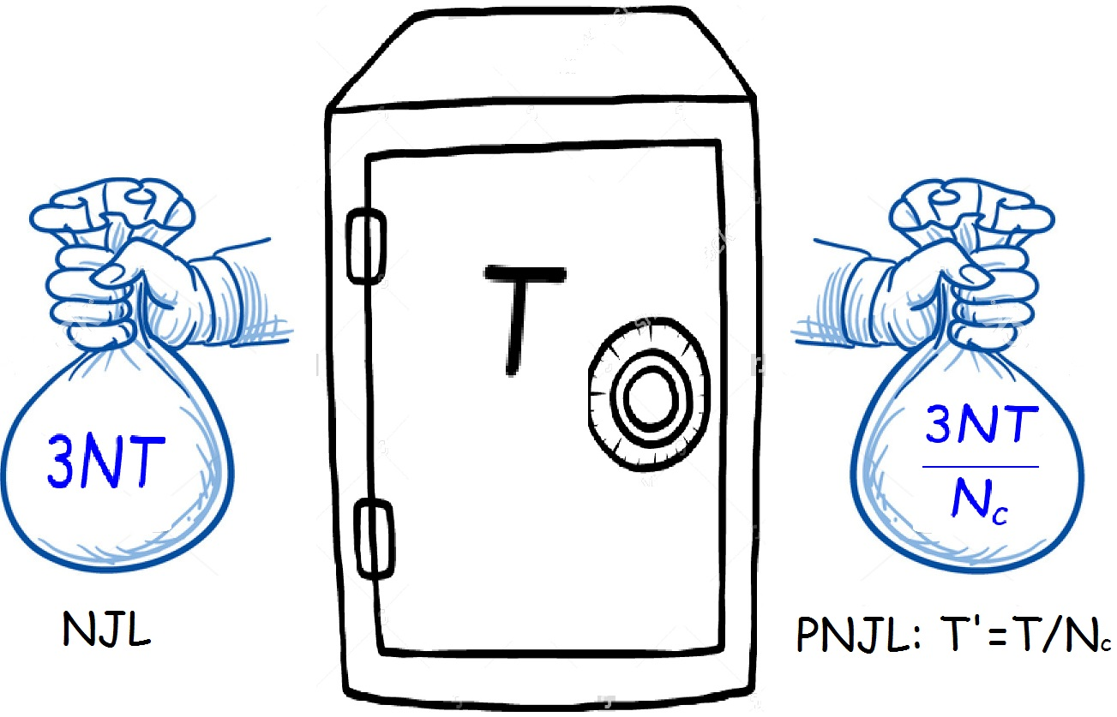
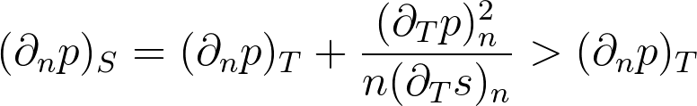
Thermal Spinodal Boundaries:
NJL, Gv=0
(Tc~70 MeV)
PNJL, Gv=0
(Tc~120 MeV)
Isothermal vs Isentropic
Frozen effect
The thermodynamics feature of a cold deconfined system is the same as that of a hot confined system.
NJL, Gv=0
(Tc~70 MeV)
PNJL, Gv=0
(Tc~120 MeV)
Isothermal vs Isentropic
Frozen effect
NJL, Gv=0
(Tc~70 MeV)
PNJL, Gv=0
(Tc~120 MeV)
Isothermal vs Isentropic
Frozen effect
NJL, Gv=0
(Tc~70 MeV)
PNJL, Gv=0
(Tc~120 MeV)
Isothermal vs Isentropic
Frozen effect

Slide 7

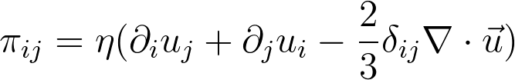


Linear Response Theory:
Theory
Spinodal Instability
Combine
Eigen
Modes
The fluctuations are proportional to the perturbations applied to the system.
Examples:
In general:
The coefficients are the retarded Green’s functions evaluated in equilibrium.

Slide 8

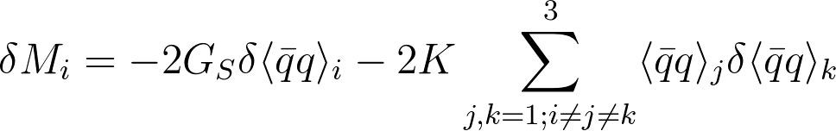
Linear Response Theory:
Theory
Spinodal Instability
Combine
Eigen
Modes
The perturbation is also proportional to the fluctuations.
In the mean field level:

Slide 9
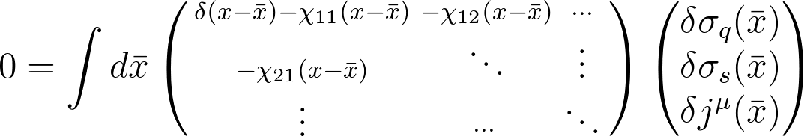
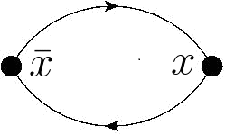
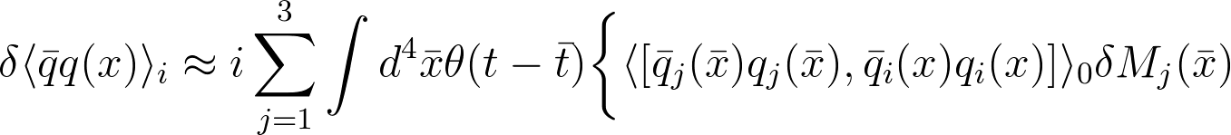
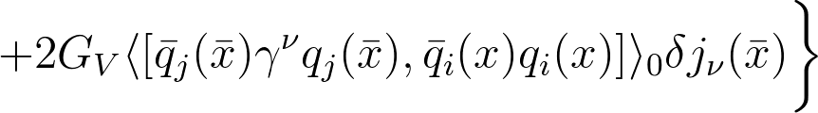
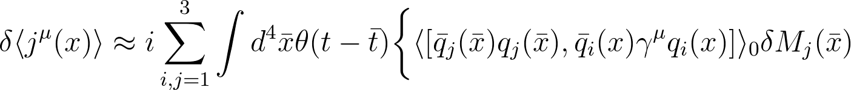
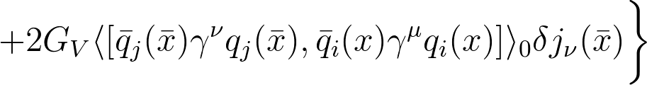
Linear Response Theory:
Theory
Spinodal Instability
Combine
Eigen
Modes

Slide 10
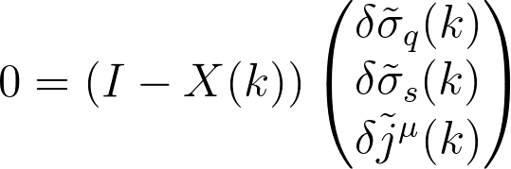



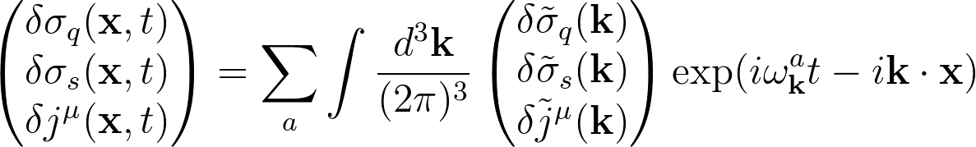
Linear Response Theory:
Theory
Spinodal Instability
Combine
Eigen
Modes
After Fourier Transformation
is the root of
Sound wave solution:
If is imaginary, the fluctuating mode with the wavenumber k will grow exponentially with time. It is thus called the unstable mode with being the growth rate.

Slide 11
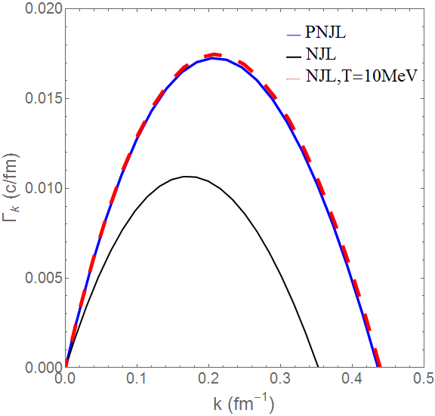
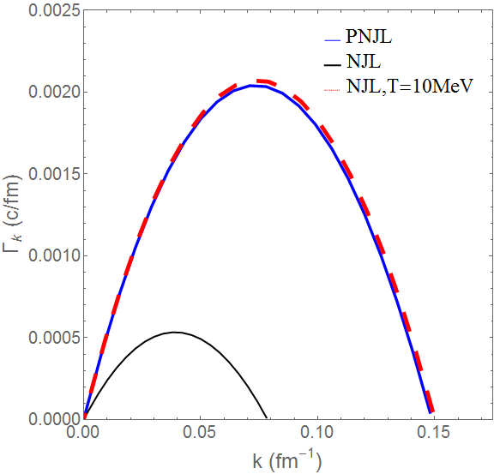
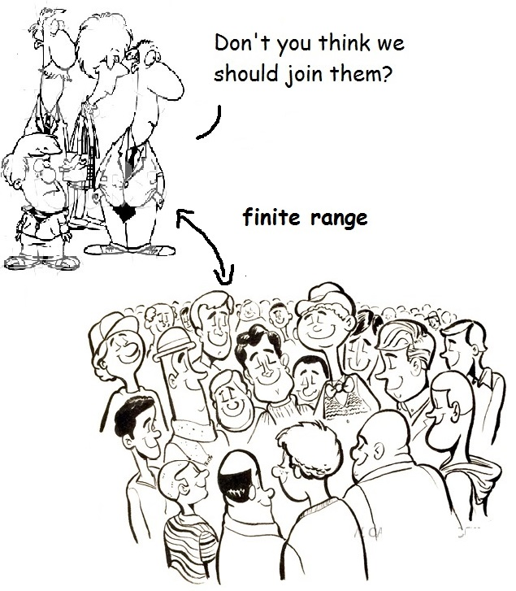


Dispersion Relation
Gv=0
Gv=0.2Gs
Why bend down
Gv=0
Gv=0.2Gs
Why bend down
Gv=0
Gv=0.2Gs
Why bend down

Slide 12
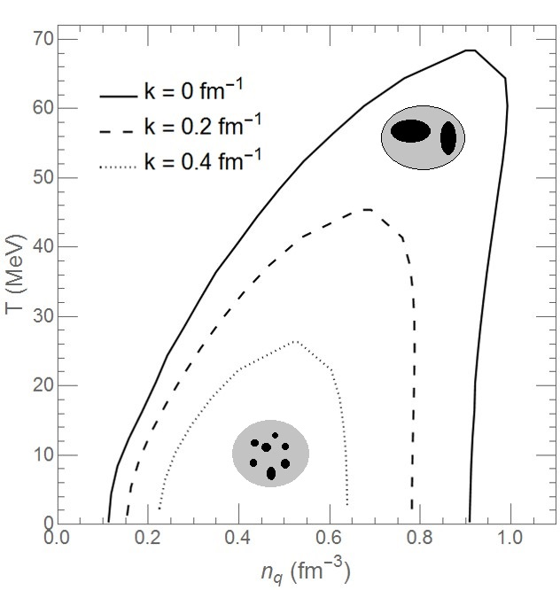
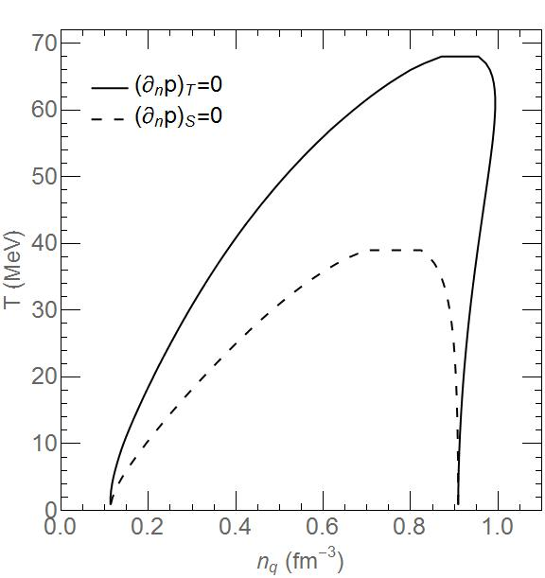
Spinodal Boundaries:
NJL, Gv=0
Unstable modes of short-wavelength survive in the center of the spinodal instability region
Comparison with the isothermal boundary
PNJL, Gv=0
NJL, Gv=0.2 Gs
Supressed by the vector interaction
PNJL, Gv=0.2 Gs
NJL, Gv=0
Unstable modes of short-wavelength survive in the center of the spinodal instability region
Comparison with the isothermal boundary
PNJL, Gv=0
NJL, Gv=0.2 Gs
Supressed by the vector interaction
PNJL, Gv=0.2 Gs

Slide 13
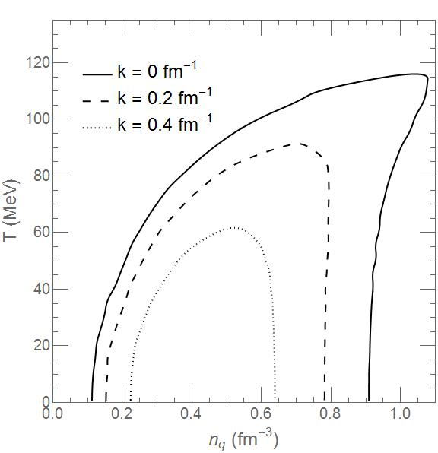
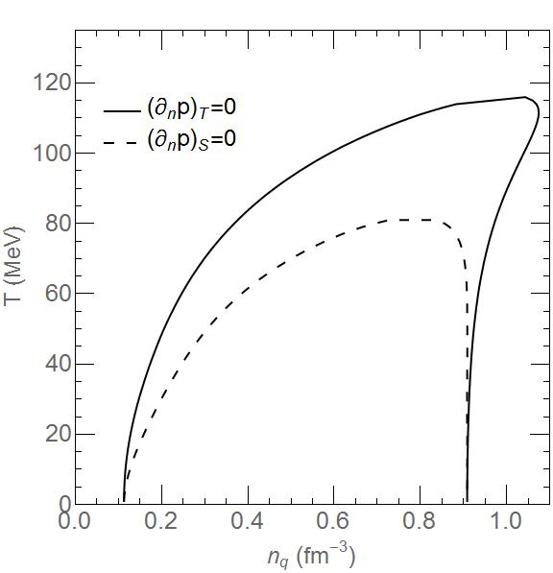
Spinodal Boundaries:
NJL, Gv=0
Unstable modes of short-wavelength survive in the center of the spinodal instability region
Comparison with the isothermal boundary
PNJL, Gv=0
NJL, Gv=0.2 Gs
Supressed by the vector interaction
PNJL, Gv=0.2 Gs
NJL, Gv=0
Unstable modes of short-wavelength survive in the center of the spinodal instability region
Comparison with the isothermal boundary
PNJL, Gv=0
NJL, Gv=0.2 Gs
Supressed by the vector interaction
PNJL, Gv=0.2 Gs

Slide 14
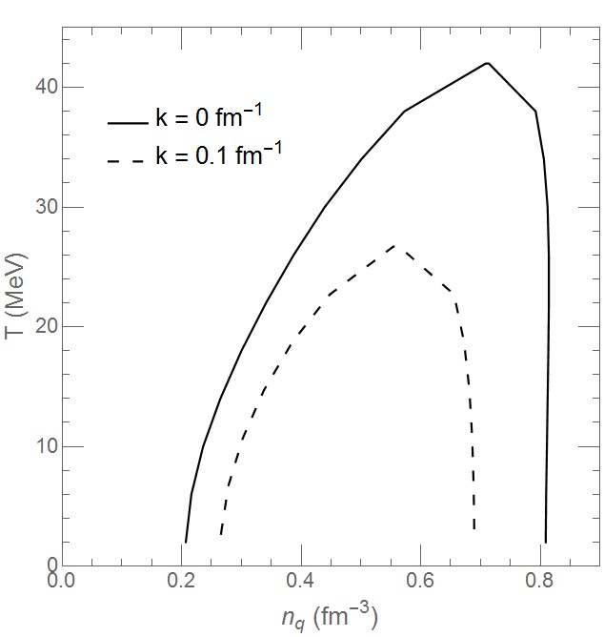
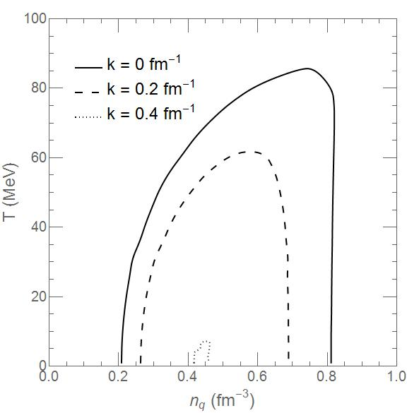
Spinodal Boundaries:
NJL, Gv=0
Unstable modes of short-wavelength survive in the center of the spinodal instability region
Comparison with the isothermal boundary
PNJL, Gv=0
NJL, Gv=0.2 Gs
Supressed by the vector interaction
PNJL, Gv=0.2 Gs
NJL, Gv=0
Unstable modes of short-wavelength survive in the center of the spinodal instability region
Comparison with the isothermal boundary
PNJL, Gv=0
NJL, Gv=0.2 Gs
Supressed by the vector interaction
PNJL, Gv=0.2 Gs

Slide 15






Solve the Boltzmann Equation
For quark
Test Particle Method
Equations of motion
Collisions
Cross sections are assumed constant (3mb)
Treated geometrically
Pauli blocking is taken into account
Test Particle Method
Equations of motion
Collisions
Test Particle Method
Equations of motion
Collisions
The distribution function f(x,p) is calculated by counting the number of the test particles in each cell in the phase space.
For anti-quark
C. Y. Wong, PRC 25, 1460 (1982)

Slide 16



Quark Matter in a Box
Almost uniform

Slide 17
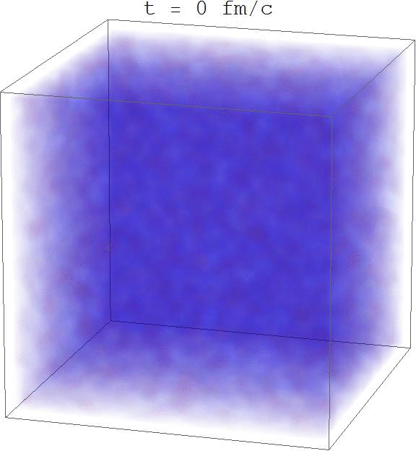
Quark Matter in a Box

Slide 18
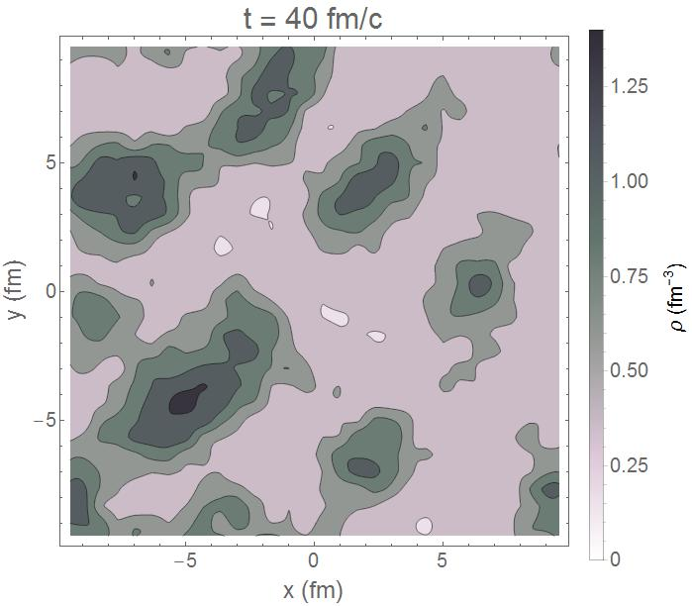
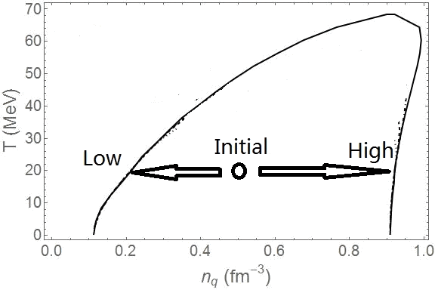

Slide 19
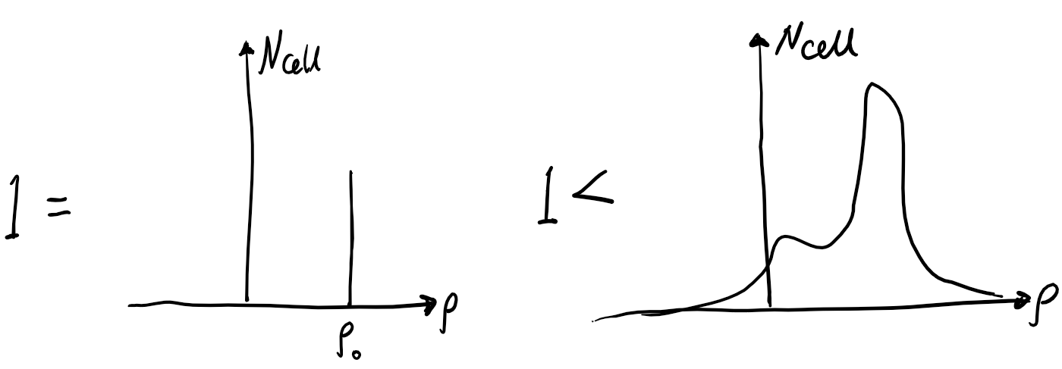
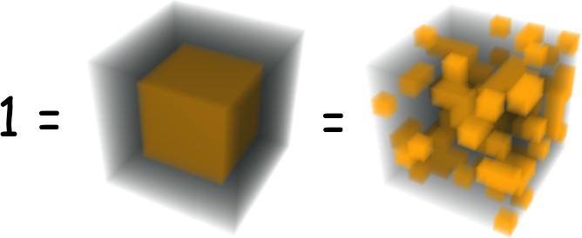
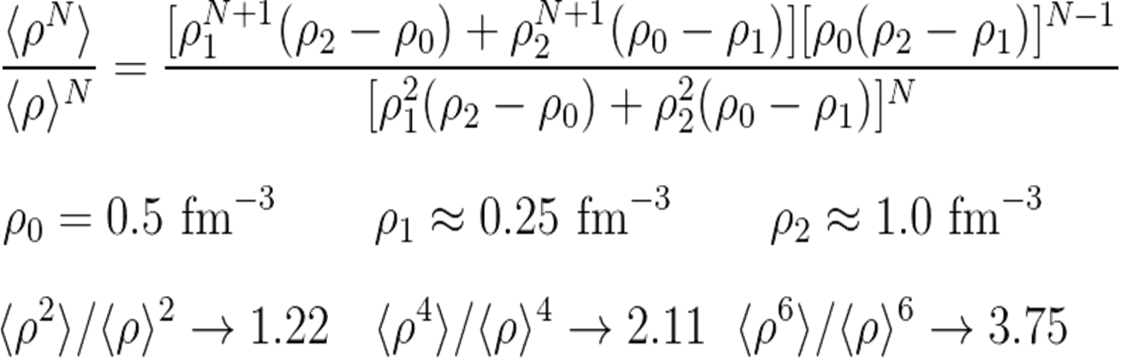


Density Moments
Definition of Nth-order (scaled) density moments
Equal to one for uniform density distribution
Density distribution is not necessarily uniform if the scaled density moments equal to one
Measure of the spectrum of density
Estimate the scaled density moments in the mixed-phase region
Definition of Nth-order (scaled) density moments
Equal to one for uniform density distribution
Density distribution is not necessarily uniform if the scaled density moments equal to one
Measure of the spectrum of density
Estimate the scaled density moments in the mixed-phase region
Definition of Nth-order (scaled) density moments
Equal to one for uniform density distribution
Density distribution is not necessarily uniform if the scaled density moments equal to one
Measure of the spectrum of density
Estimate the scaled density moments in the mixed-phase region
Definition of Nth-order (scaled) density moments
Equal to one for uniform density distribution
Density distribution is not necessarily uniform if the scaled density moments equal to one
Measure of the spectrum of density
Estimate the scaled density moments in the mixed-phase region
J. Steinheimer and J. Randrup, PRC 87, 054903 (2013)

Slide 21
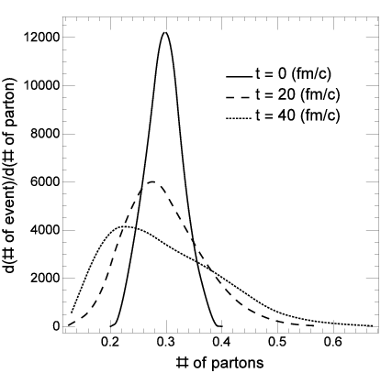
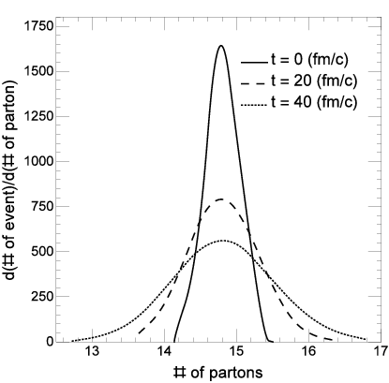
Number Fluctuation in a Sub-volume
Size of the sub-volume = 0.8 fm^3, which is 1/10000 of the total volume. (Event number = 1000)
Broaden and positively skewed with time
Size of the sub-volume = 40 fm^3, which is 1/200 of the total volume
Broaden but not skewed
Size of the sub-volume = 0.8 fm^3, which is 1/10000 of the total volume. (Event number = 1000)
Broaden and positively skewed with time
Size of the sub-volume = 40 fm^3, which is 1/200 of the total volume
Broaden but not skewed

Slide 22
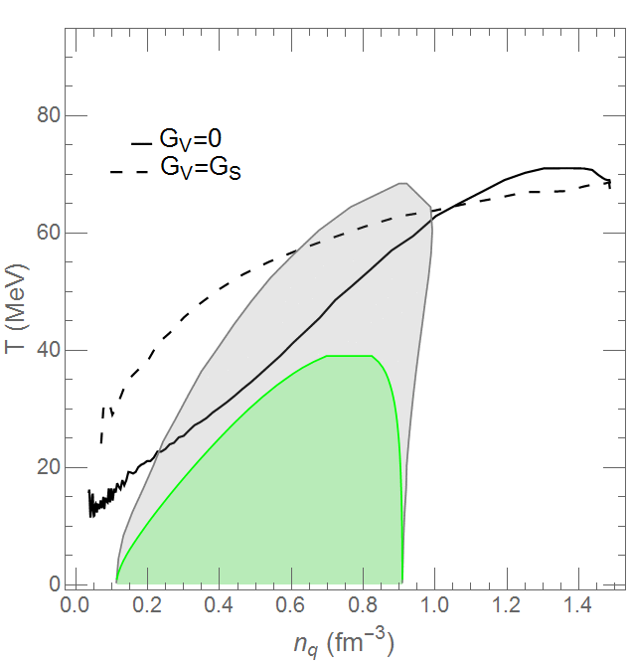

Quark Matter in a Fireball
Phase trajectory of the central part of the fireball

Slide 23
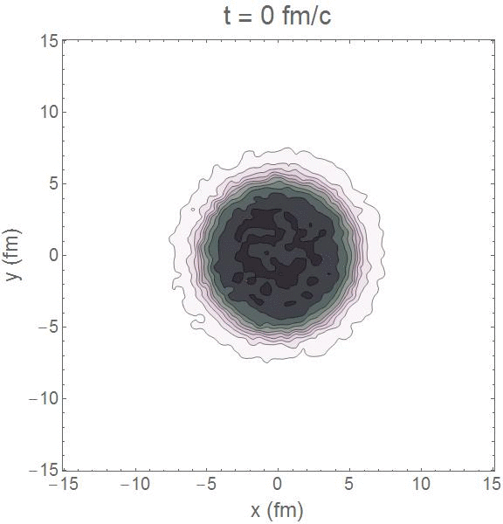
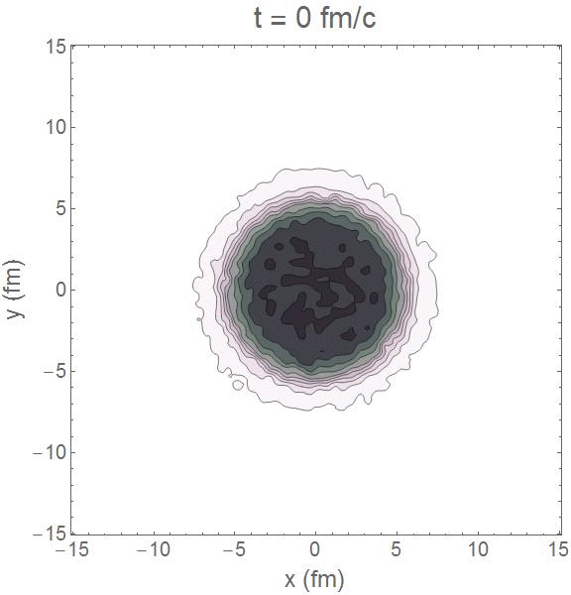


Quark Matter in a Fireball

Slide 24
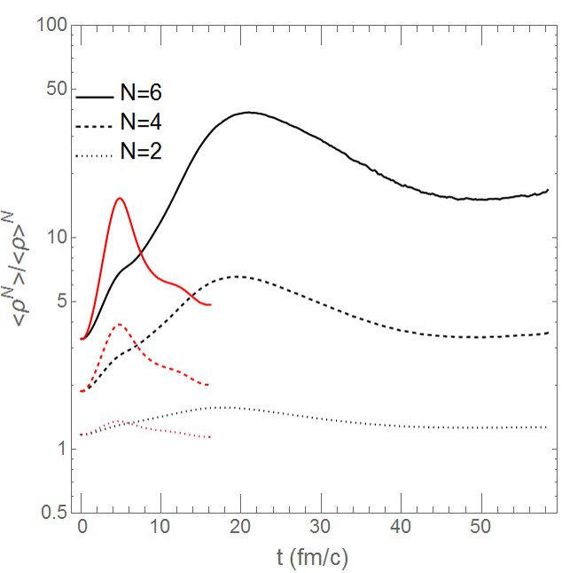
Density Moments
Black: GV=0
Red: GV=GS

Slide 25
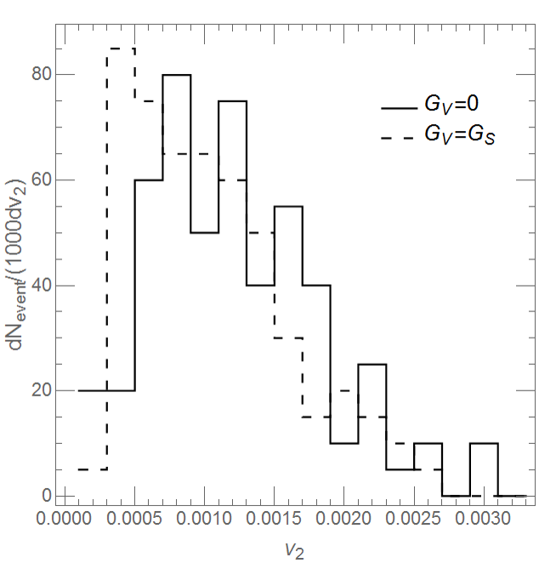
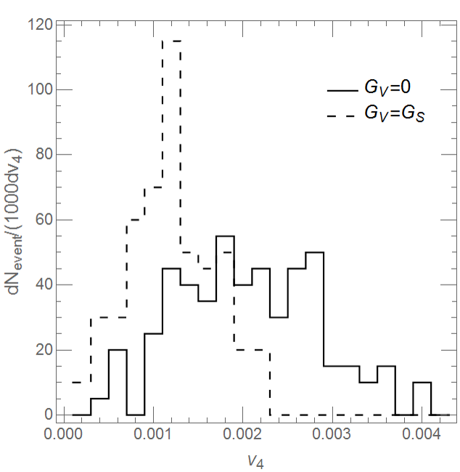



Anisotropic Flow
Induced by the density fluctuations in the transverse plane
Angular distribution in the transverse plane
Two body correlation
V2 event by event
V4 event by event
Induced by the density fluctuations in the transverse plane
Angular distribution in the transverse plane
Two body correlation
V2 event by event
V4 event by event
Induced by the density fluctuations in the transverse plane
Angular distribution in the transverse plane
Two body correlation
V2 event by event
V4 event by event
Induced by the density fluctuations in the transverse plane
Angular distribution in the transverse plane
Two body correlation
V2 event by event
V4 event by event
Induced by the density fluctuations in the transverse plane
Angular distribution in the transverse plane
Two body correlation
V2 event by event
V4 event by event
C. Herold, et al., NPA 925, 14 (2014)
Even in an isotropic system:

Slide 26

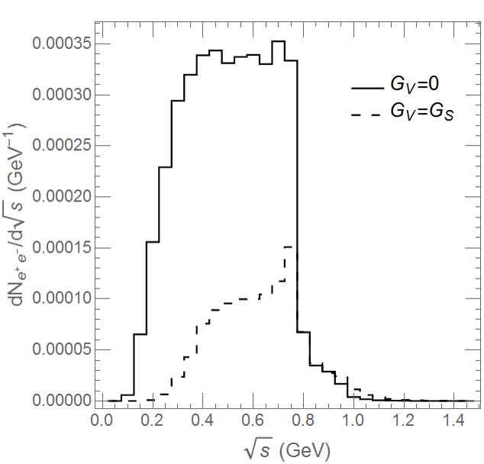
Dilepton Yield
proportional to the square of the density

Slide 27
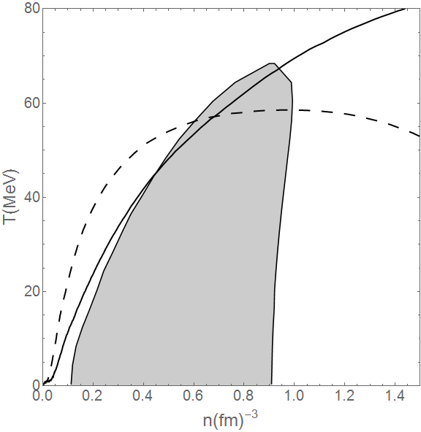







Quark Matter in a fireball (AMPT)
Defects of AMPT initial condition
Modification
Phase trajectory
Defects of AMPT initial condition
Modification
Phase trajectory
Defects of AMPT initial condition
Modification
Phase trajectory

Slide 28


Quark Matter in a Fireball

Slide 29

Density Moments
Black: GV=0
Red: GV=GS

Slide 30

Dilepton Yield
proportional to the square of the density

Slide 31
Summary
Study of the spinodal instability in a (P)NJL transport approach
Tc might be increased by confinement
The vector interaction suppress the spinodal instability.
The instabilities of smaller wavelengths survive under lower temperature
High-order moments are induced by phase separation and saturate at large values.
Event-by-event distribution in a sub-volume is broadened and positively skewed; skewness disappears when increasing the volume.
Expansions are slowed down in the presence of a first-order phase transition.
Anisotropic flow and dilepton yield are potentially good observables for the first order phase transition.
Outlook: Calculations in a more realistic model.

