Slide 1


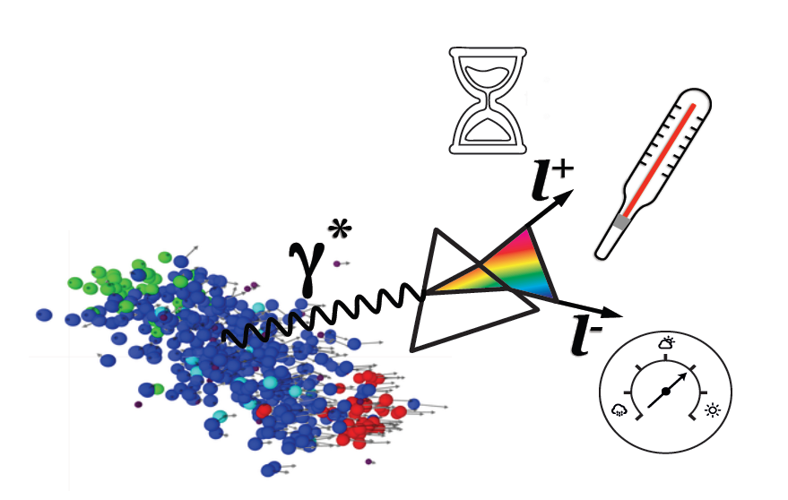


Slide 2
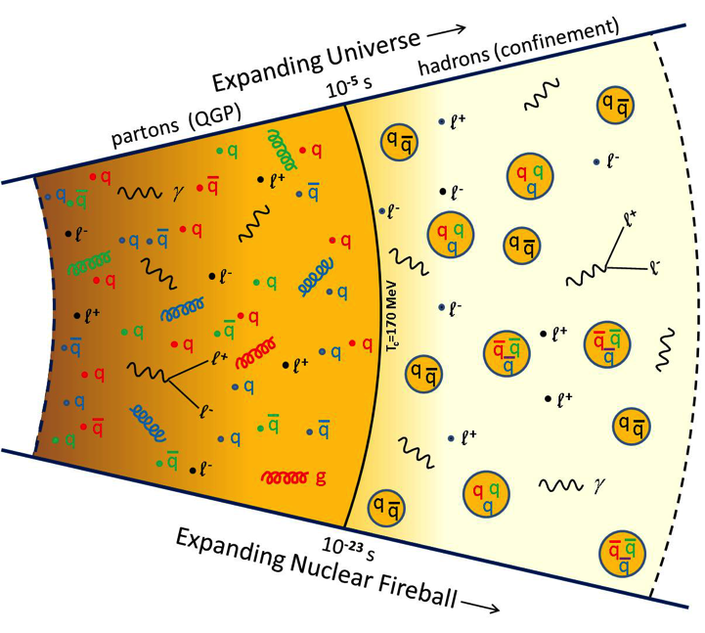
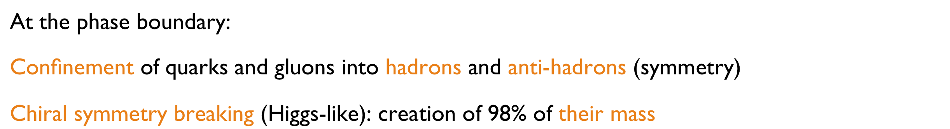

Slide 3
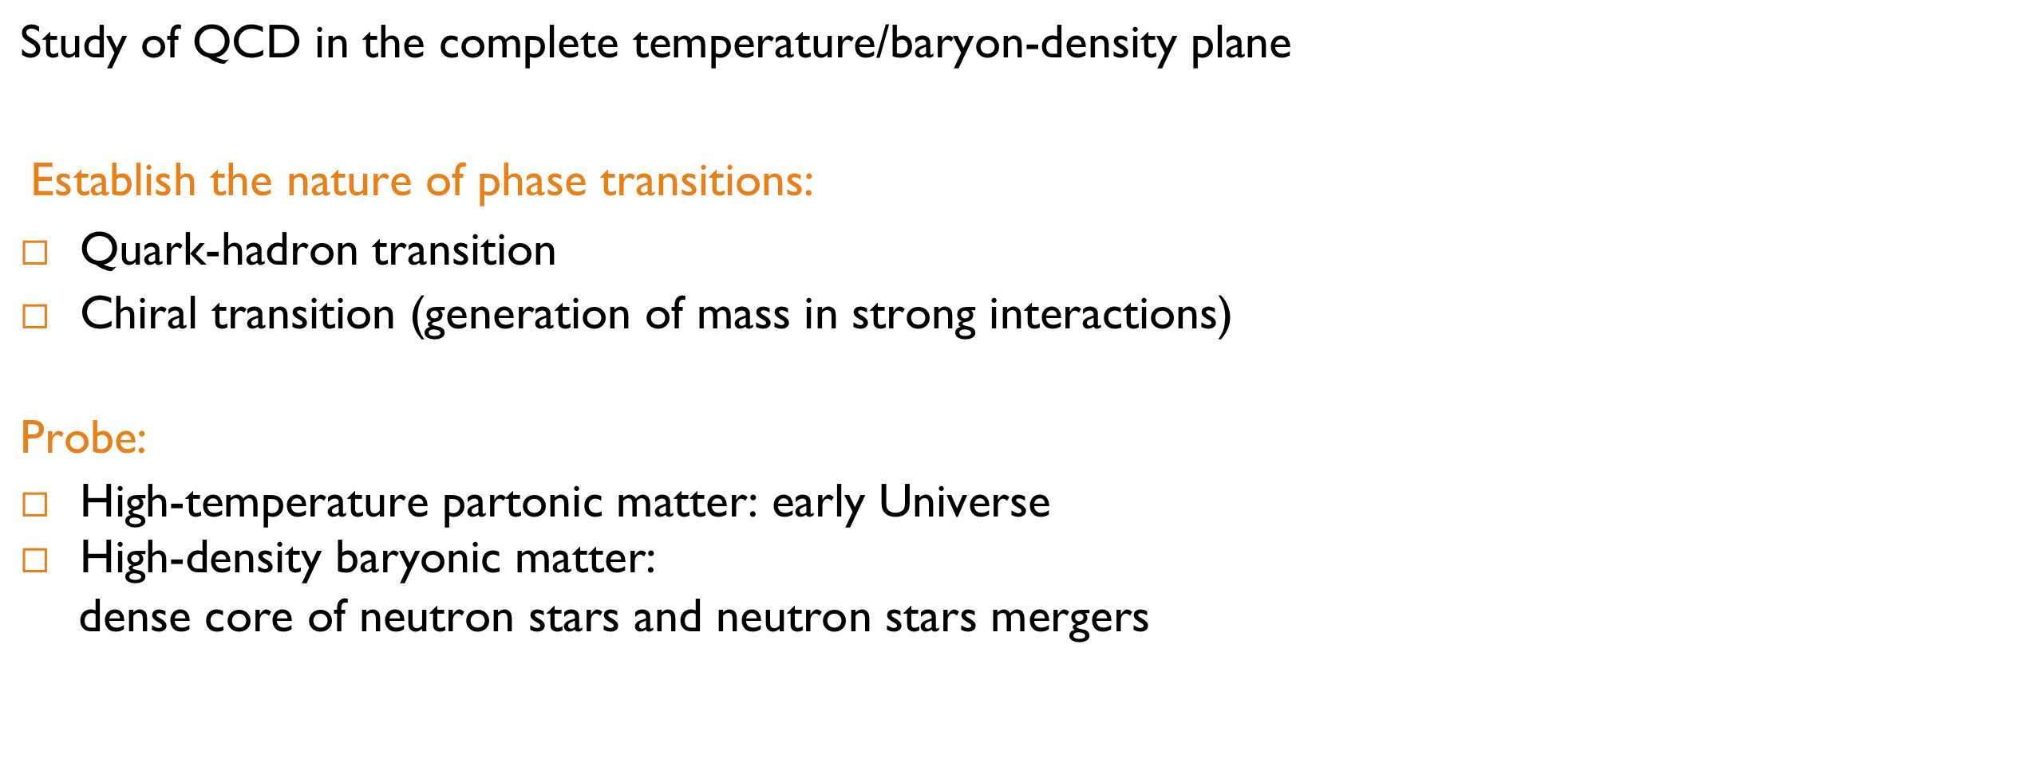

Slide 4

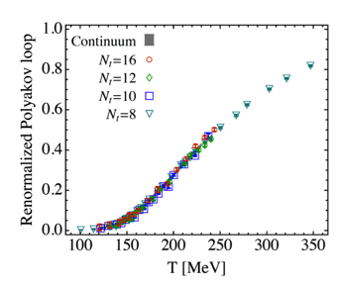
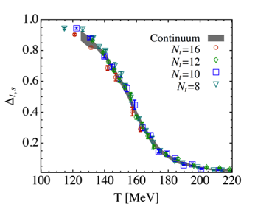
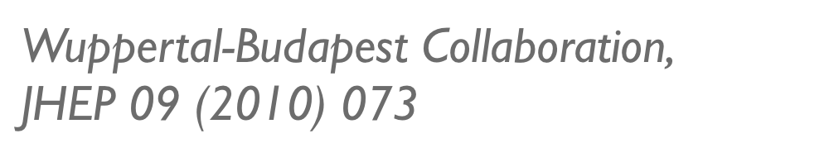


Slide 5
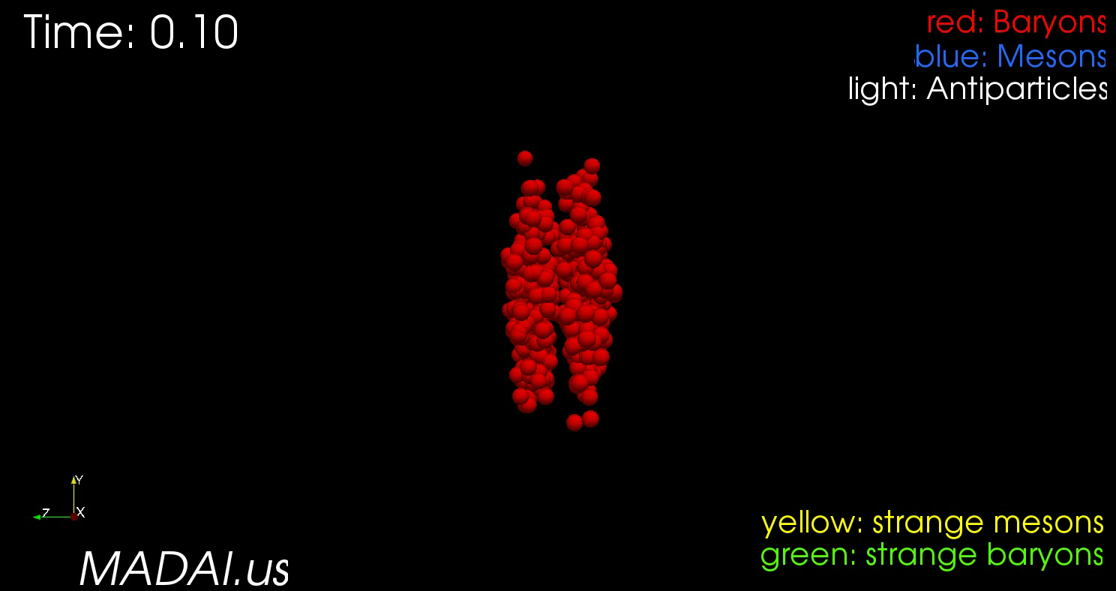

Slide 6
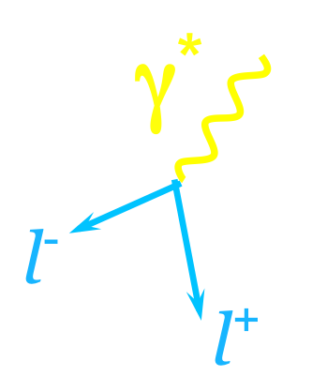
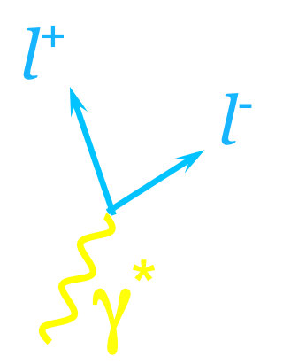
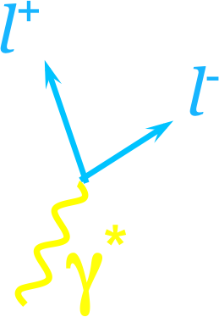


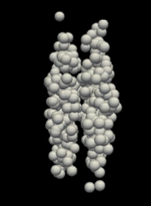
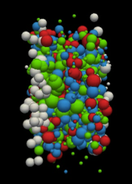
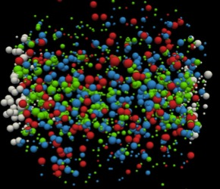

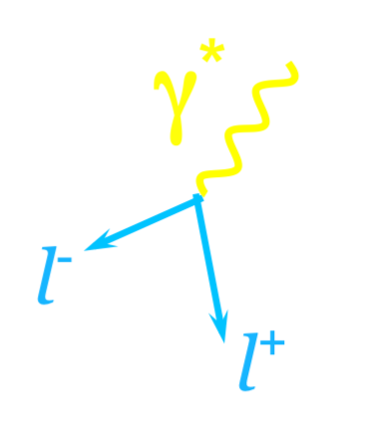
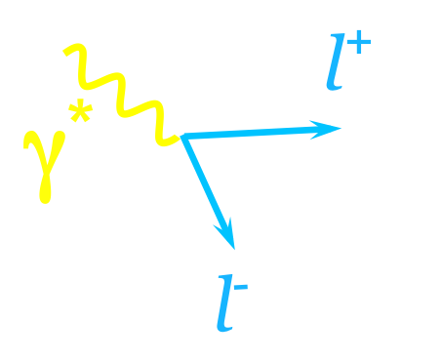





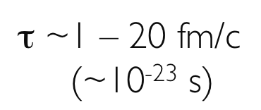
γ*
γ*
l⁺
γ
l⁺
l⁻
γ
l⁻
γ
γ*
γ
l⁺
γ*
l⁺
l⁻
Κ, Λ, φ, Ξ …
l⁻
new forms of matter?
medium modifications of hadrons ?
Collision zone:
probe the full space-time evolution of the collision,
being emitted through all stages of the reaction
Dileptons:
Photons and Dileptons: undistorted probes of strongly interacting matter

Slide 7
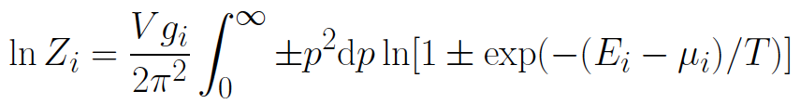


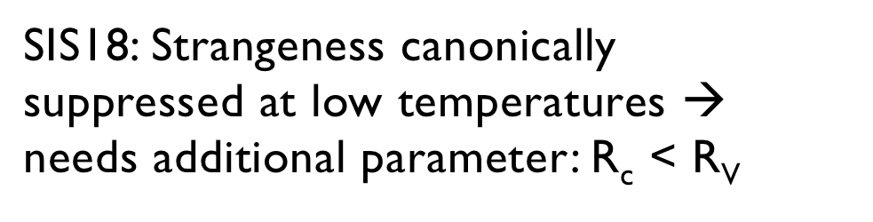
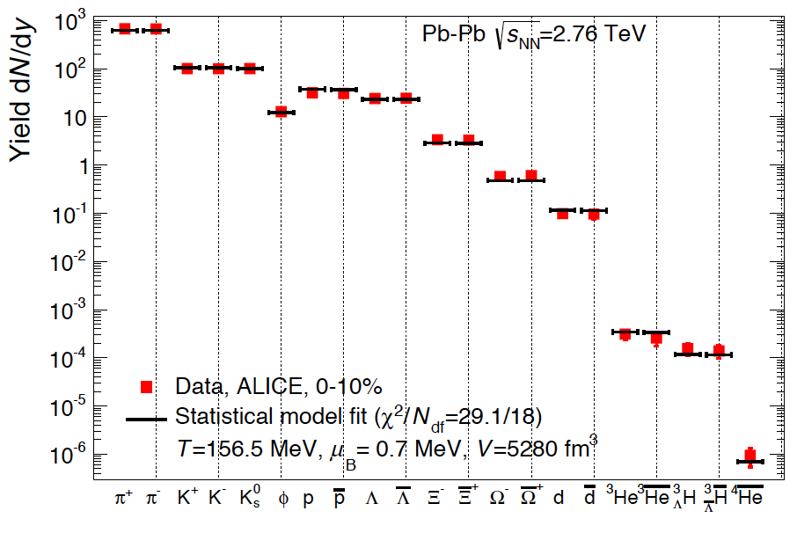
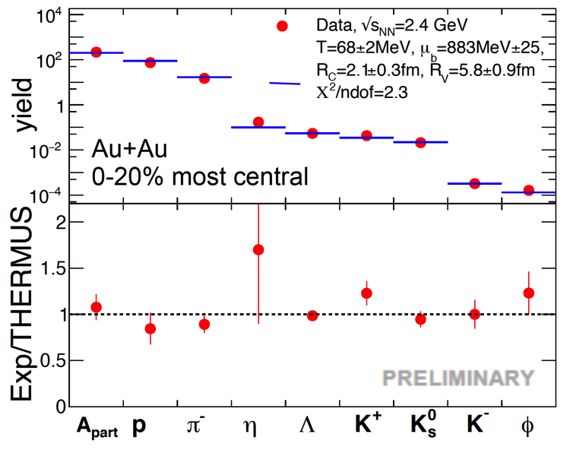

Slide 8
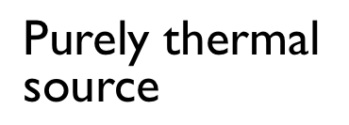
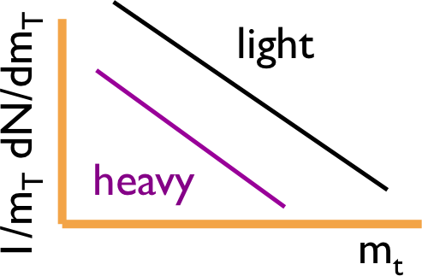
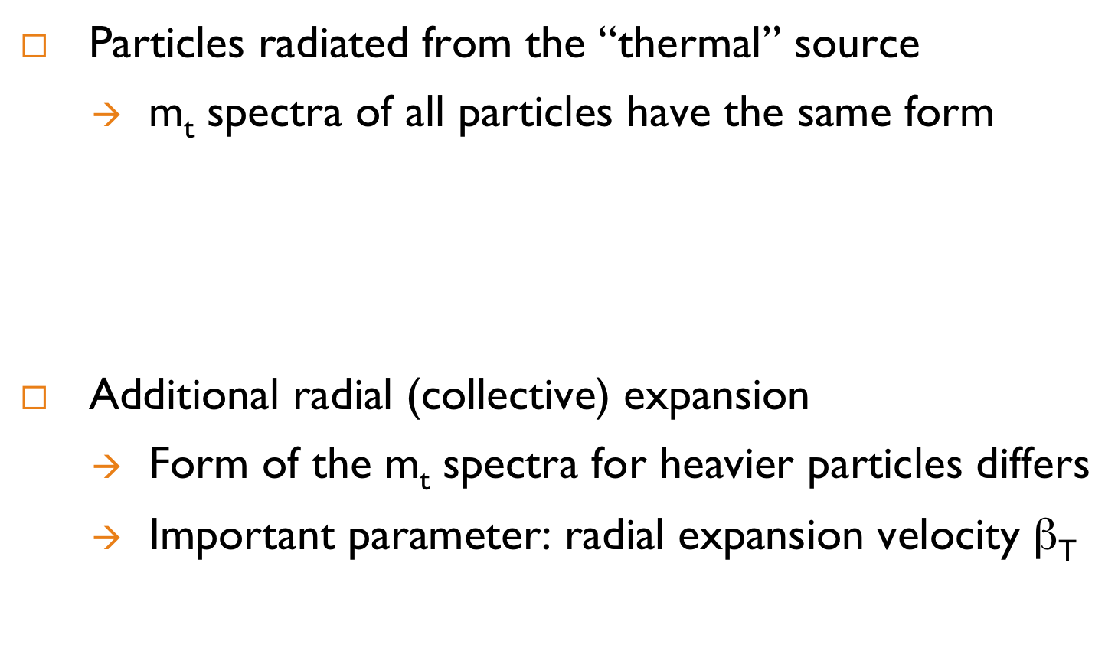








Slide 9
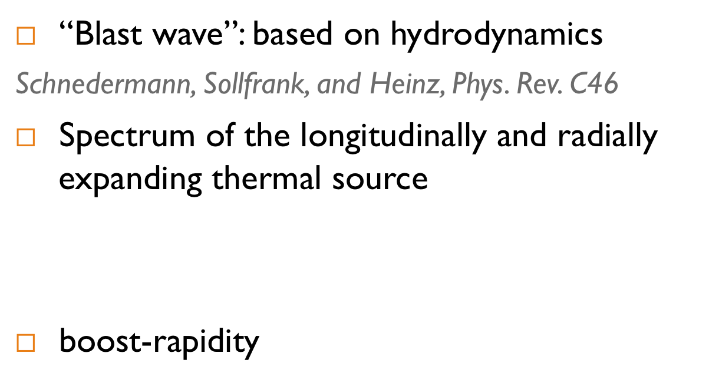
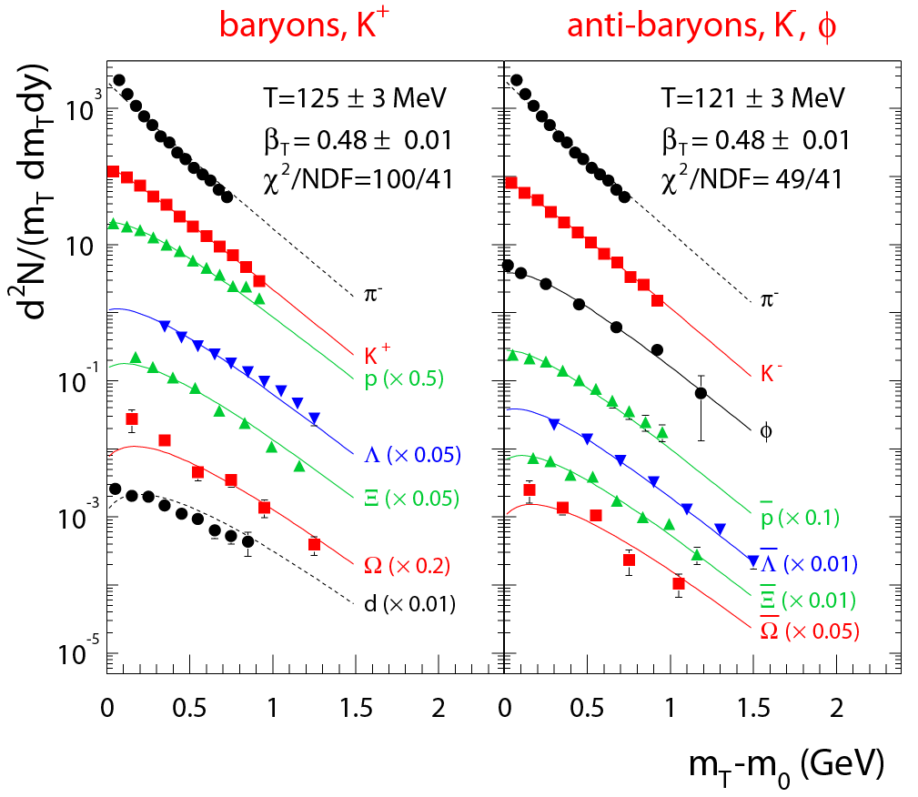
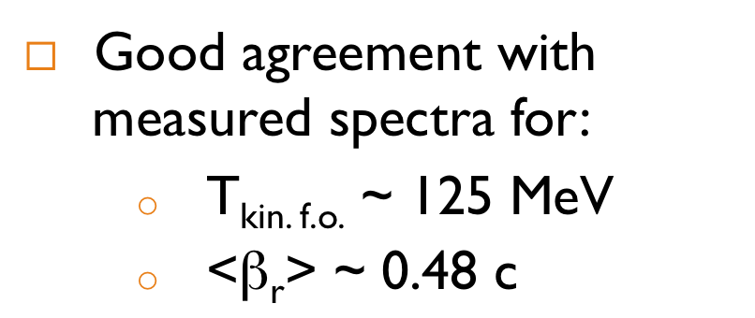

Slide 10
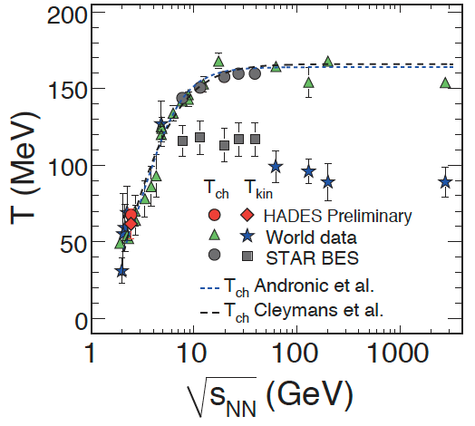
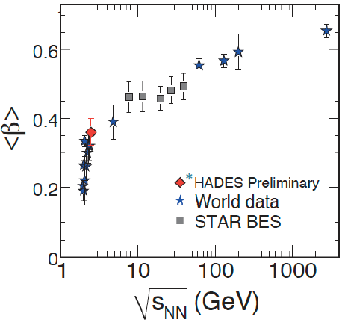

Slide 11
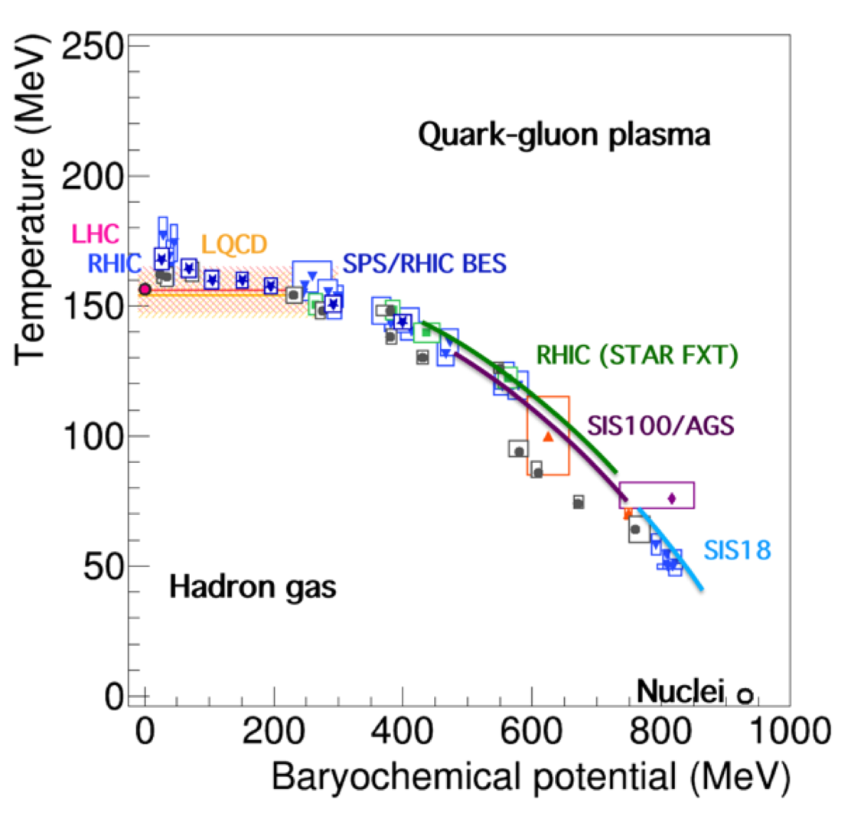
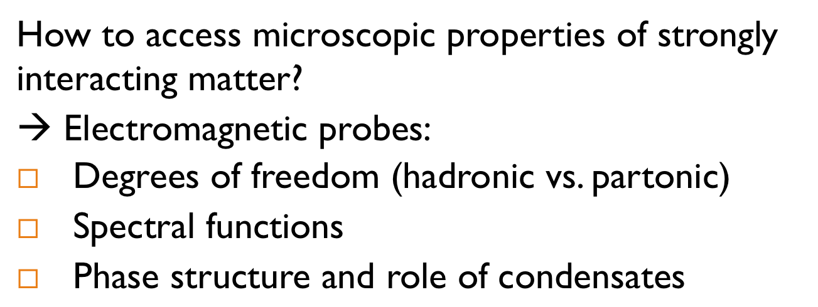


Slide 12

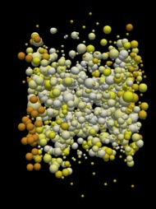
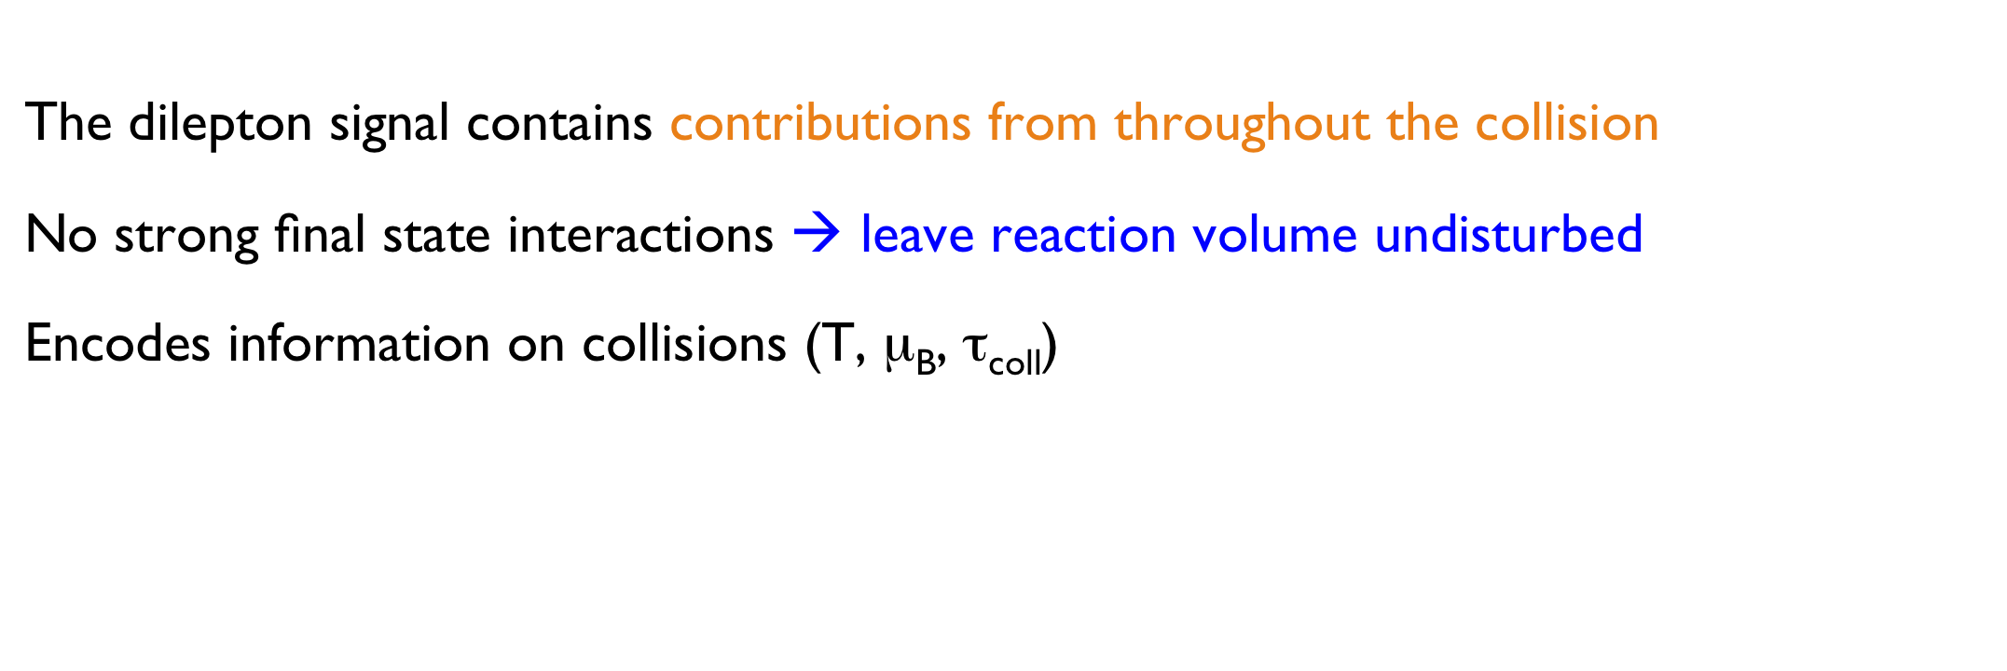

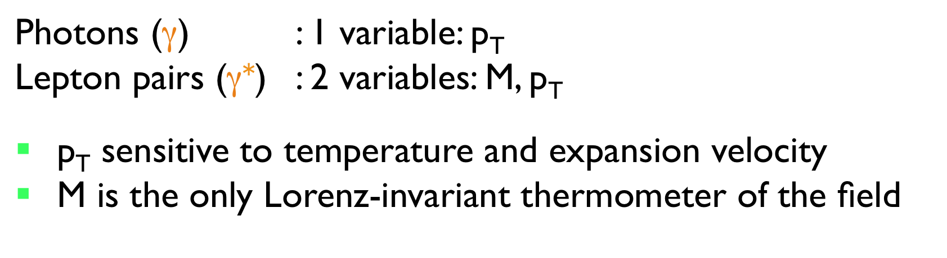


Slide 13
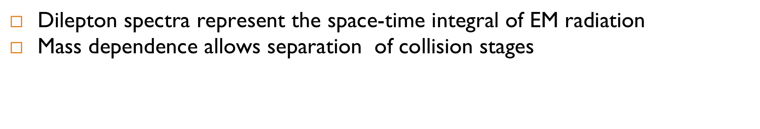
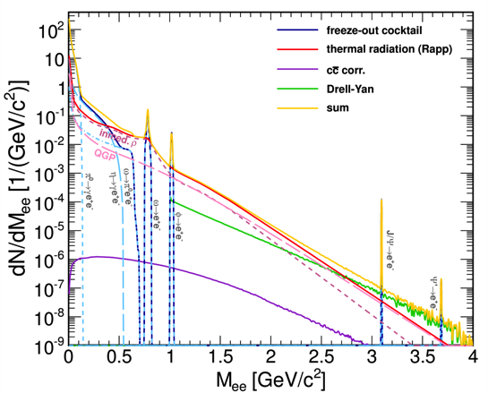
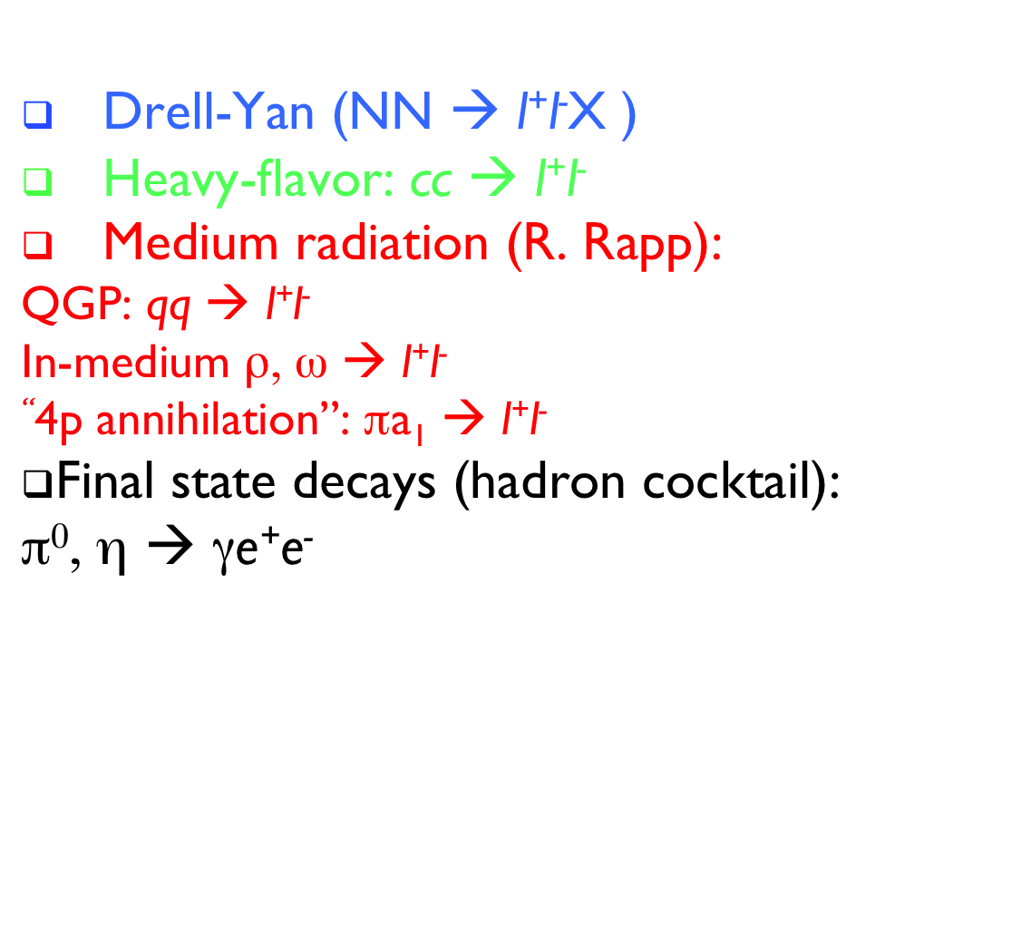
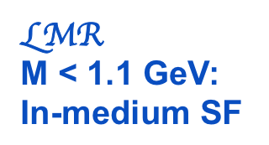
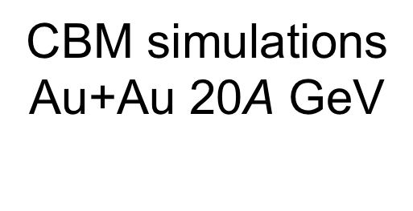
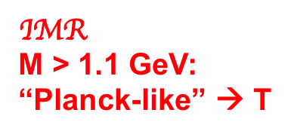

Slide 14

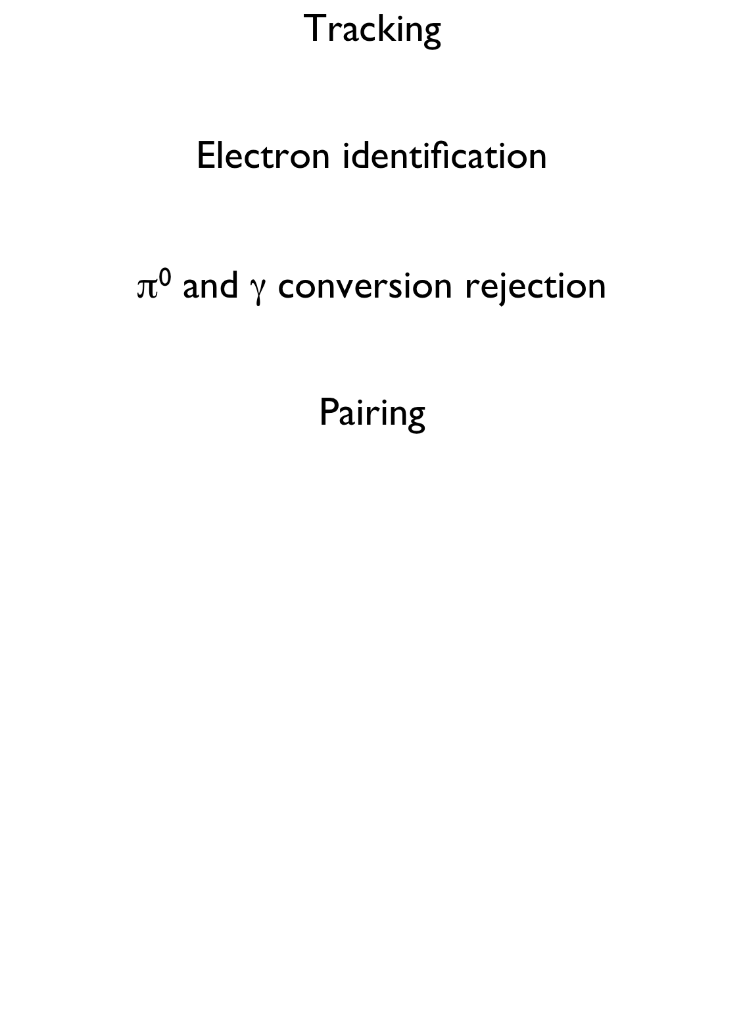
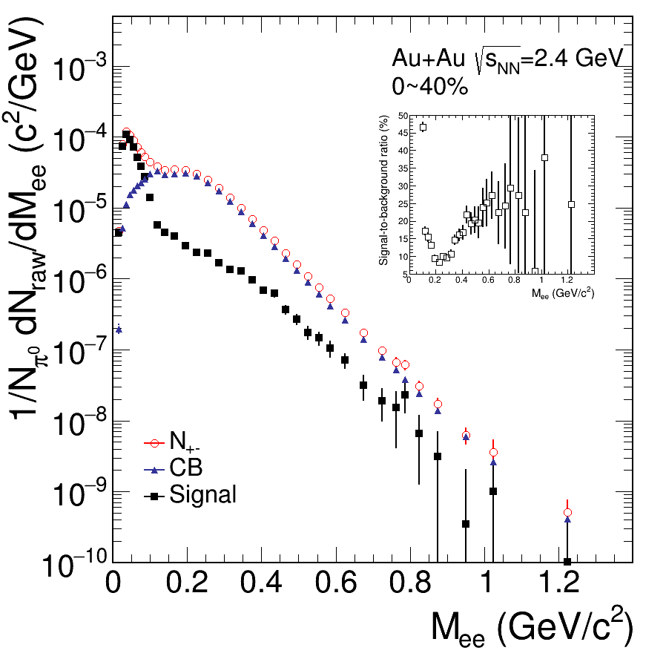


Slide 15
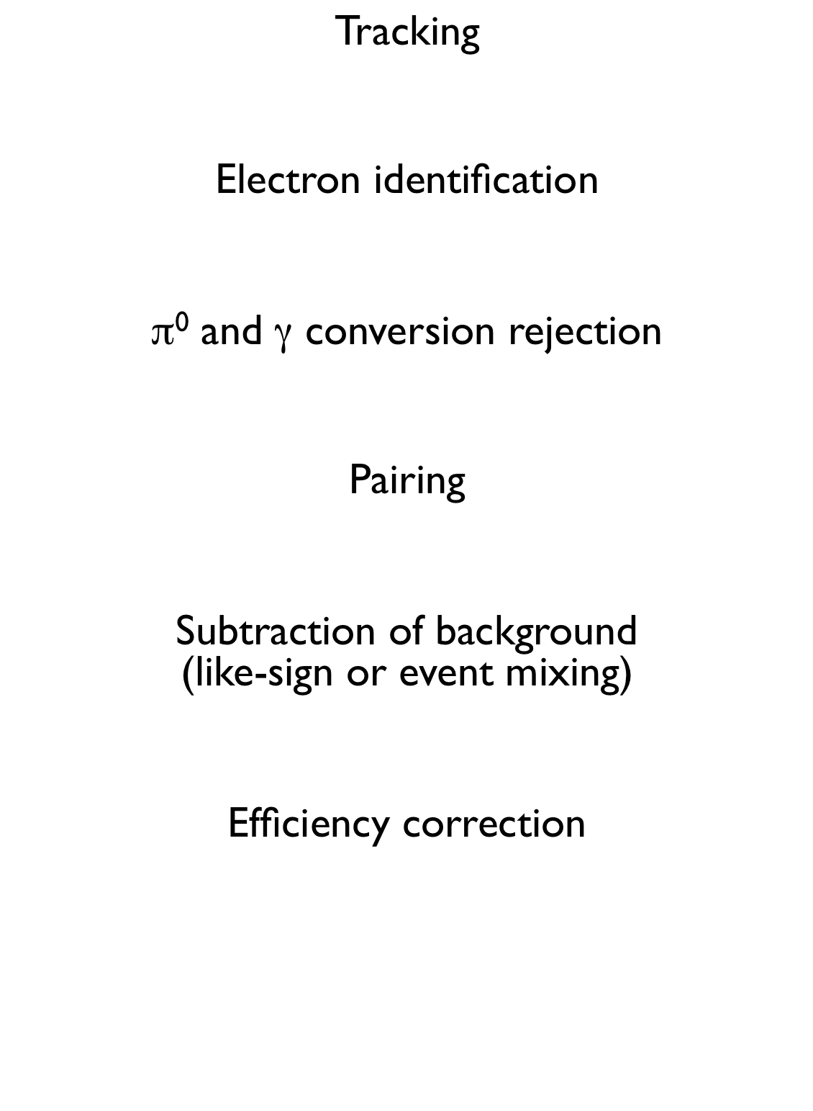
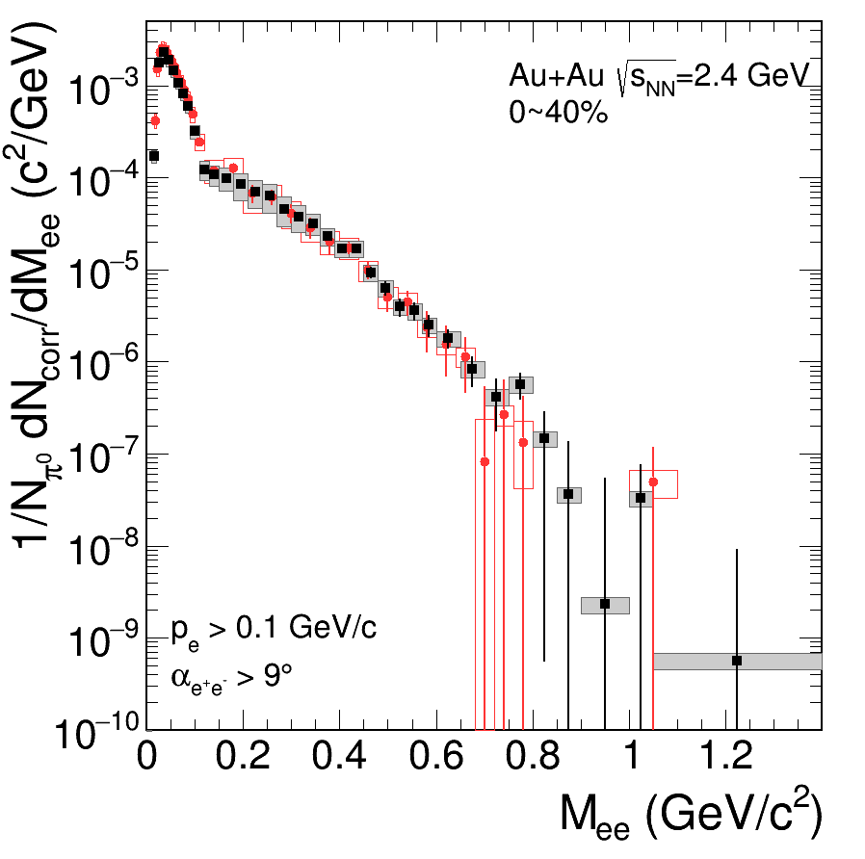

Slide 16
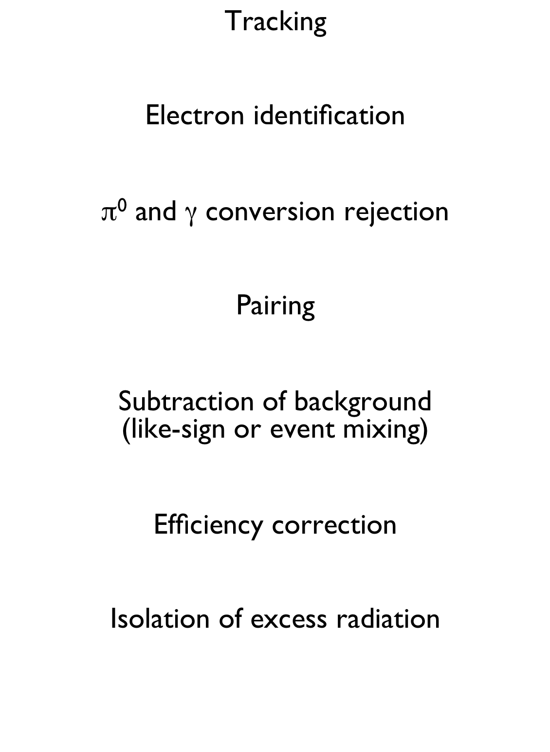
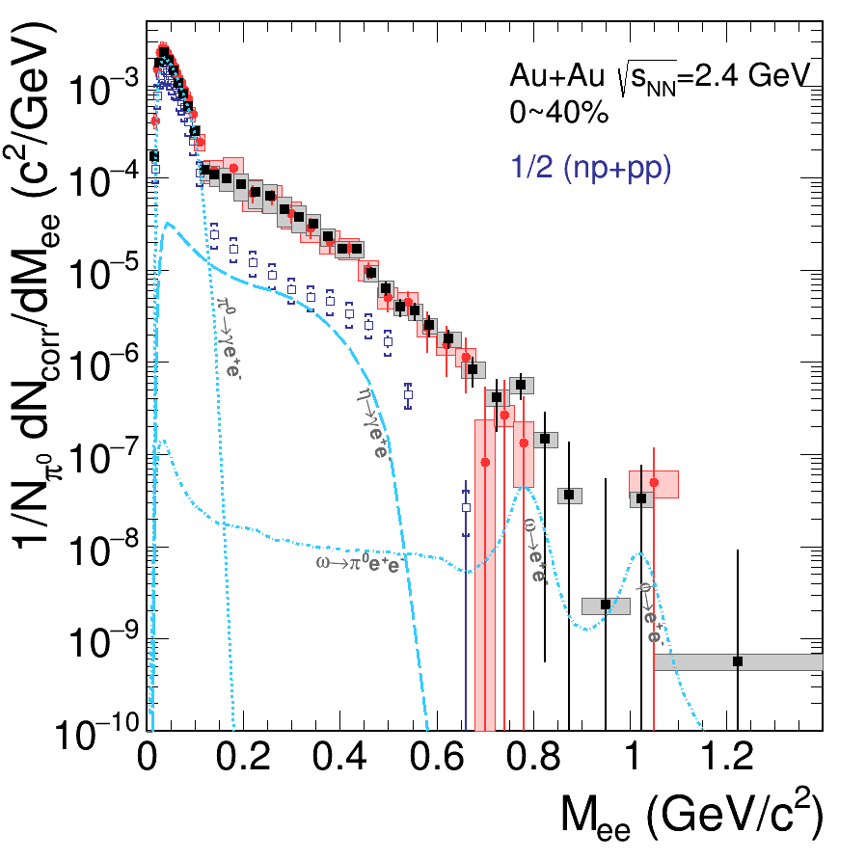

Slide 17
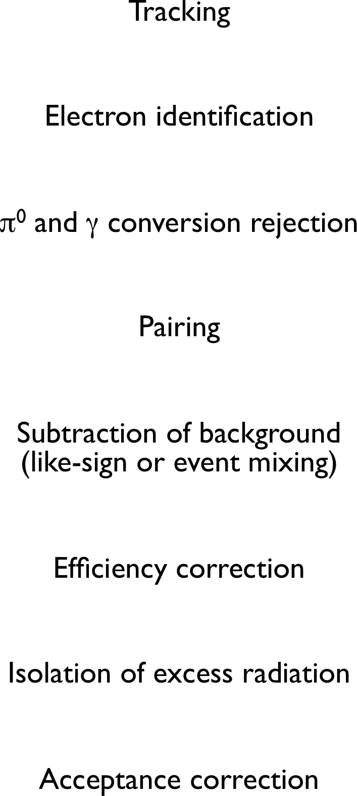
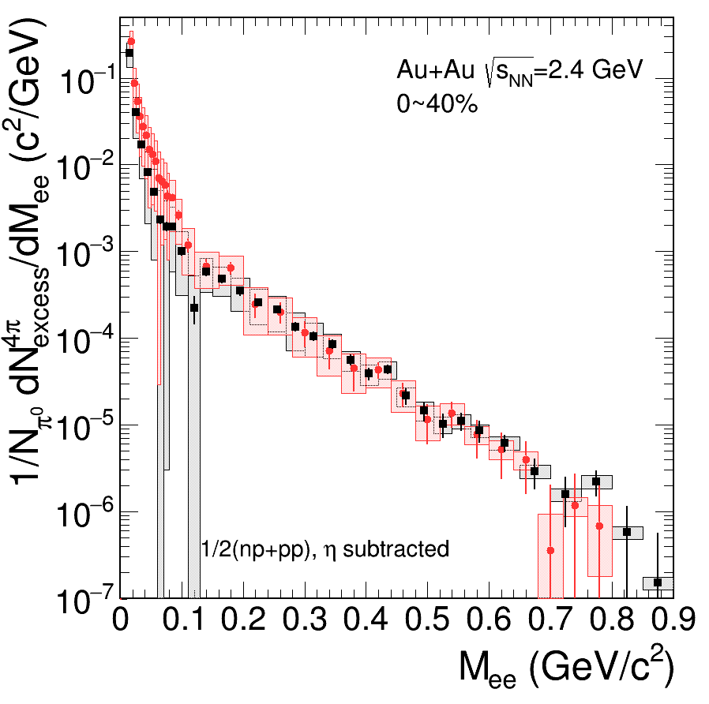

Slide 18

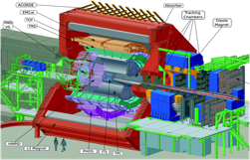
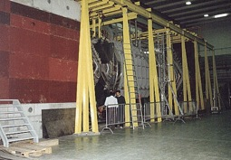












Slide 19











Slide 20




Slide 21


Slide 22


Slide 23


Slide 24





Slide 25



Slide 26





Slide 27





CERES EPJ C41(2005)475
Dielectron excess at low and intermediate masses in HI collisions is well established
Maximum below ρ meson near 400 MeV/c²
→ Hint for modified ρ meson in hot and dense matter

Slide 28






Slide 29





R. Rapp, J. Wambach EPJA 6 (1999) 415
e+e- pair yield after subtraction
of hadronic cocktail excluding ρ:
H. Hees, R. Rapp PRL 97 (2006) 102301
dropping ρ mass
in-medium hadronic
In particular e⁺e⁻ yield between
ω and φ favours ρ broadening
over dropping mass scenario
Excess smeared out over wider
mass range than expected for
dropping ρ mass scenario

Slide 30



Slide 32






Peripheral collisions (large b): large spectators (cold, flying away undisturbed) centrality fraction for b
(pur geometry; b_{max} = 2R)
Central collisions (small b): large participating zone (hot/dense, also called fireball), large N_{part} (number of participating nucleons)
A nucleus is a very small object, how to hit in the center?
→ In fact, σ(b=0) = 0!
  σ – geometrical cross section
  b – impact parameter

Slide 33




Slide 34




Slide 35




Slide 36



Slide 37


Slide 38






Slide 39



Slide 40



  Thick hadron absorber to reject hadronic background
  Trigger system based on fast detectors to select muon candidates
  (1 in 104 PbPb collisions at SPS energy)
  Muon tracks reconstructed by a spectrometer (tracking detectors+magnetic field)
  Extrapolate muon tracks back to the target taking into account multiple scattering and energy loss, but …
    poor reconstruction of interaction vertex (σ_{z} ~10 cm)
    poor mass resolution (80 MeV at the φ)

Slide 41





Slide 42









Slide 43










Slide 44



Slide 45







Slide 46






Vertex selection and
muon track matching
Opposite sign dimuon mass distribution before quality cuts and without muon track matching
Drastic improvement in mass resolution
Still a large unphysical background

Slide 47



Slide 48






Slide 49



Slide 50


Separation of prompt muon production
from semi-leptonic open charm decays
Decomposition of total di-muon yield into Drell-Yan, open charm and prompt excess
(discrimination prompt from off-vertex muons)
Fit of weighted offset distribution with
charm decay and prompt contributions
Excess and open charm have similar
slopes; excess = thermal radiation
(ambiguity (NA50) resolved)
⇒ excess due to prompt muons

Slide 51


Slide 52





Slide 53





Slide 54




Slide 56






Rapid increase of relative yield reflect the number of ρ‘s regenerated in fireball

Slide 57





Slide 58


Slide 59


Slide 60





Slide 61



Slide 62








Slide 63





Slide 65




Slide 66




Slide 67





Slide 68





Slide 69









Slide 70


Slide 71


