Slide 1

Hydrodynamic Tests of Fluctuating Initial Conditions
Transport Meeting
24 January 2012
George Moschelli
&
Hannu Holopainen

Slide 2
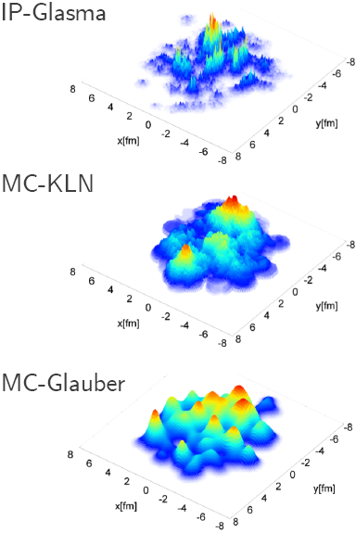
Motivation
Fluctuating Initial Conditions
and
Event-by-Event Studies
Local Correlations
Global Correlations
Geometry Fluctuations
Different initial conditions give different eccentricities and therefore different flow coefficients
Event by event hydro… going beyond ε_{n} and Ψ_{n} …the three examples have different ε_{n} because they have different numbers of sources with different sizes multiplicity fluctuations for example also depend on these things
IP-Glasma: Schenke, Tribedy, Venugopalan,
arXiv:1206.6805, Phys. Rev. Lett. 108 (2012) 252301
MC-KLN: Drescher, Nara, nucl-th/0611017

Slide 3
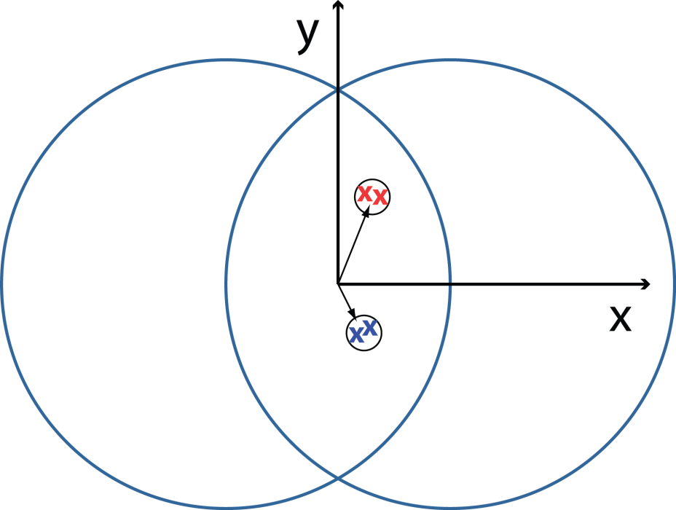
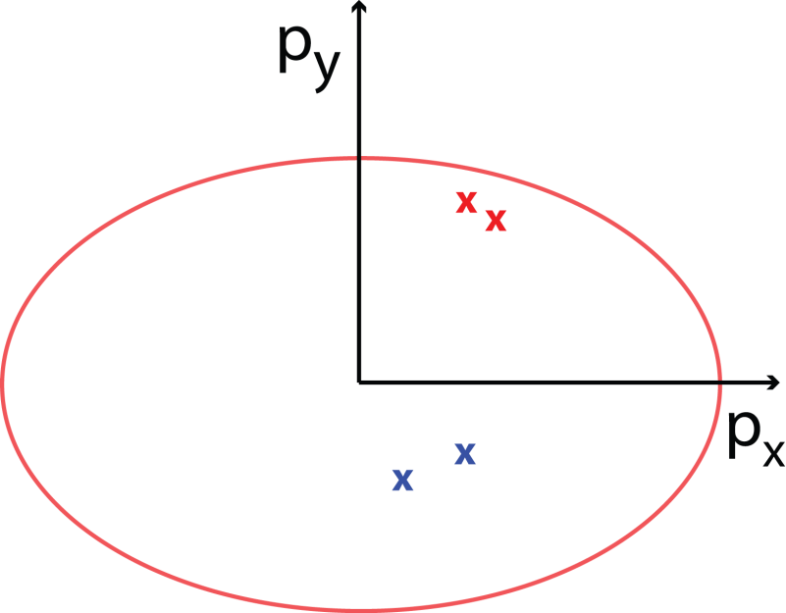
Local Correlations
Initial State Configuration
Final State Momentum
Final state momenta are correlated to initial position.
Reaction / event plane
Common origin
Influence of fluctuating ICs
Arbitrary event shapes.
Random number of sources and source sizes.
Goal: Determine hydro response to “common origin” correlations and dependence on choice of IC.

Slide 4
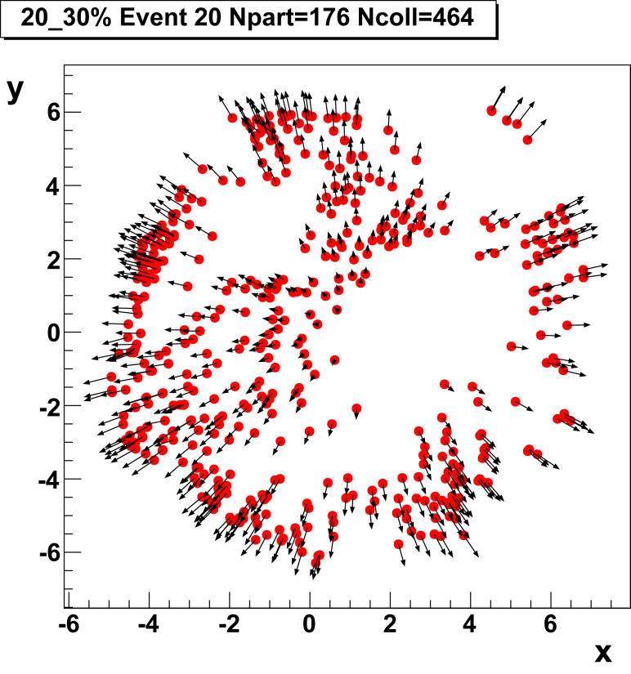
Global Correlations
E-by-E Hydro Evolution
Ideal Hydro
Lattice EoS
Gaussian Energy Density lumps at mixture of MC Glauber Nbin and Npart positions
Gaussian width: 0.4 fm
Goal: Trace the evolution of fluid element correlations to freeze out.

Slide 5
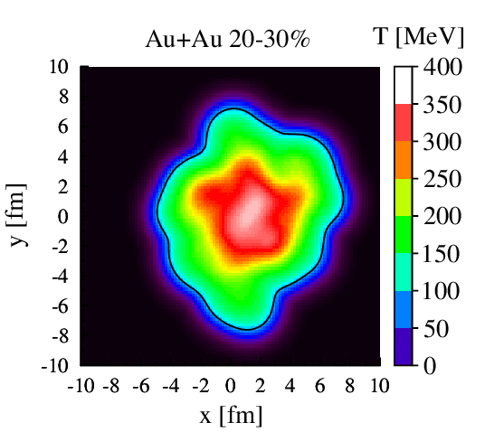
Global Correlations
E-by-E Hydro Evolution
Ideal Hydro
Lattice EoS
Gaussian Energy Density lumps at mixture of MC Glauber Nbin and Npart positions
Gaussian width: 0.4 fm
Goal: Trace the evolution of fluid element correlations to freeze out.

Slide 6
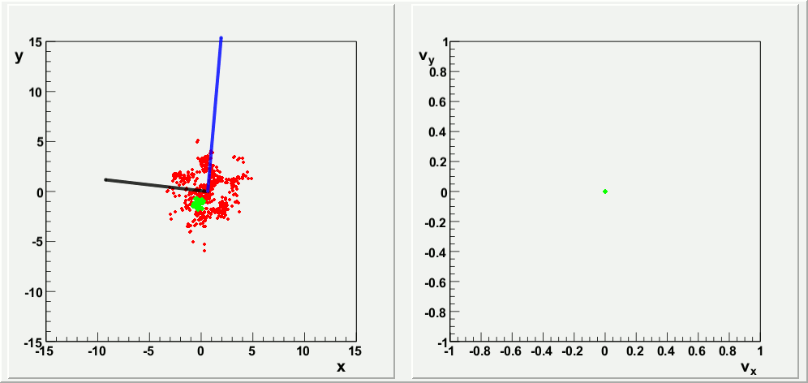
Flow Lines
Space
Velocity
20-30% centrality
Nbin = 464
Npart = 176
Freeze out: T = 120 MeV
Dots at initial positions of binary collisions
Movement indicates fluid cell position and velocity
Black line: const*ε₂
Blue line: const*ε₃
Green dots: randomly chosen group within 0.4 fm radius

Slide 7
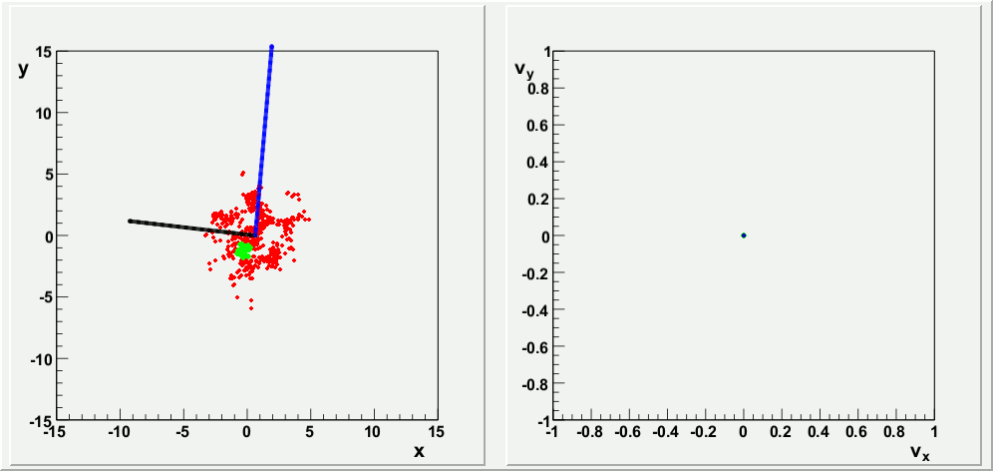
Flow Lines
Space
Velocity
20-30% centrality
Nbin = 464
Npart = 176
Freeze out: T = 120 MeV
Dots at initial positions of binary collisions
Movement indicates fluid cell position and velocity
Black line: const*ε₂
Blue line: const*ε₃
Green dots: randomly chosen group within 0.4 fm radius

Slide 8
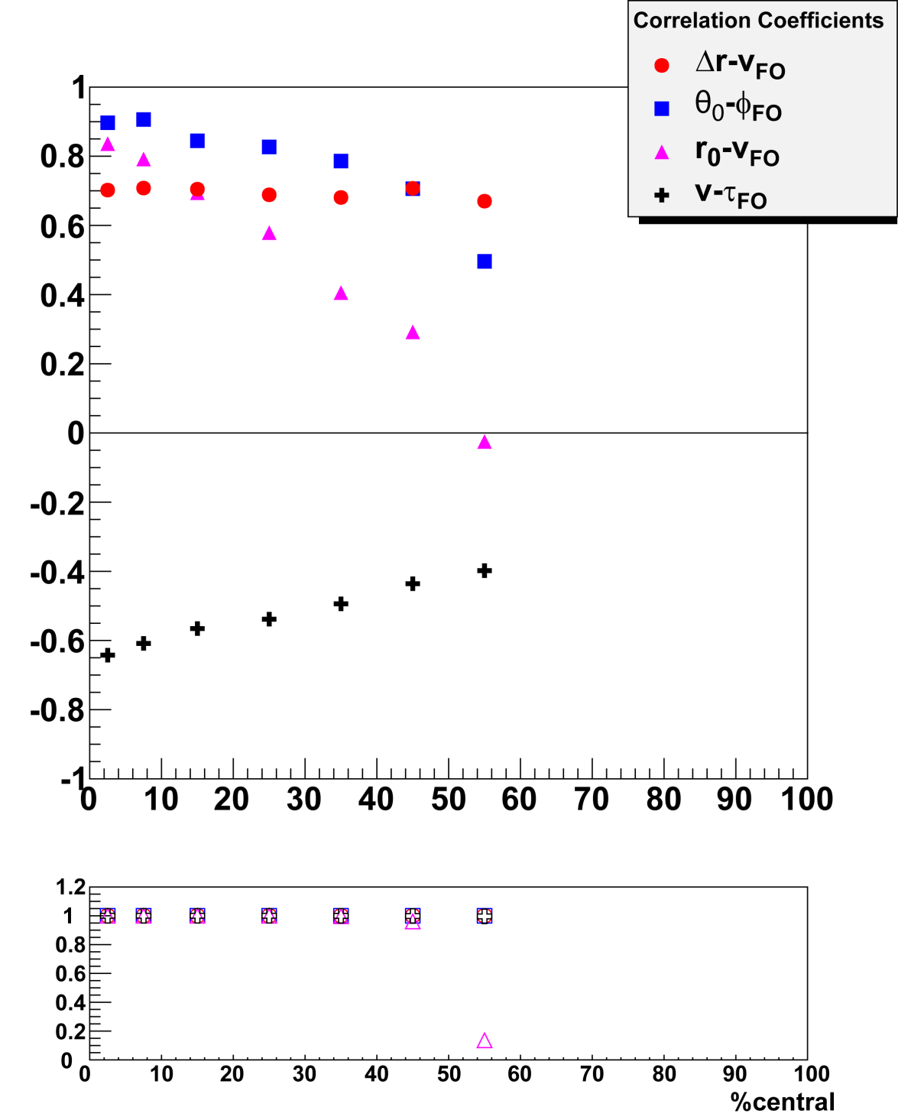
Fluid-Fluid Correlations
“Emission” angle corresponds to initial spatial angle. Expectation: central (circular) collisions agree, peripheral (elliptical) collisions should deviate
Faster dots have larger displacement
Final velocity depends on initial position. → Angular correlations!
Faster dots freeze out first
Need mixed events
1-p
Notes:
Final velocity depends on initial position leads to angular correlations not just because of their angle with respect to the reaction plane but also because of their distance from the center
NEXT SLIDES BREAK DOWN THE IMPLICATIONS OF THESE LINEAR CORRELATIONS

Slide 9
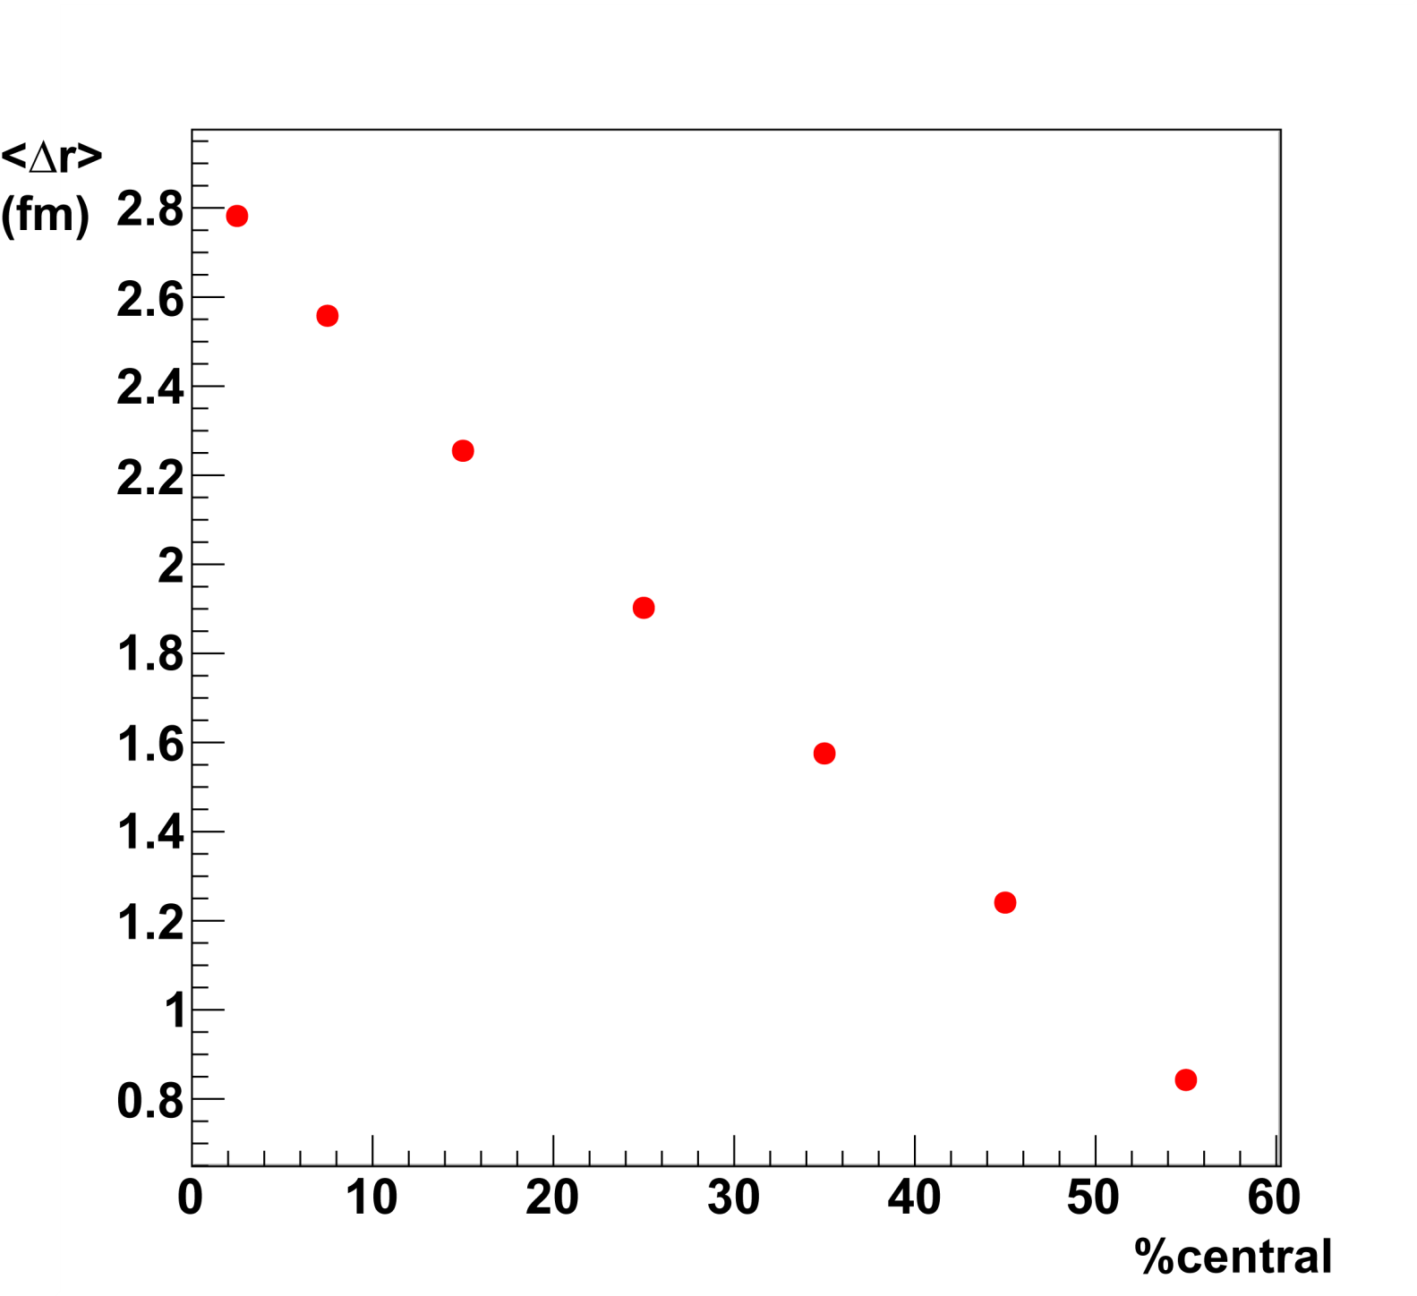
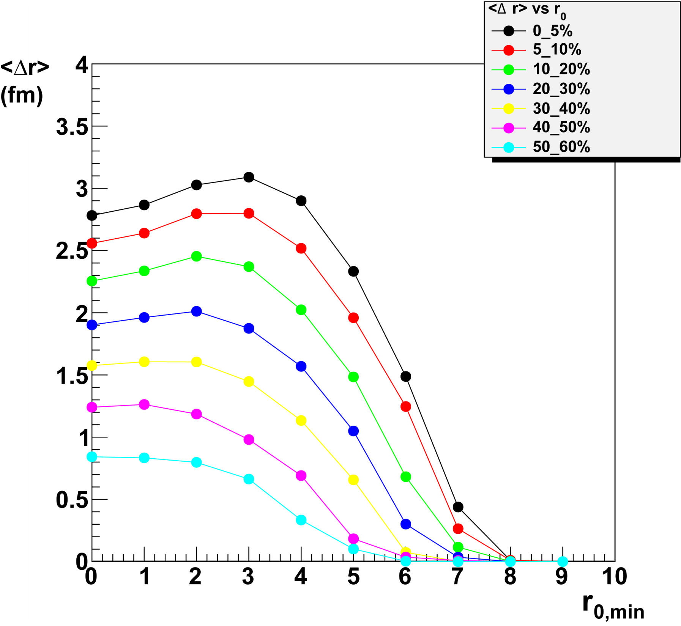
Average Displacement
Larger average displacement in central collisions
central collisions live longer
greater effect on common origin correlations than v_{n}
Linear correlation between r₀, Δr, and v_{FO}
Flow lines starting at different radial positions get different transverse push.
Enhances common source correlations
Changes <ε_{n}>_{time}
r_{0,max}
r_{0,max}
r_{0,min}
r_{0,min}
Goal: Determine a source “resolution”.
Notes:
Drop off: not every event has flow lines that start at large r0
Delta r also depends on angle and its likely that large r0 flow lines are in the out of plane direction and get less push
WE SAW IN THE ANIMATION THAT FLOW LINES STARTING TOGETHER PRETTY MUCH STAY TOGETHER, HERE WE SEE SOURCES (FLOW LINES) AT DIFFERENT INITIAL SPOTS GET DIFFERENT PUSH MEANING THE AVERAGE MODIFICATION IN VELOCITY IS DIFFERENT this is the ridge and flow fluctuations

Slide 10
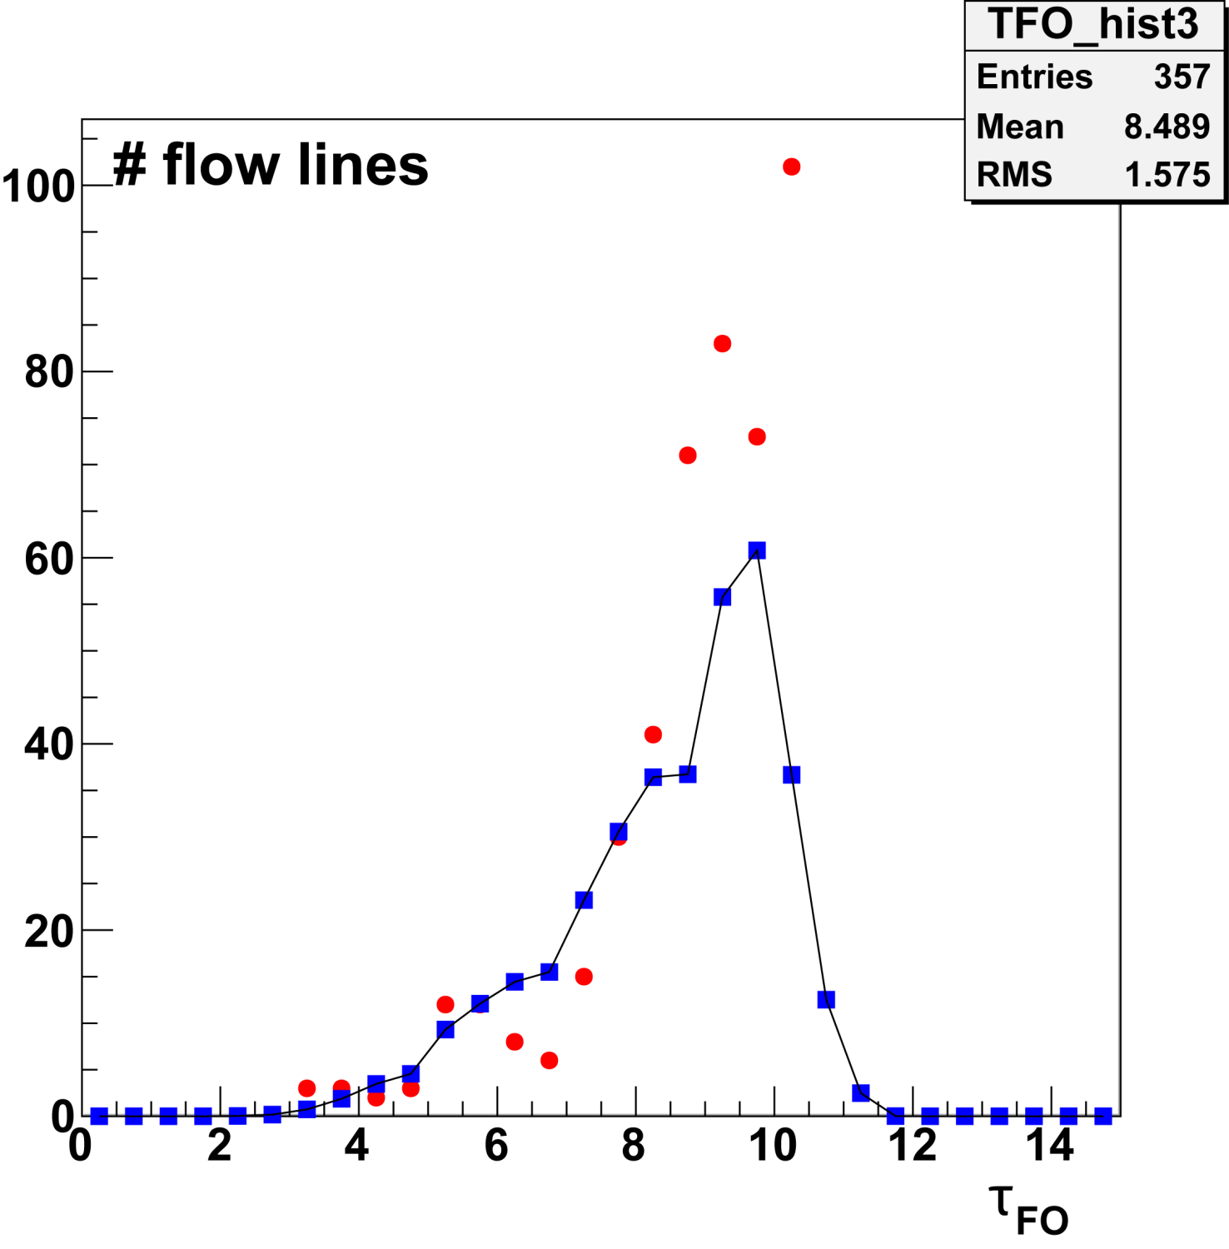
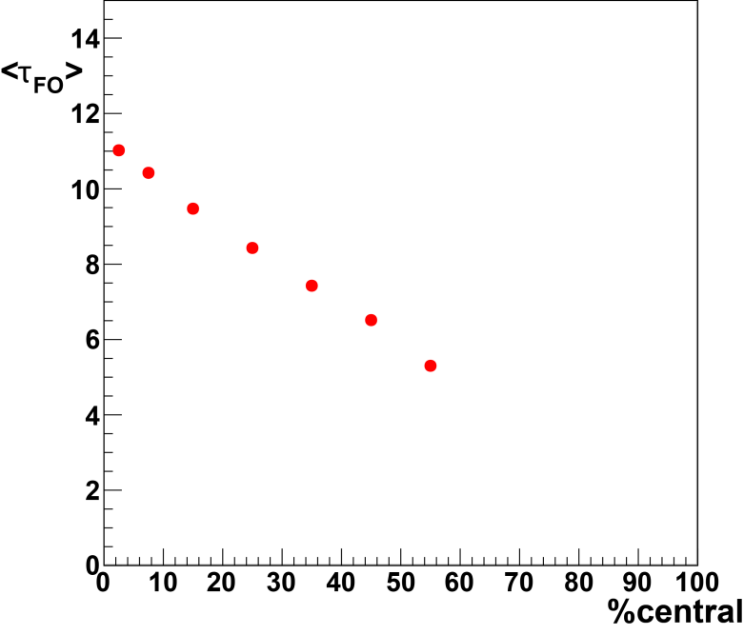
Freeze Out Time
Faster dots freeze out first
Blue: Event average 20-30% centrality
Red: single event with 464 Flow Lines
Average flow line lifetime longest in most central collisions

Slide 11
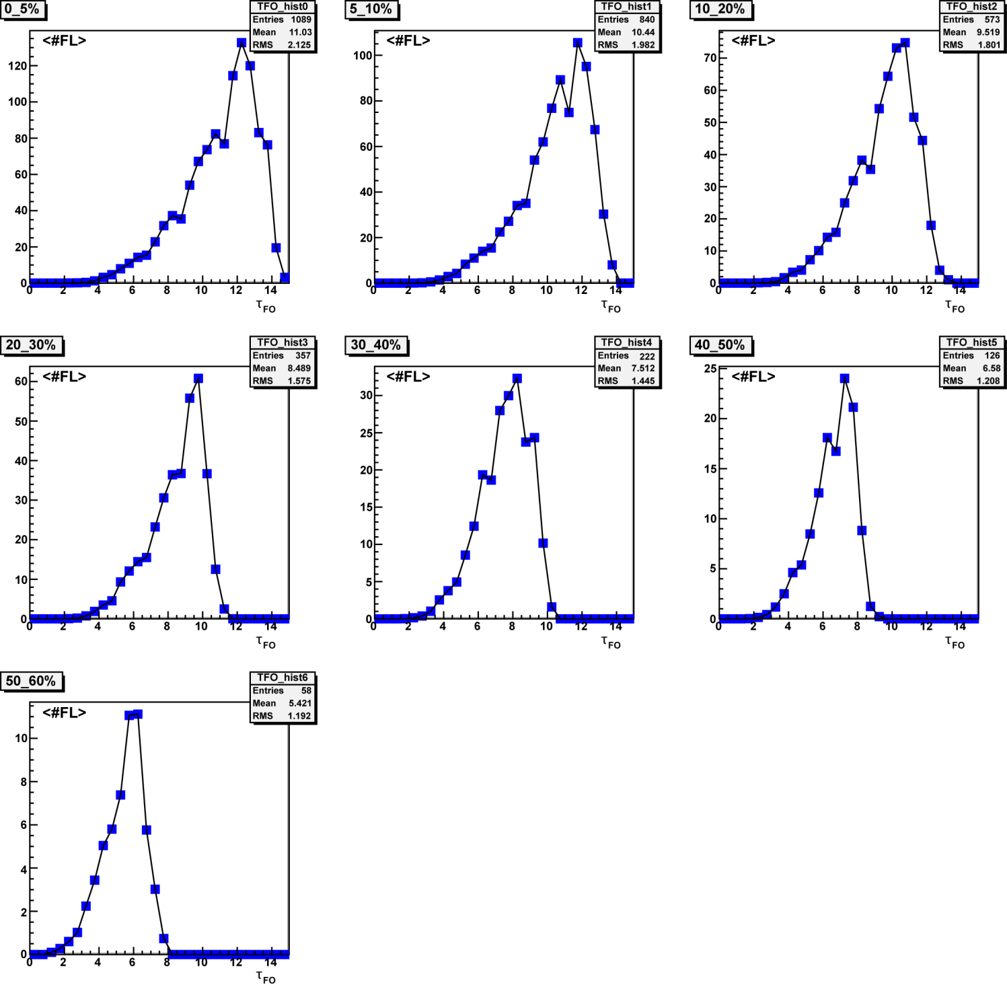
Freeze Out Time
Freeze out histograms indicate the flux of flow lines through the freeze out surface at different times.

Slide 12
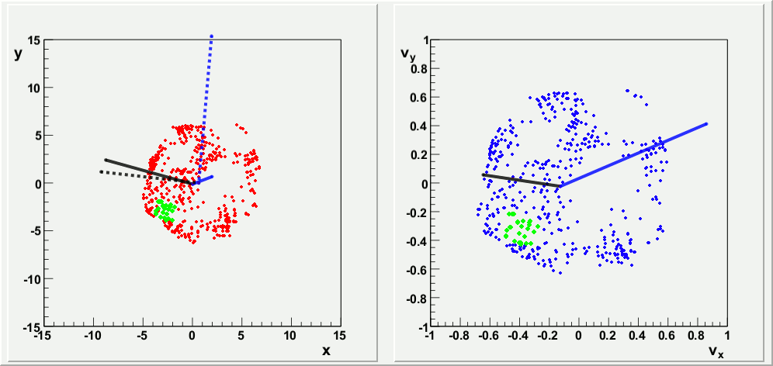
Freeze out and Event Planes
Space
Velocity
Alvioli, Holopainen, Eskola, Strikman arXiv:1112.5306
n = 1 w(r) = r³
n = 2 w(r) = r²
n = 3 w(r) = r³

Slide 13
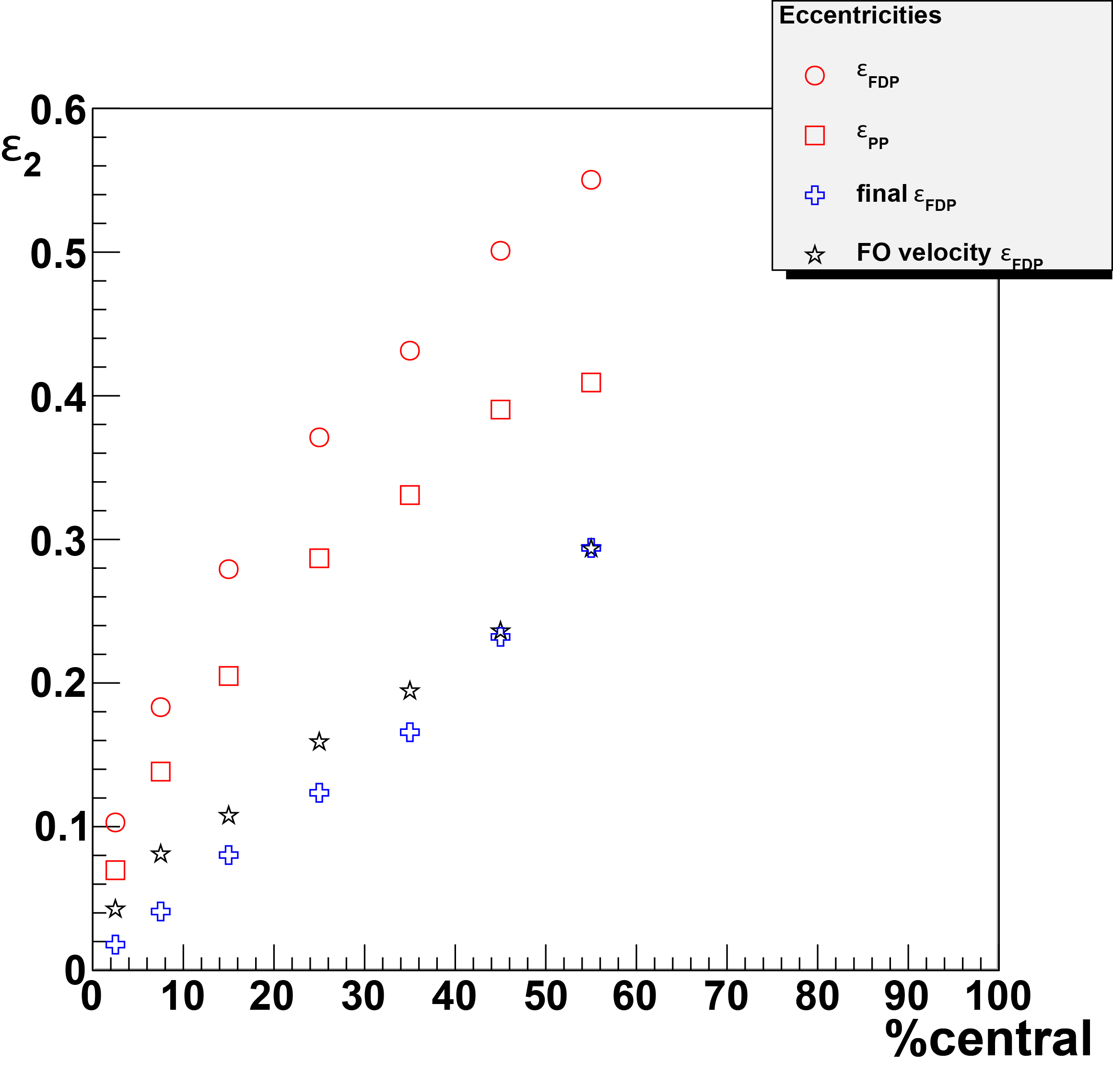
ε₂
Difference in initial eccentricities due to Glauber mixture IC vs. Nbin Flow Lines
Freeze out changes initial and final eccentricity
Freeze out velocity eccentricity represent a “time averaged” freeze out surface
Final eccentricity agrees with freeze out velocity eccentricity
Goal: Study IC structure impact on time averaged velocity eccentricity.

Slide 14
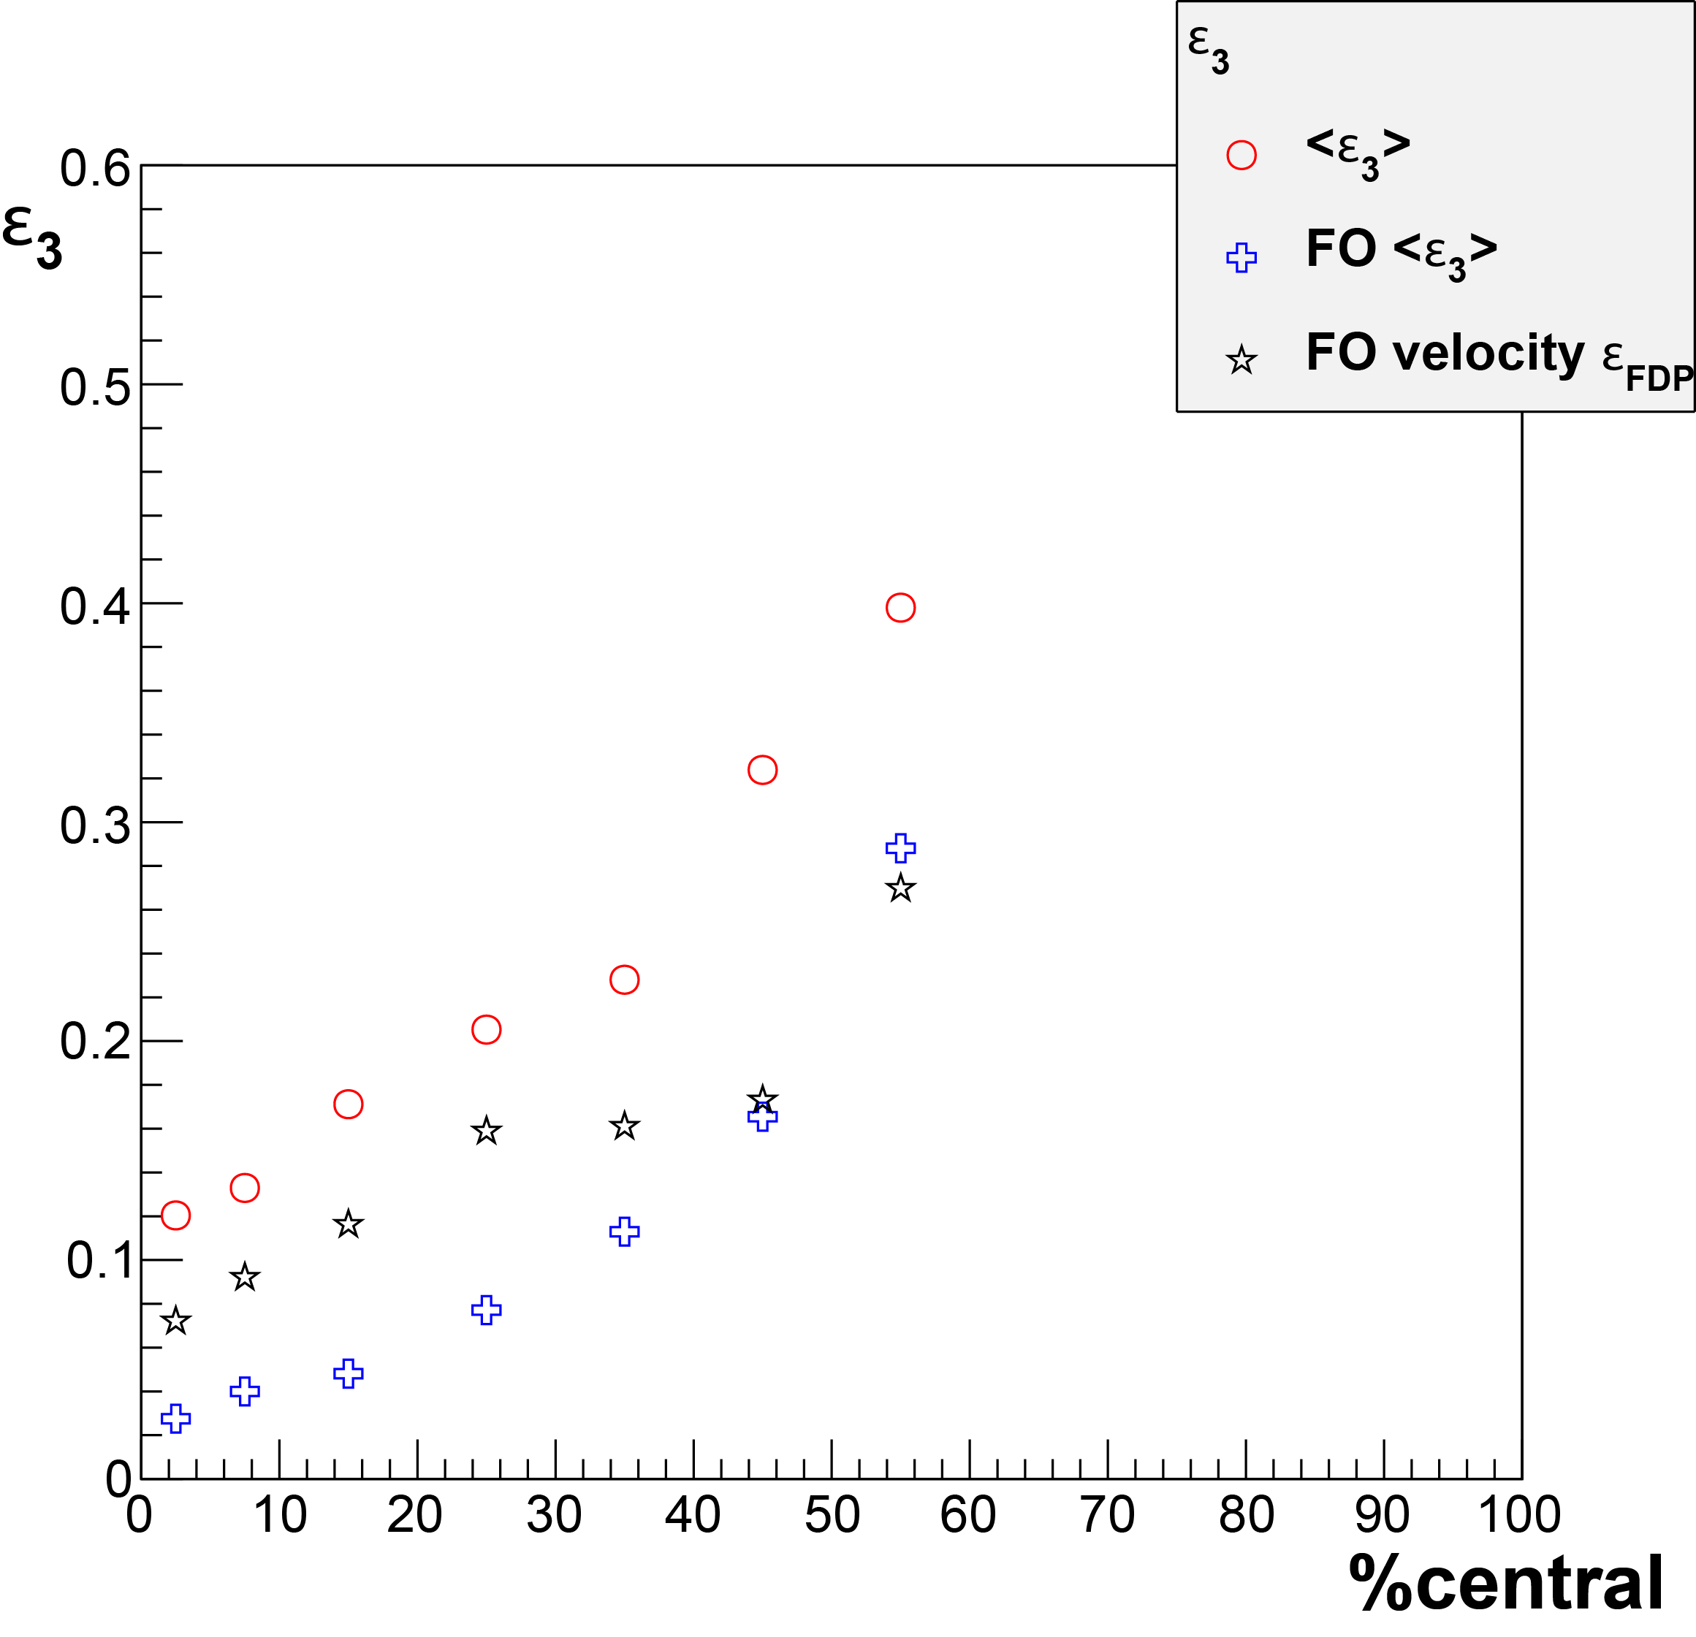
ε₃
Difference in initial eccentricities due to Glauber mixture IC vs. Nbin Flow Lines
Freeze out changes initial and final eccentricity
Freeze out velocity eccentricity represent a “time averaged” freeze out surface
Final eccentricity agrees with freeze out velocity eccentricity
Goal: Study IC structure impact on time averaged velocity eccentricity.

Slide 15
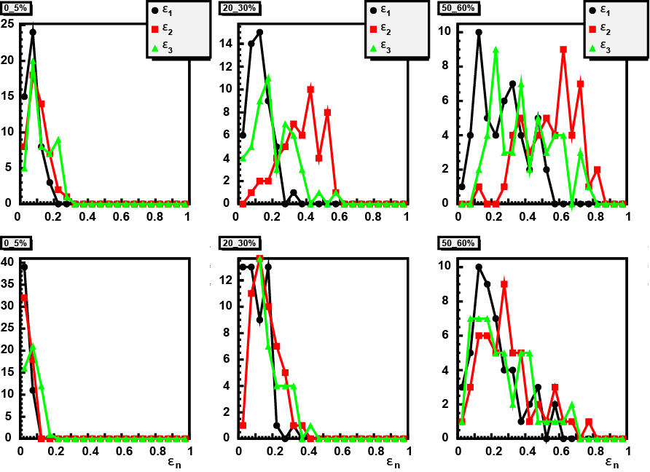
ε_{n} Distributions
# Events
Cartesian Space
# Events
Velocity Space
Fluctuations can differentiate initial conditions
Notes:
Can do eccentricity fluctuations in velocity space
They can be time averaged or freeze out dependent
DO THEM FOUR DIFFERENT IC SOURCE STRUCTURES → Fluctuations needed to “tune hydro”

Slide 16
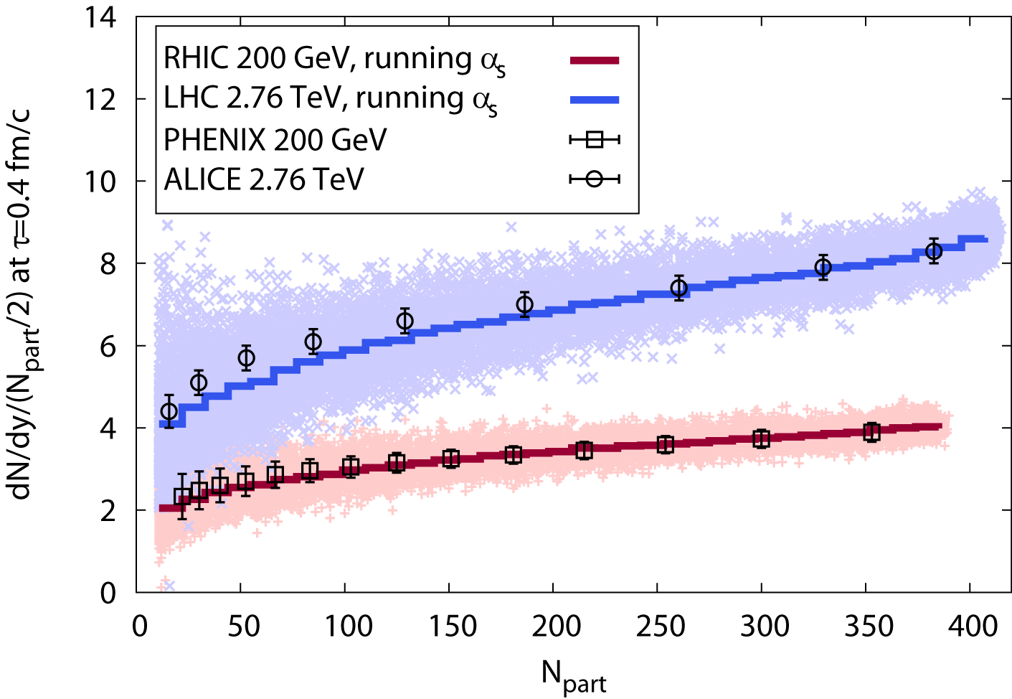
Multiplicity Fluctuations
Gavin, Moschelli Phys.Rev. C79, 051902 (2009)
For K sources that fluctuate per event
Fluctuations per source
Fluctuations in the number of sources
Negative binomial distribution
Gelis, Lappi, McLerran Nucl.Phys. A828, 149 (2009)
Schenke, Tribedy, Venugopalan, arXiv:1206.6805, Phys. Rev. Lett. 108 (2012) 252301
Notes:
If multiplicity is poissonian then first term is zero
If source distribution is powssonian, then last term is 1/<K>
IN E-BY-E STUDIES YOU CANt ONLY GET Dn/dy correct

Slide 17
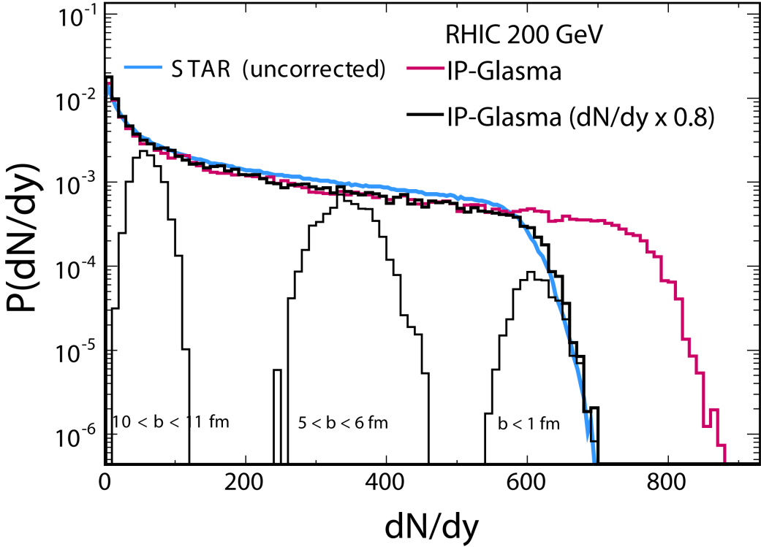
Negative Binomial Distribution
Gavin, Moschelli Phys.Rev. C79, 051902 (2009)
For K sources that fluctuate per event
Fluctuations per source
Fluctuations in the number of sources
Negative binomial distribution
Gelis, Lappi, McLerran Nucl.Phys. A828, 149 (2009)
NBD put in by hand
Schenke, Tribedy, Venugopalan, arXiv:1206.6805, Phys. Rev. Lett. 108 (2012) 252301

Slide 18
Fluctuations and Correlations
correlations = pairs - singles²
  Gavin, Moschelli
  nucl-th/1107.3317
  nucl-th/1205.1218
Multiplicity Fluctuations
Momentum Fluctuations
“Flow Fluctuations”

Slide 19
The next step
IC lumps from K random sources
Poisson flow line multiplicity per source
Compare large <K> and small source size to small <K> and large source size
Compare to “smooth” hydro
Mixed Events
With and without aligned reaction / event planes
Angular Correlations
Compare ε_{n} and v_{n} with different IC
Radial cuts
Momentum, v_{n} (eccentricity) and v_{n}{2}²-v_{n}{4}² fluctuations
Notes:
Constrain: Instead of input specific IC from a theory, determine what conditions work best to explain the data. Which theory is closest.

Slide 20
Summary
Freeze out effects
Eccentricity fluctuations
Event plane angle determination
Can we use hydro select the right IC?
Determine hydro response to “common origin” correlations and dependence on choice of IC.
Trace the evolution of fluid element correlations to freeze out.
Determine a source “resolution”.
Study IC structure impact on time averaged velocity eccentricity.
Notes:
Rather than use initial condition calculations, determine the conditions that initial conditions calculations must satisfy

Slide 22
Cumulant Expansion
Pair Distribution:
  Borghini, Dinh, Ollitrault
Two-particle coefficient:
<v_{n}>² = reaction plane correlations
σ²_{n} = other correlations
v_{n}{4} ≈ <v_{n}>
  Borghini, Dinh, Ollitrault;
  Voloshin, Poskanzer, Tang, Wang
Correlated Part:
v_{n} factorization is a signature of flow if σ_{n} = 0

Slide 23
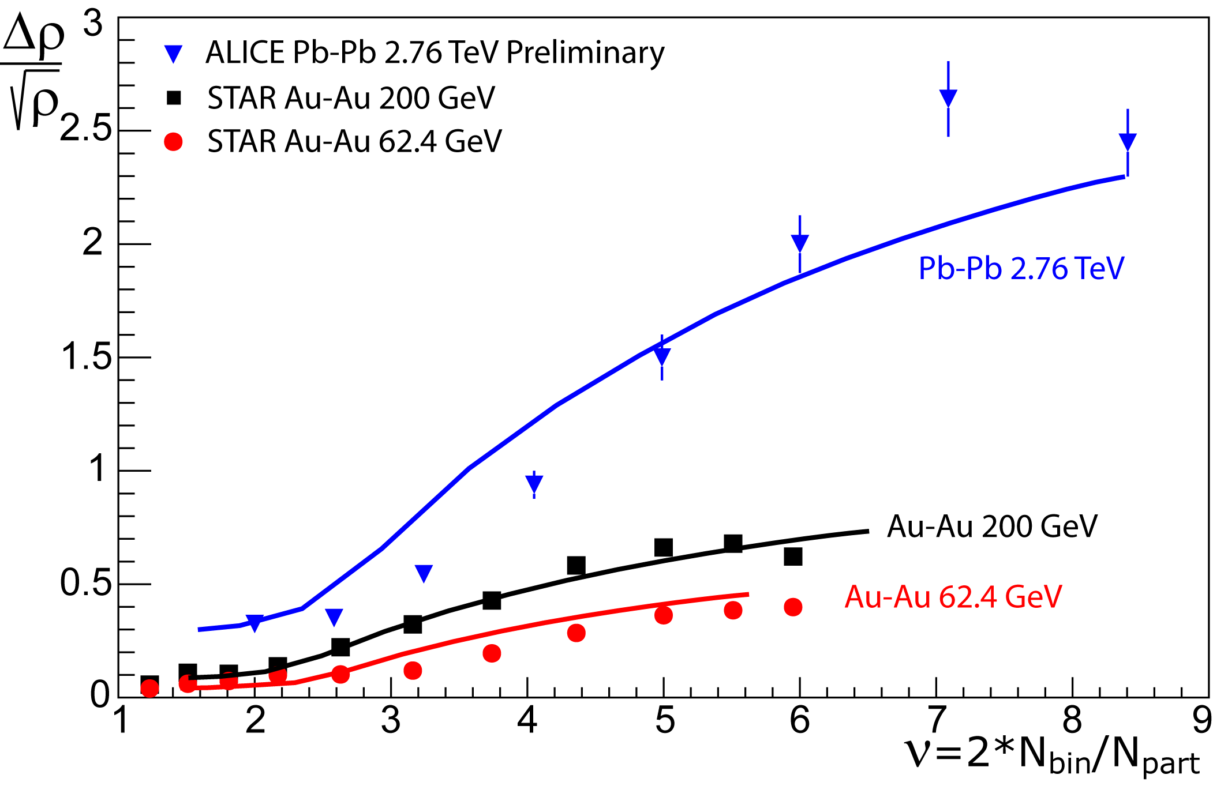
The Soft Ridge
Flow subtracted ridge
Only cos Δφ and cos 2Δφ terms subtracted
These terms also contain fluctuations
Glasma energy dependence
R scale factor set in
Au-Au 200 GeV
Blast wave f (p,x)
Difference in peripheral STAR→ALICE
Notes:
Cos Dphi and cos 2Dphi are two particle coefficients and therefore contain fluctuations, the top equation suggests that only reaction plane correlated flow coefficients should be subtracted, (more closely related to vn{4})

Slide 24
Four-Particle Coefficients
Four-Particle Distribution: keep only two-particle correlations
  Borghini, Dinh, and Ollitrault
Four-particle coefficient:
  Voloshin, Poskanzer, Tang, Wang

Slide 25
v_{n}{4} corrections
Four-particle coefficient:
  Will cancel with v_{n}{2} terms
  Corrections of order ~1.2%

Slide 26
R
  K flux tubes, assume
  K varies event-by-event
For K sources that fluctuate per event
Fluctuations per source
Fluctuations in the number of sources

