Slide 1
Longitudinal de-correlation of anisotropic flow in Pb+Pb collisions
Victor Roy
ITP Goethe University Frankfurt
In collaboration with
L-G Pang, G-Y Qin, X-N Wang and G-L Ma

Slide 2
Plan of the talk
Motivation
Dynamical models
-3+1 D Ideal Hydro
-Transport model AMPT
Results
Summary
Notes:
The plan of my talk is as following ,
First I will discuss about the motivation for this study of longitudinal correlation of flow harmonics
Then I will briefly discuss about the two dynamical models used for this purpose
After that I will show the result and finally I will summaries our work.

Slide 3
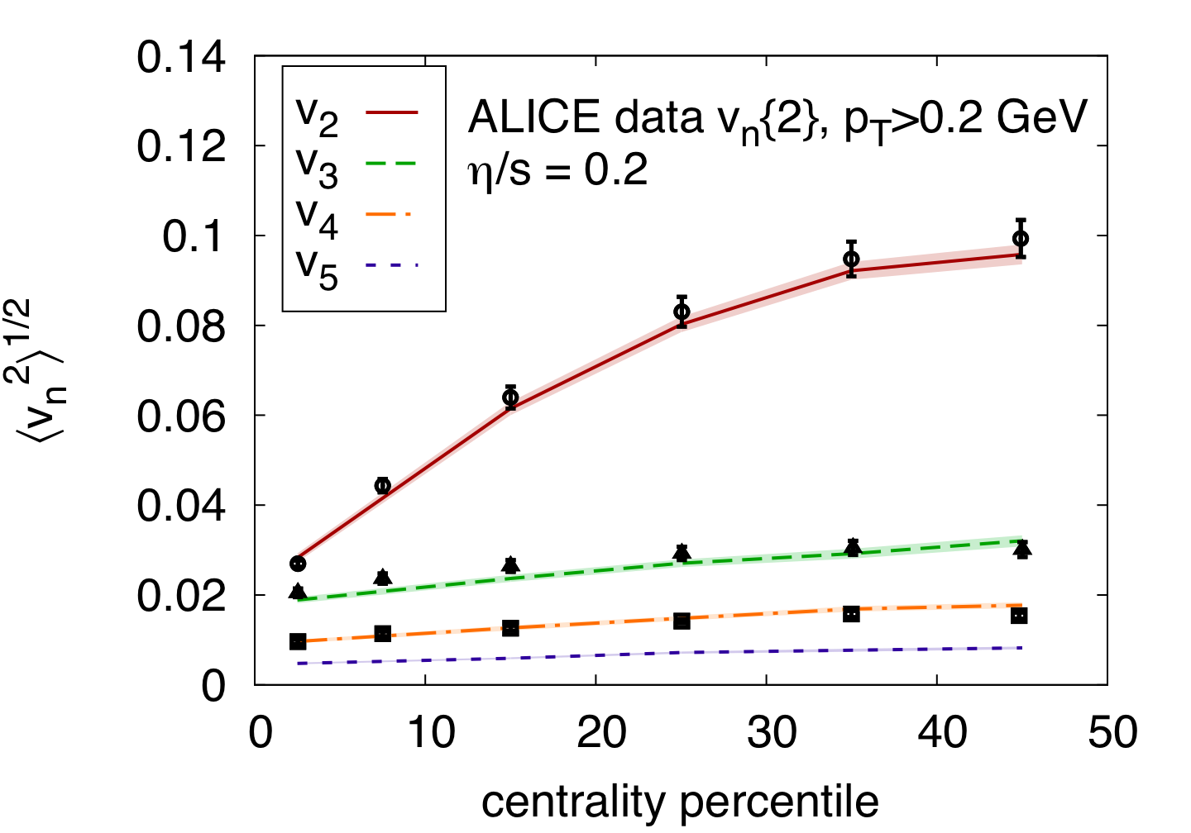
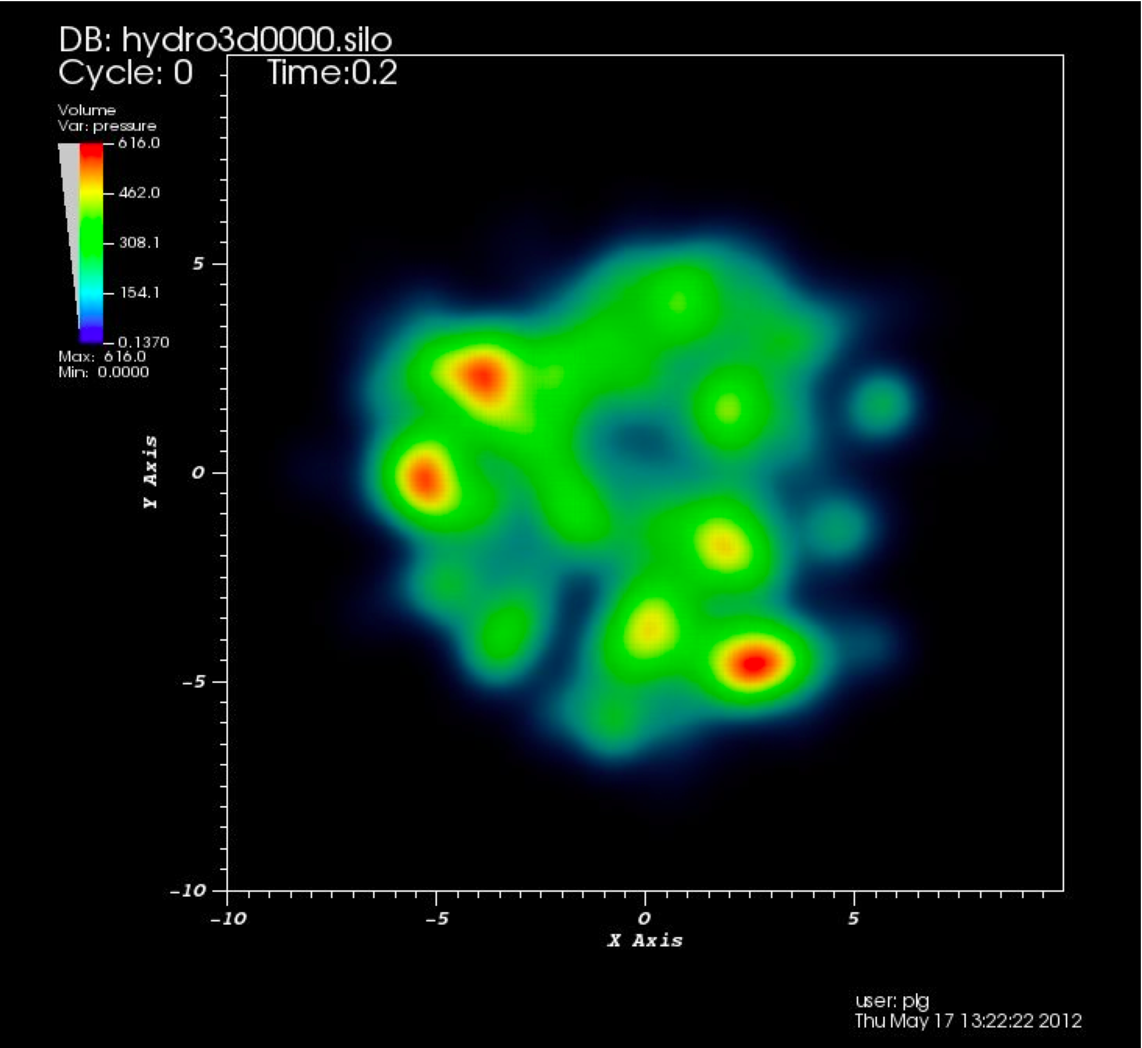
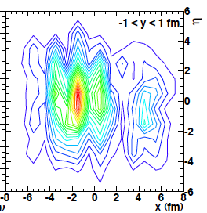
Motivation: anisotropic flow & initial fluctuation
Transverse fluctuation of initial energy density
Y
Non-zero odd flow
harmonics
Schenke et al.
X
Longitudinal fluctuation of initial energy density
Hydrodynamic model study:
Anisotropic flow reduces in presence
of longitudinal fluctuation.
What is the effect of longitudinal fluctuation
on event plane correlation.
Any dependency on transport coefficients?
LG Pang et al
Phys.Rev. C86 (2012) 024911
-v
v
η
We use a 3+1D ideal Hydro & AMPT model to investigate these questions
Notes:
It is well known that in order to explain the experimentally observed non zero odd flow harmonics in the hydrodynamic framework, one must use the lumpy initial energy density distribution. Only then one can have non-zero odd flow harmonics in hydrodynamical evolution as shown in the figure.
Now when measuring anisotropic flows and their correlation one common practice is to correlate particles with a large pseudorapidity gap.
The use of large pseudorapidity gap is to minimize the contribution from non-flow effect, However, such method is good under the assumption that
The initial density distribution and final state anisotropic flows are perfectly aligned as in the case of boost invariance.
However the density distribution of firball produced in high energy heavy ion collision contains fluctuation not only in the transverse plane but also in the longitudinal direction as shown here in the schematic picture.

Slide 4
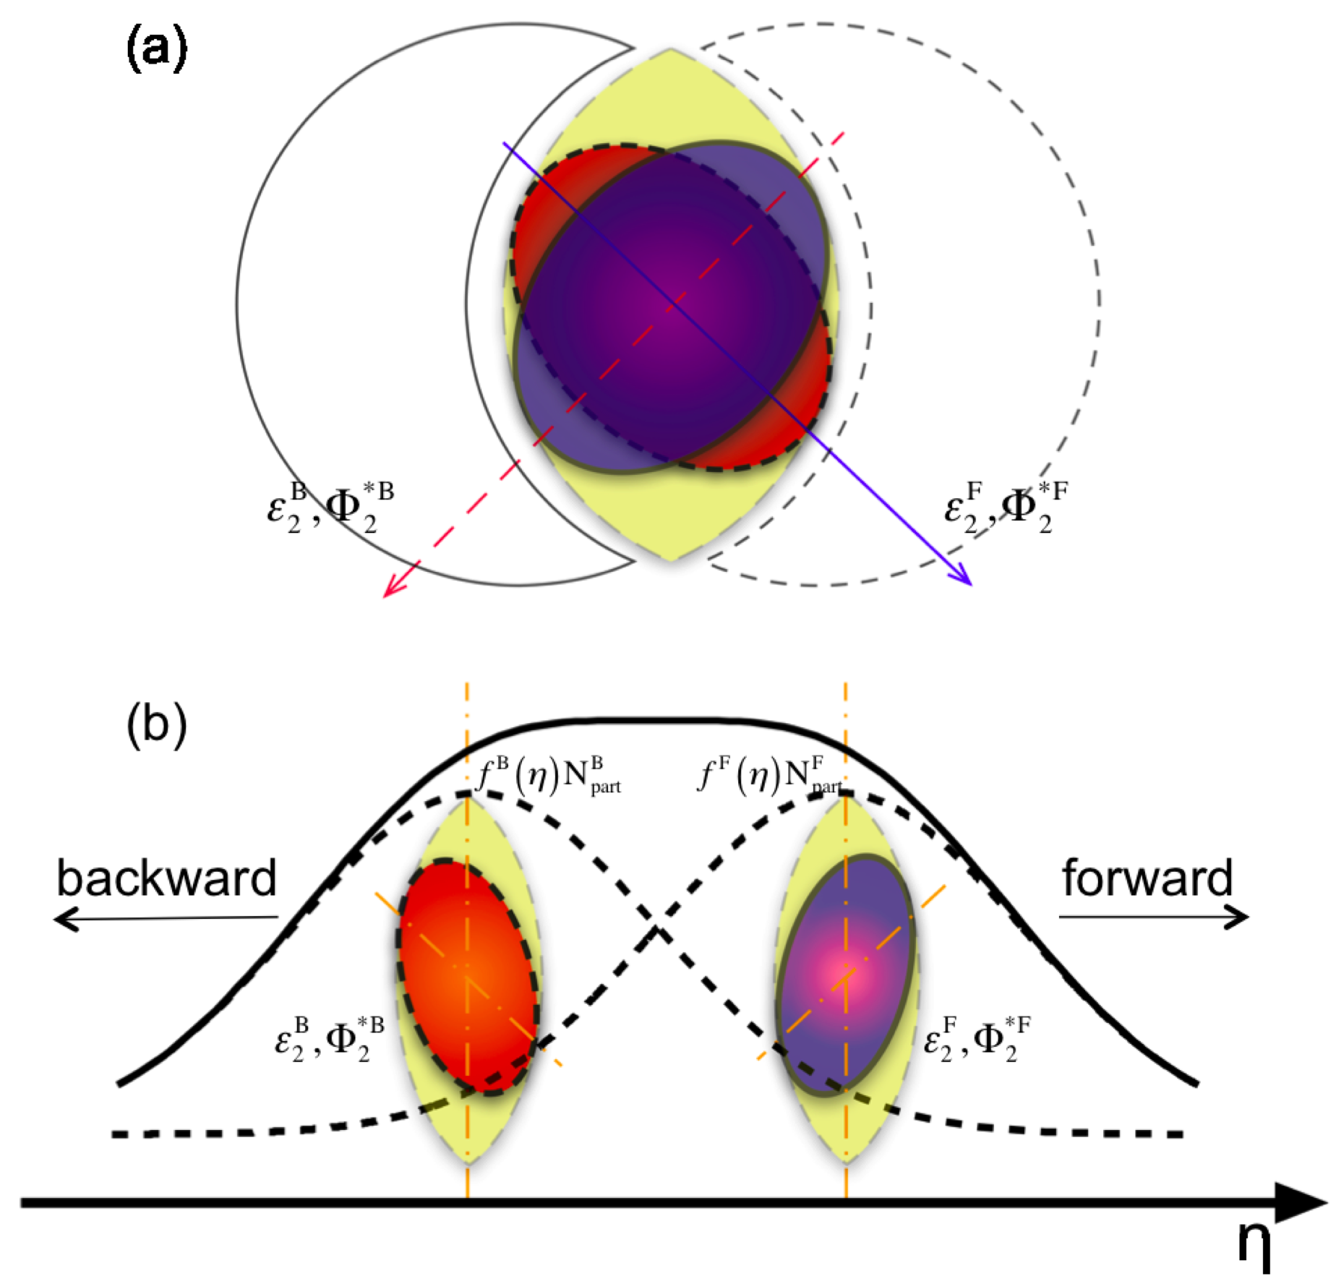
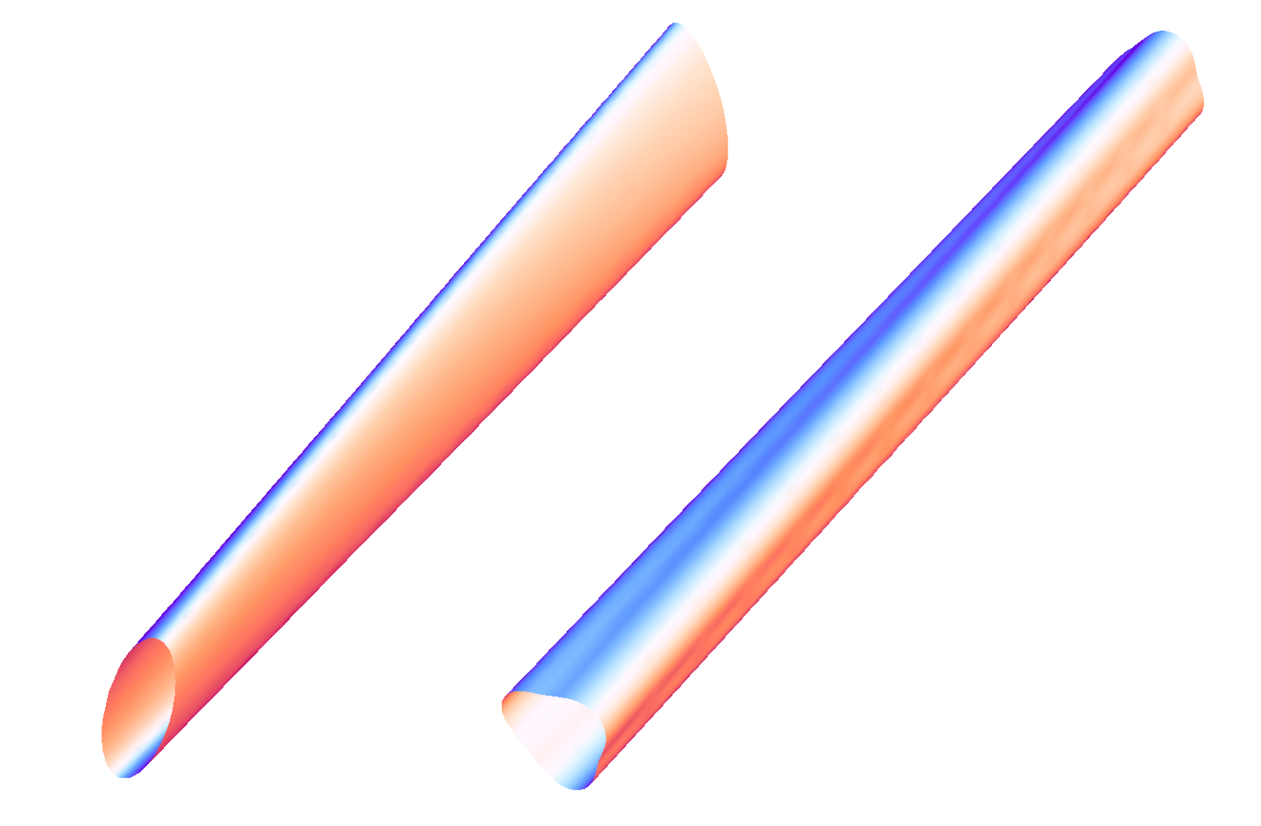
Twist of Event planes
Hydrodynamics , torqued fireball
Transport
P Bozek et al,
PRC 83, 034911 (2011)
rapidity
Statistical fluctuation in the transverse distribution
the asymmetry in the emission profiles of
forward(backward) moving wounded nucleons
J Jia et al,
PRC 90, 034915 (2014)

Slide 5
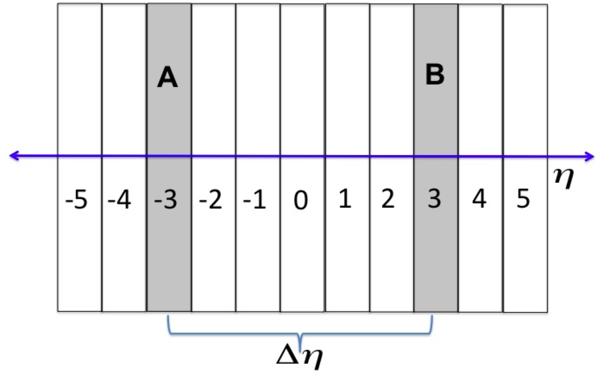
Formulation: longitudinal correlation
Correlation of event plane at rapidity “A” and “B”
General Definition :
→ n-th order Q vector
Specific cases,
(i) Continuous p_{T} spectra of particles : relevant for hydrodynamic model study
(ii) Finite multiplicity → sub-event method : relevant our transport model study
Notes:
Here we discuss the outline of the plan of studying longitudinal correlation,
The rapidity range of -5 to +5 is subdidedinto 11 equally spaced rapidity bin, and we calculate the Q vector in each of this bin for each event.
The nth order Q vector is obtained by constructing the sum .

Slide 6
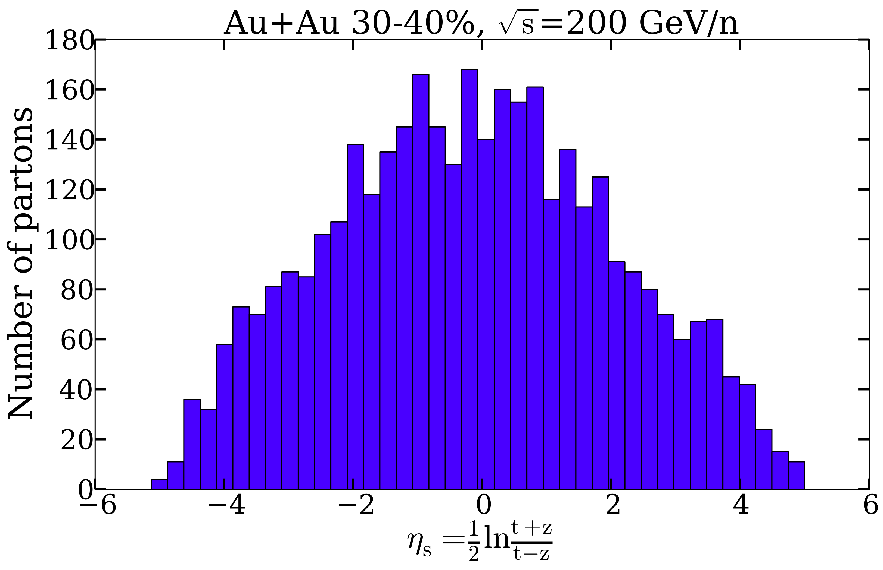
Dynamical Model-1: E-by-E 3+1D ideal hydro
L Pang et al
PhysRevC.86.024911
Initial Condition
Energy Momentum tensor is calculated from the
position and momentum of the initial parton on a
fixed proper time surface
QGP phase
Hadronic Phase
Freeze-out → T_{f}=137 MeV
Number of event
for each centrality ~1000
HIJING (MC Glauber model)
Energy density in XY
EoS (Lattice QCD+HRG)
Chemical Equilibrium, s95p-v1
P Huovinen et al, Nucl Phys A 837,26
T
I
M
E
Parton density along
spatial-rapidity
Notes:
Add the line for No resonance decay product limited CPU time

Slide 7
Dynamical Model-2: AMPT Monte Carlo
Initial condition
Excited string and mini-jet
fragmented to partons
QGP phase
Parton freeze-out ,
Hadron formation via coalescence
Hadronic phase
Hadron freeze-out
Number of events for
Each centrality ~ 10000
Parton cross section=1.5, 20 mb
HIJING (Glauber model)
T
I
M
E
Zi wei lin et al
PhysRevC.72.064901
Zhang’s Parton Cascade
two parton collision only
X (fm)
A Relativistic Transport
B-B,B-M,M-M elastic and
inelastic processes
Distribution of participating nucleons
In a typical non-central Au+Au collision.

Slide 8
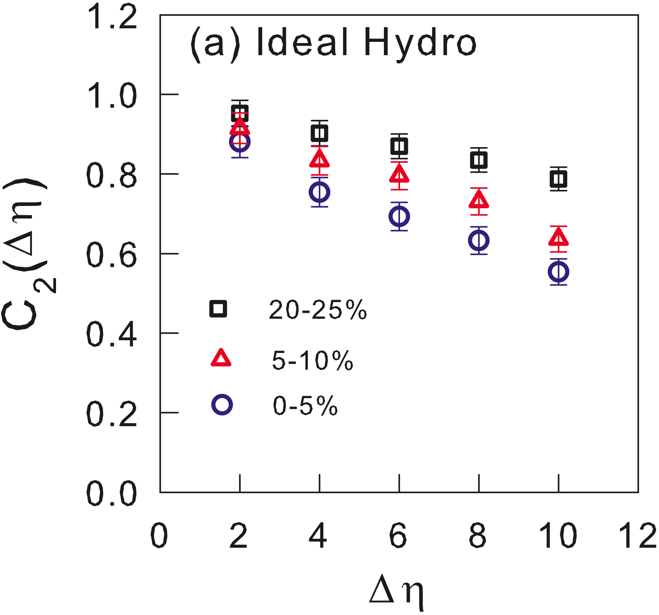
Result: 3+1D Ideal Hydrodynamics
2nd order flow correlation
Decreases with rapidity gap
Twist and/or fluctuation ?
We will come to it later
Depends on centrality of
collision
Role of initial state geometry ?
Answer can be possibly
found from third flow harmonics

Slide 9
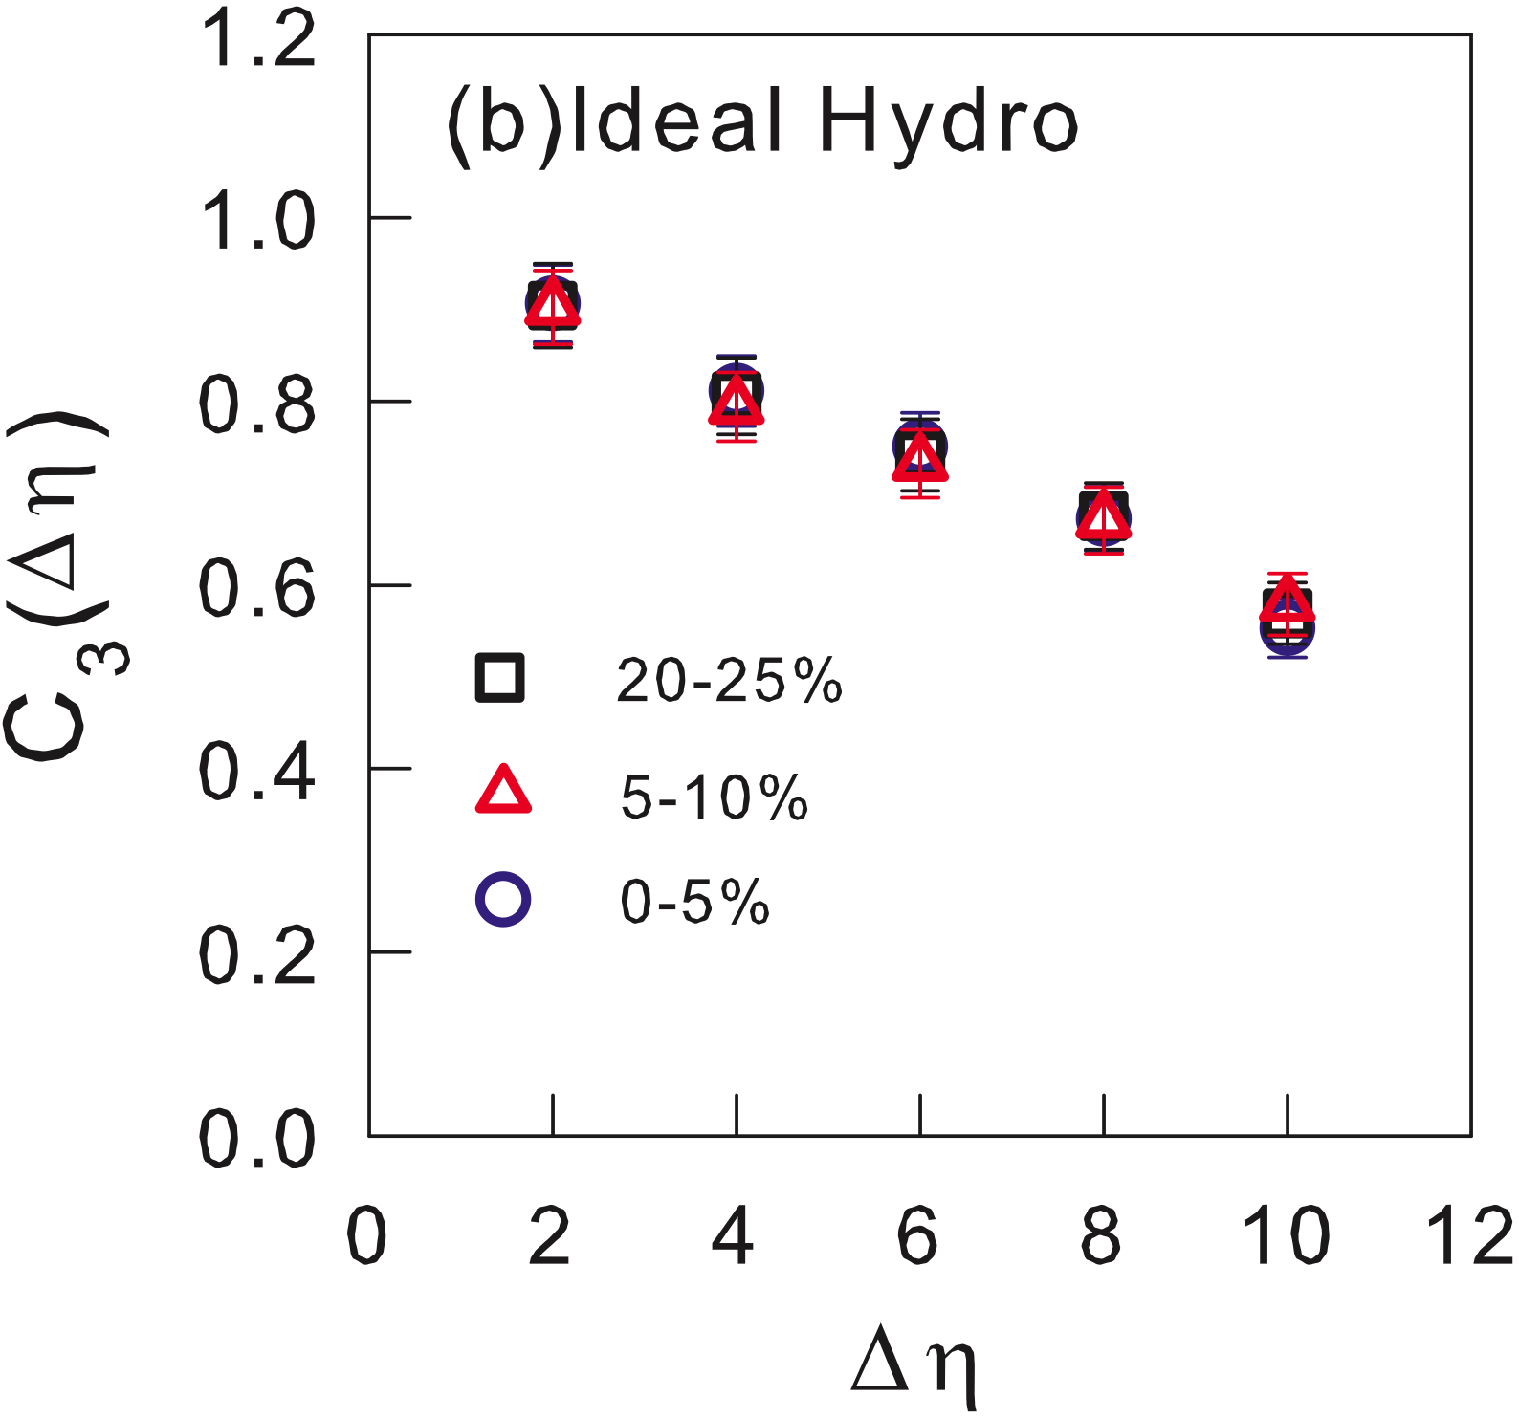
Result: 3+1D Ideal Hydrodynamics
3rd order flow correlation
Decreases with rapidity gap
Twist and/or fluctuation ?
We will come to it later in talk
Doesn’t depends on centrality
of collision
Role of initial state geometry ?
Indeed geometry plays an important role.

Slide 10
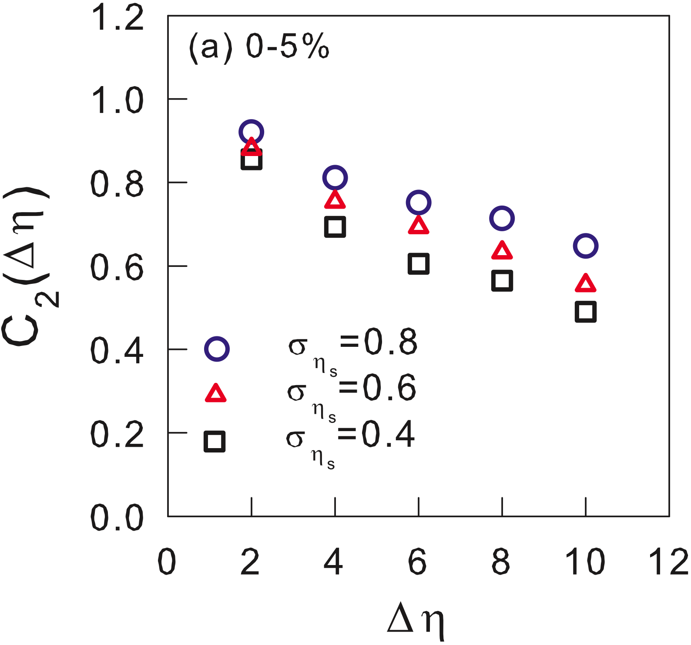
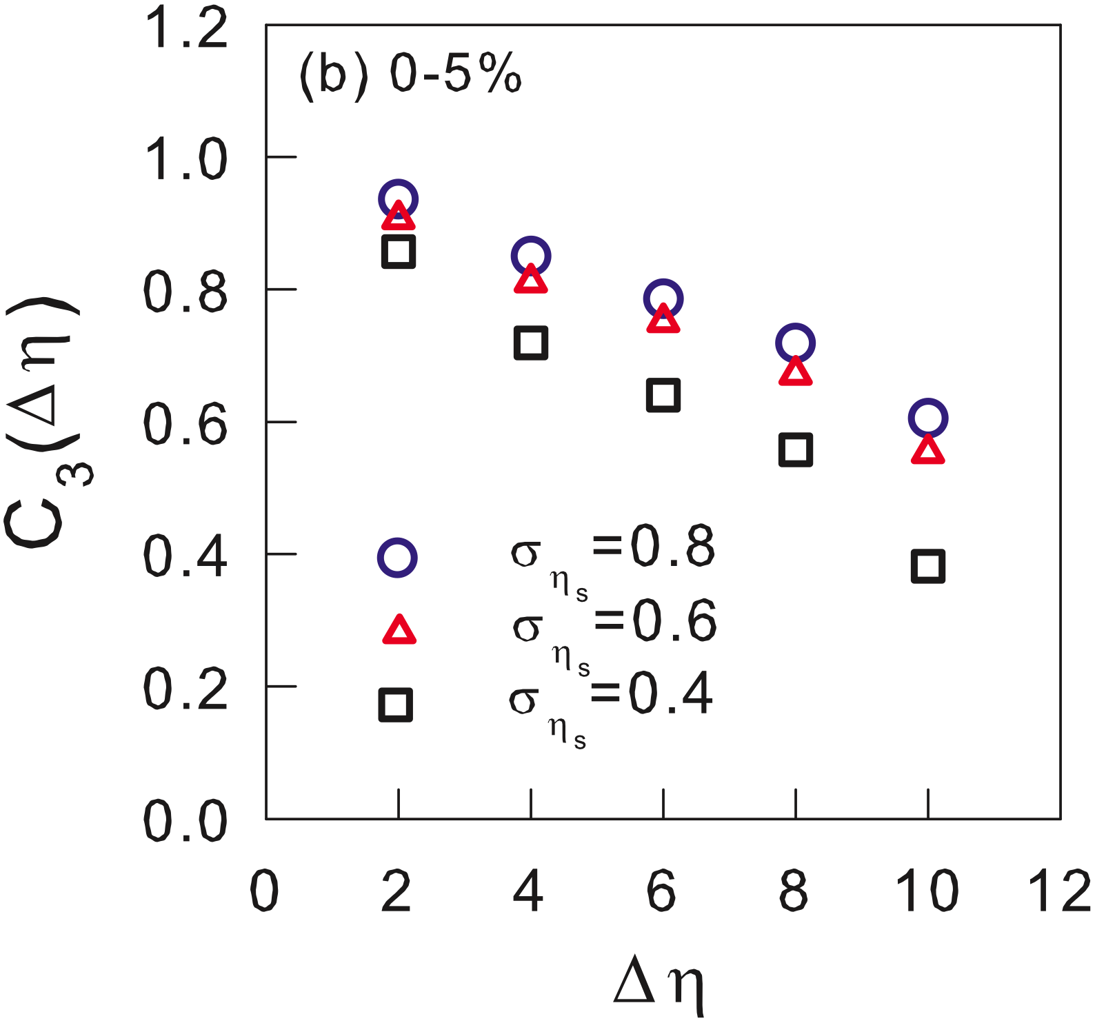
Result: 3+1D Ideal Hydrodynamics
Dependency on the smearing parameter
Does correlation depends on shear viscosity ?

Slide 11
Possibility of studying Transport coefficients
Bad News : No existing 3+1D viscous hydro code
with longitudinal fluctuating IC
Good News: transport models can be utilized
to study the dependency
by using different parton cross section.
We use: A Multi Phase Transport Model (AMPT)
Advantage : Same initial condition as 3+1D Ideal hydro
Disadvantage : finite hadron multiplicity, larger Stat errors.

Slide 12
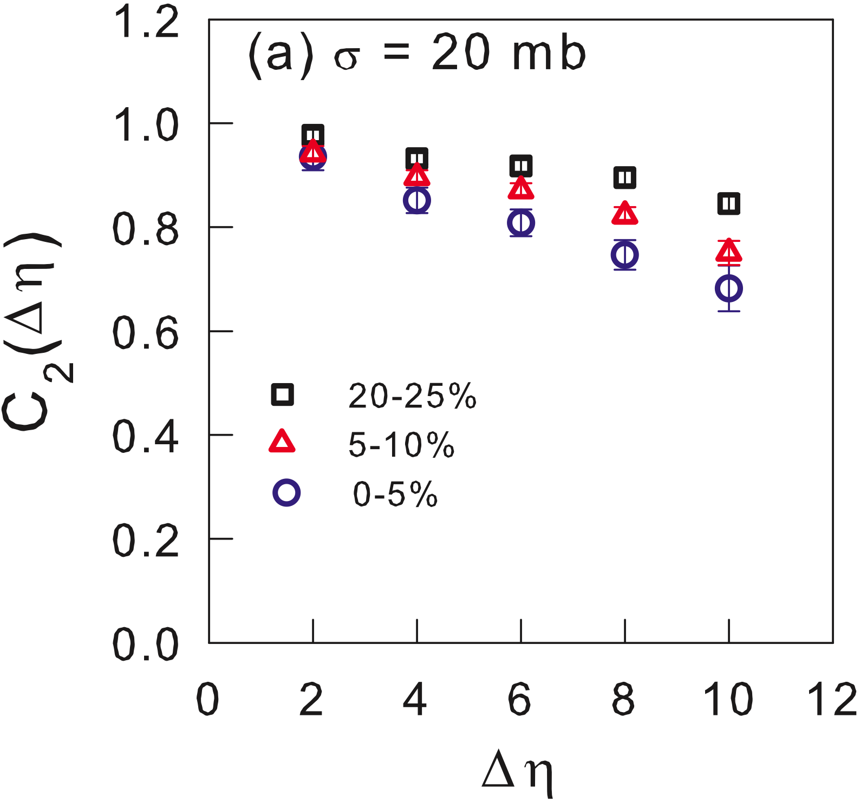
Result: E-by-E AMPT
2nd order flow correlation
Decreases with rapidity gap
Depends on centrality of
collision
Similar to the ideal 3+1D hydro

Slide 13
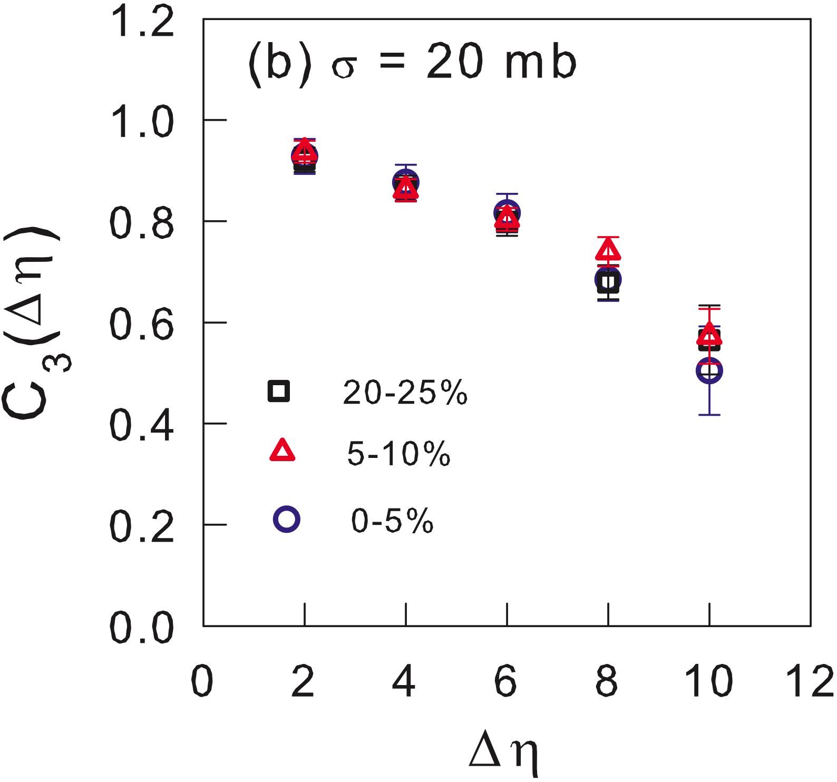
Result: E-by-E AMPT
3rd order flow correlation
Decreases with rapidity gap
Doesn’t depends on centrality
of collision
Again similar to ideal hydro
How much contamination from Non-Flow and Finite multiplicity ?

Slide 14
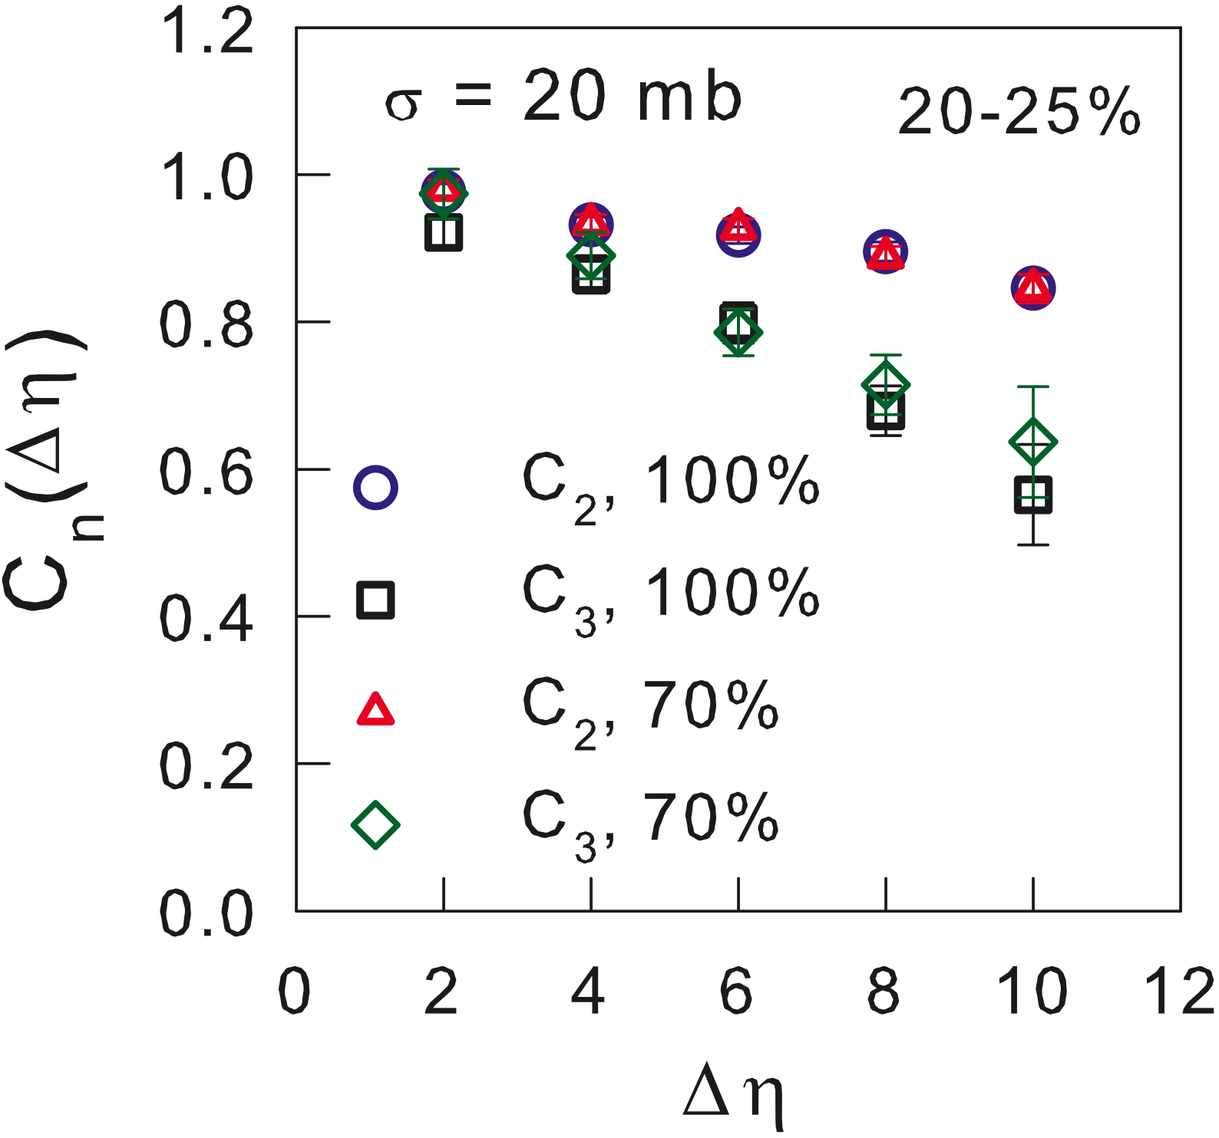
Result: E-by-E AMPT finite multiplicity
Two cases:
Correlation obtained from all (100%) particles
- circles → C₂
- squares → C₃
Correlation from 70% of the total particles
- Triangles → C₂
- Rhombus → C₃
Very small contribution is
observed for finite multiplicity

Slide 15
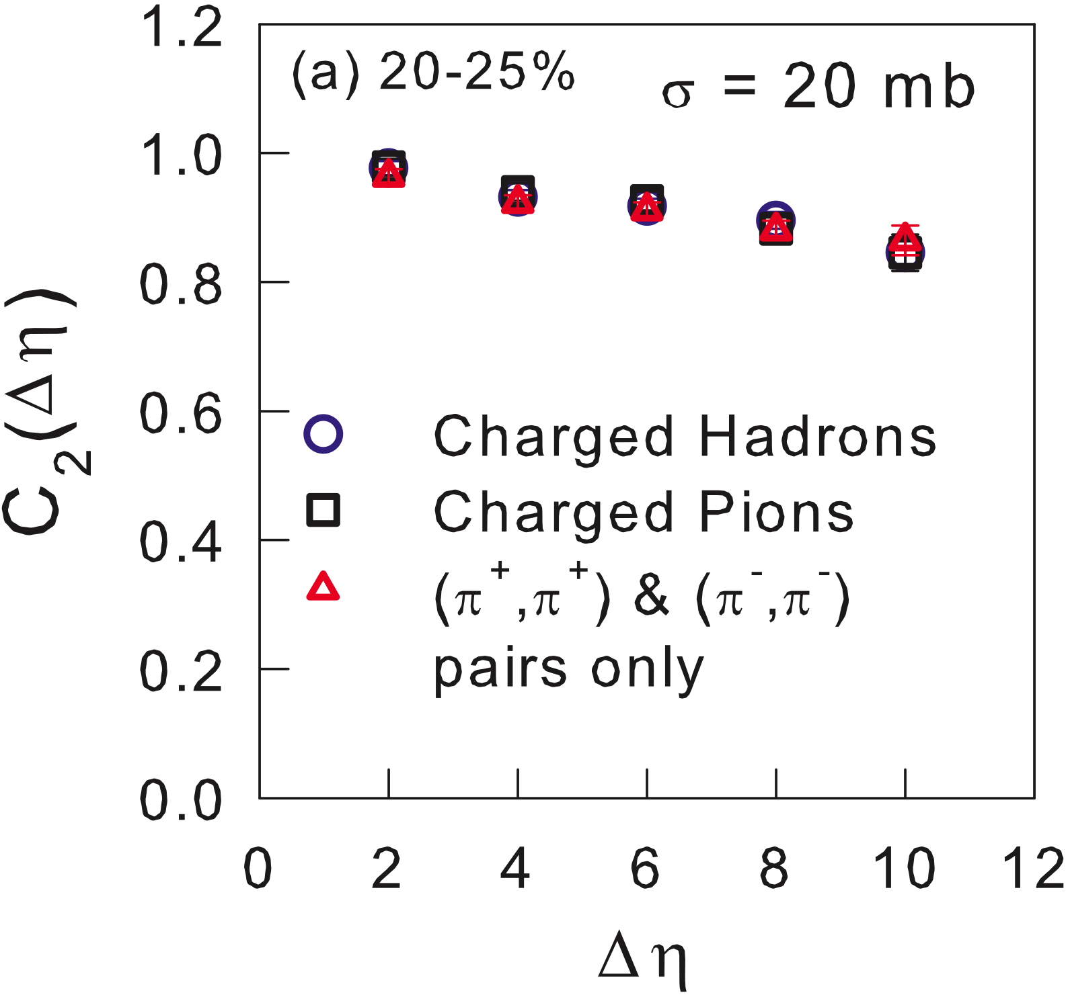
Result: E-by-E AMPT non-flow
Three cases:
Correlation from all charged hadrons
- circles
Correlation from charged Pions
- Squares
Correlation from the same charged pair of Pions
- Triangles
Negligible non-flow contribution

Slide 16
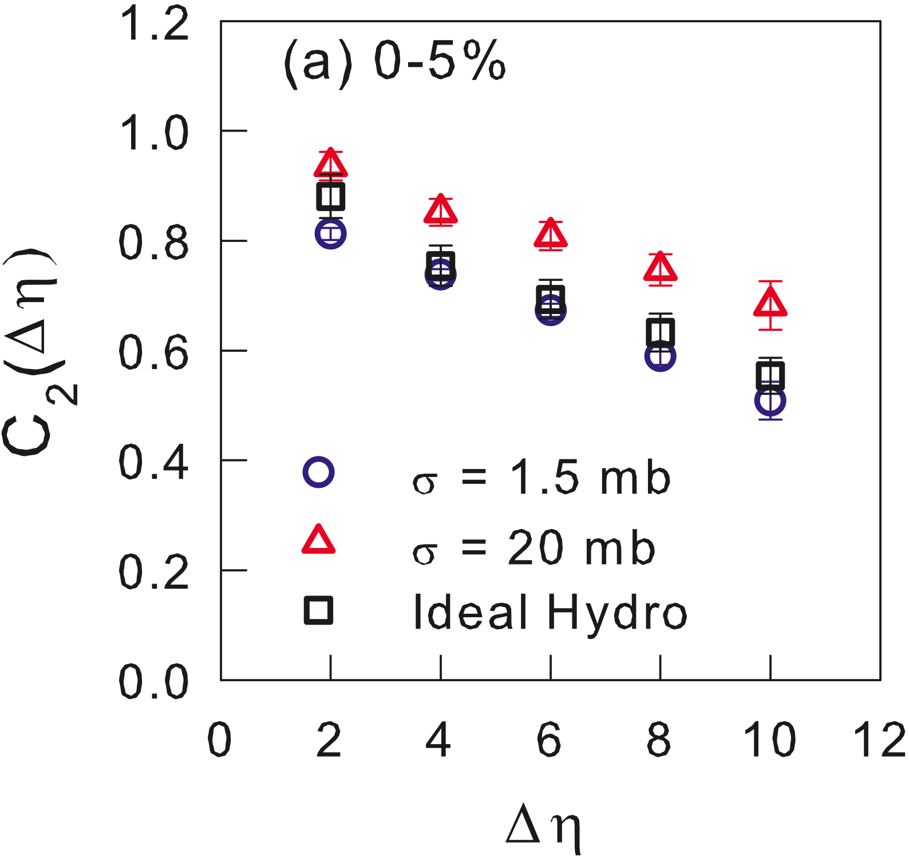
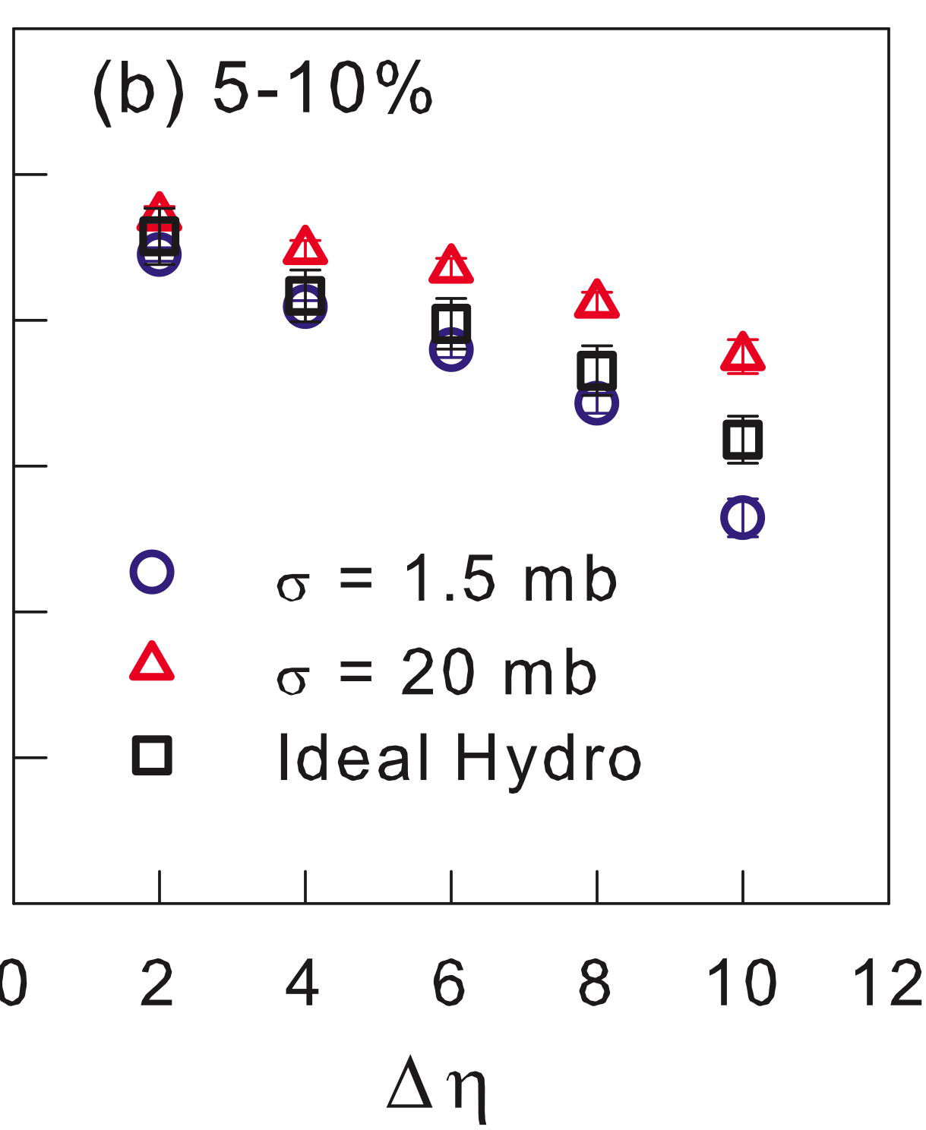
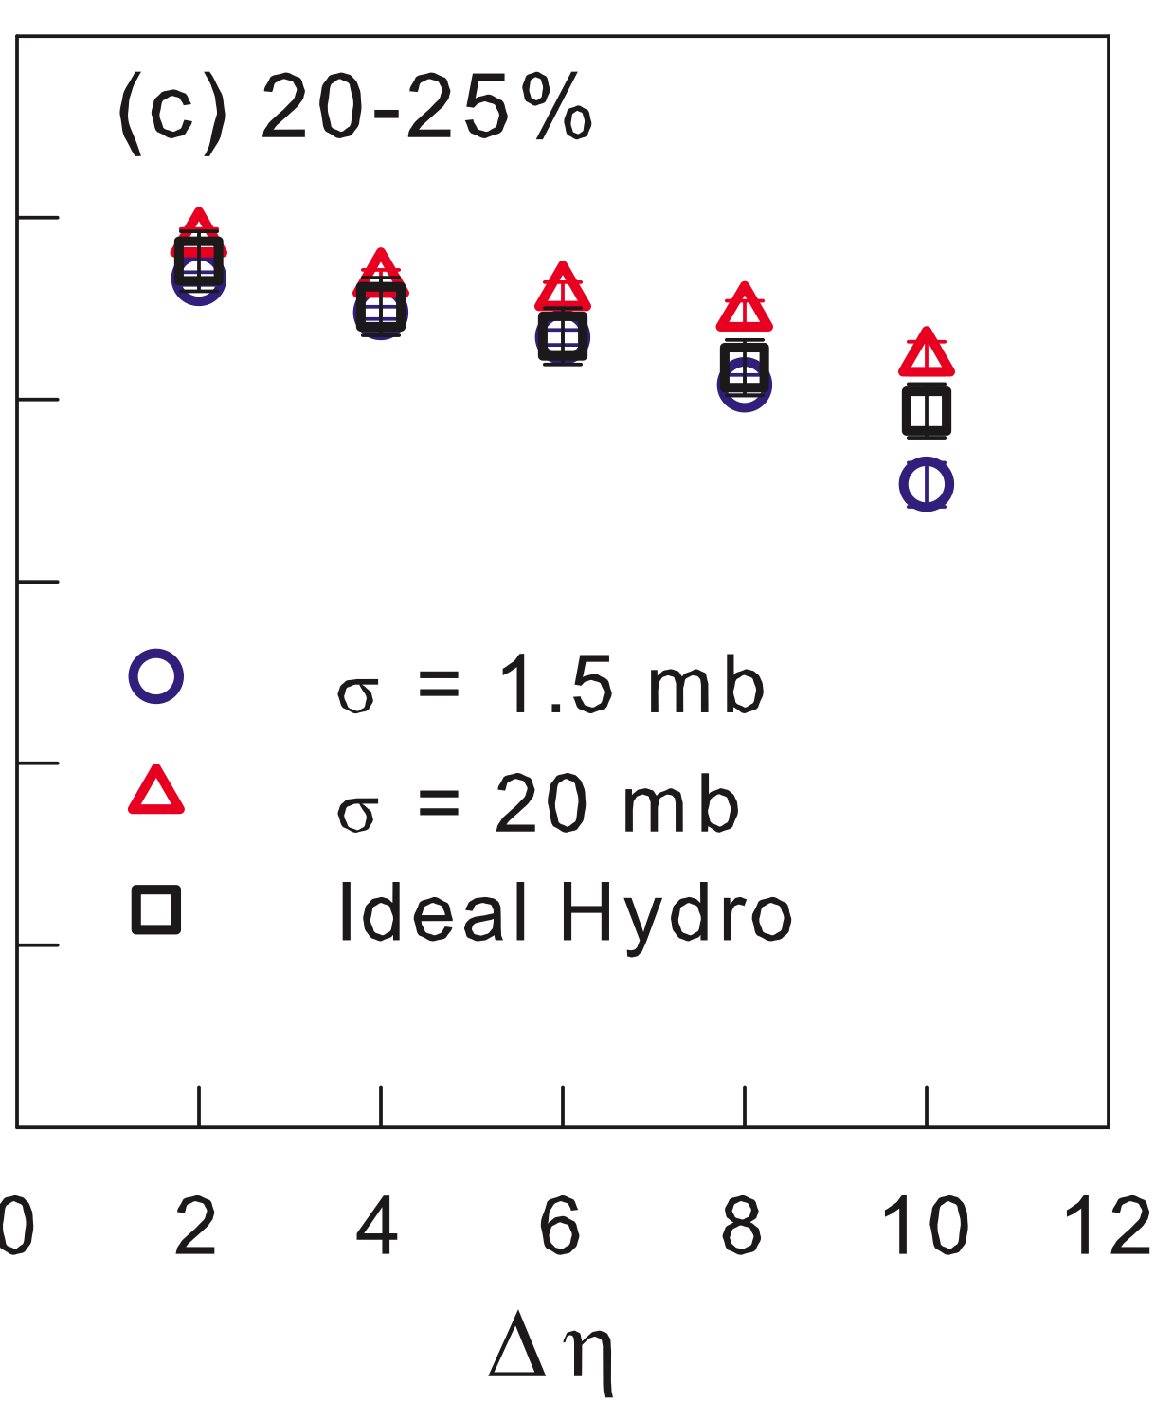
Result: C₂, E-by-E AMPT & hydro
Larger cross section (small shear viscosity) → higher correlation
Expectation : Strong coupling limit ( ) , AMPT → ideal hydro
Possible reasons : different EoS, smearing of initial energy density in hydro
among other possibilities.

Slide 17
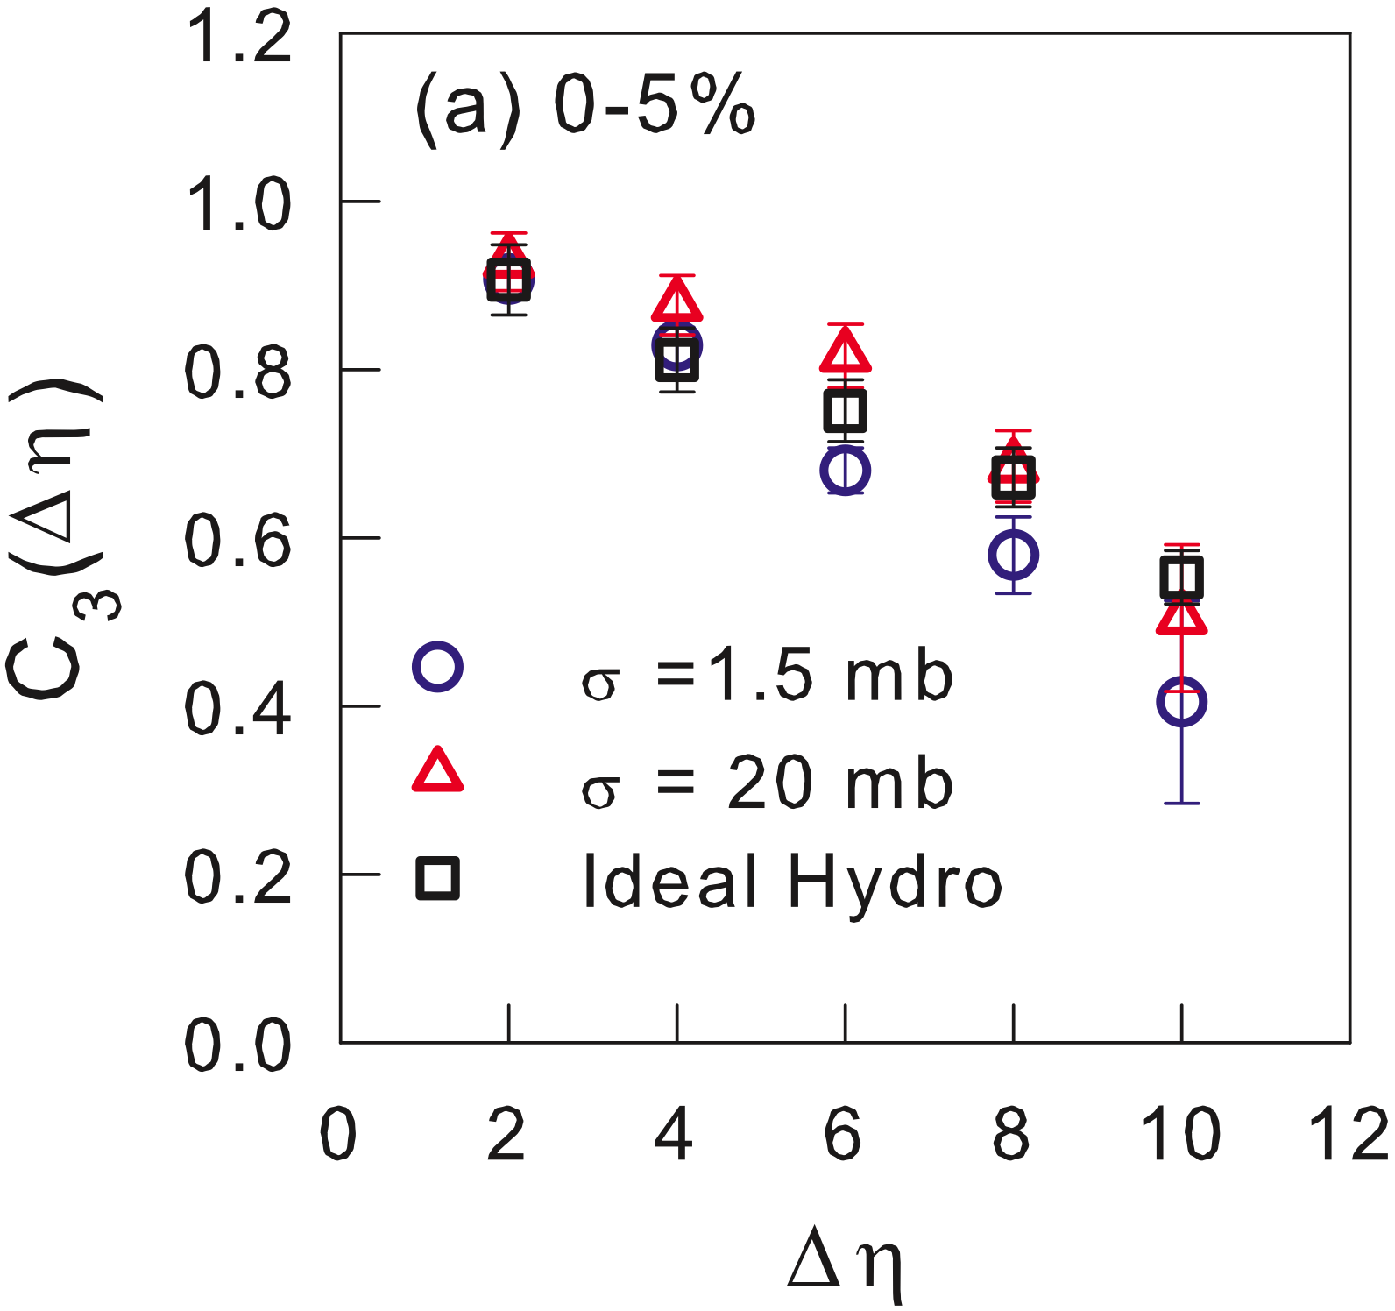
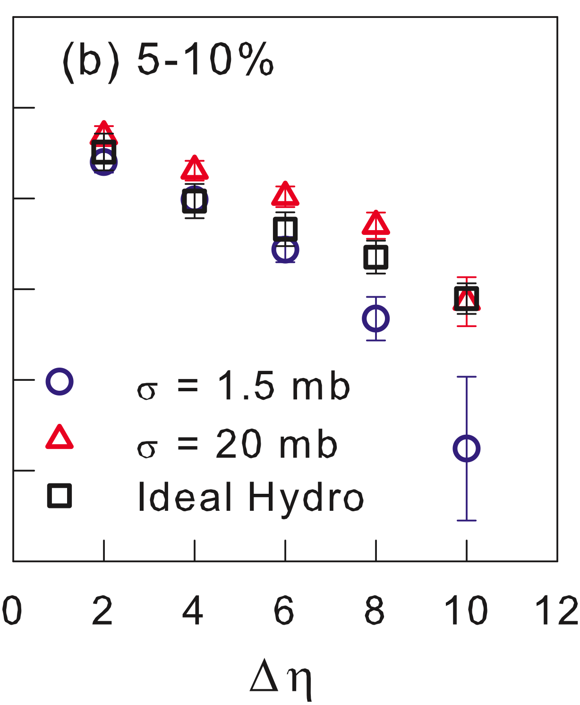
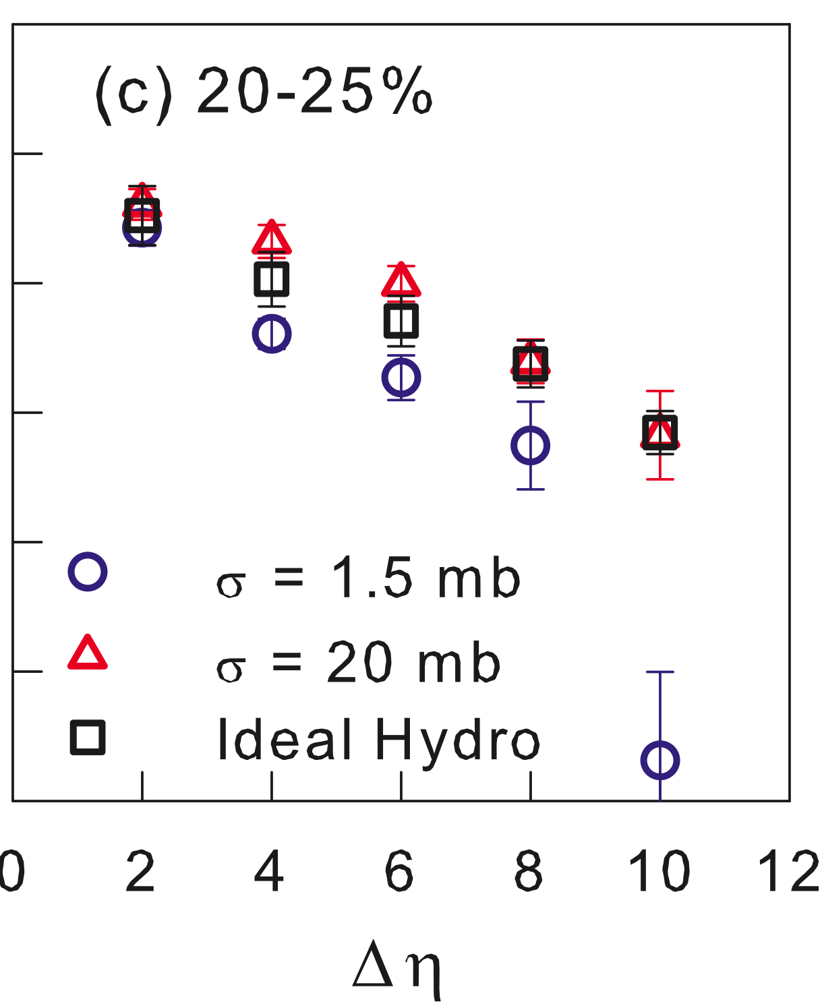
Result: C₃, E-by-E AMPT & hydro
Observation : C₃ independent of collision centrality
C₃ larger for smaller shear viscosity (larger cross section)

Slide 18
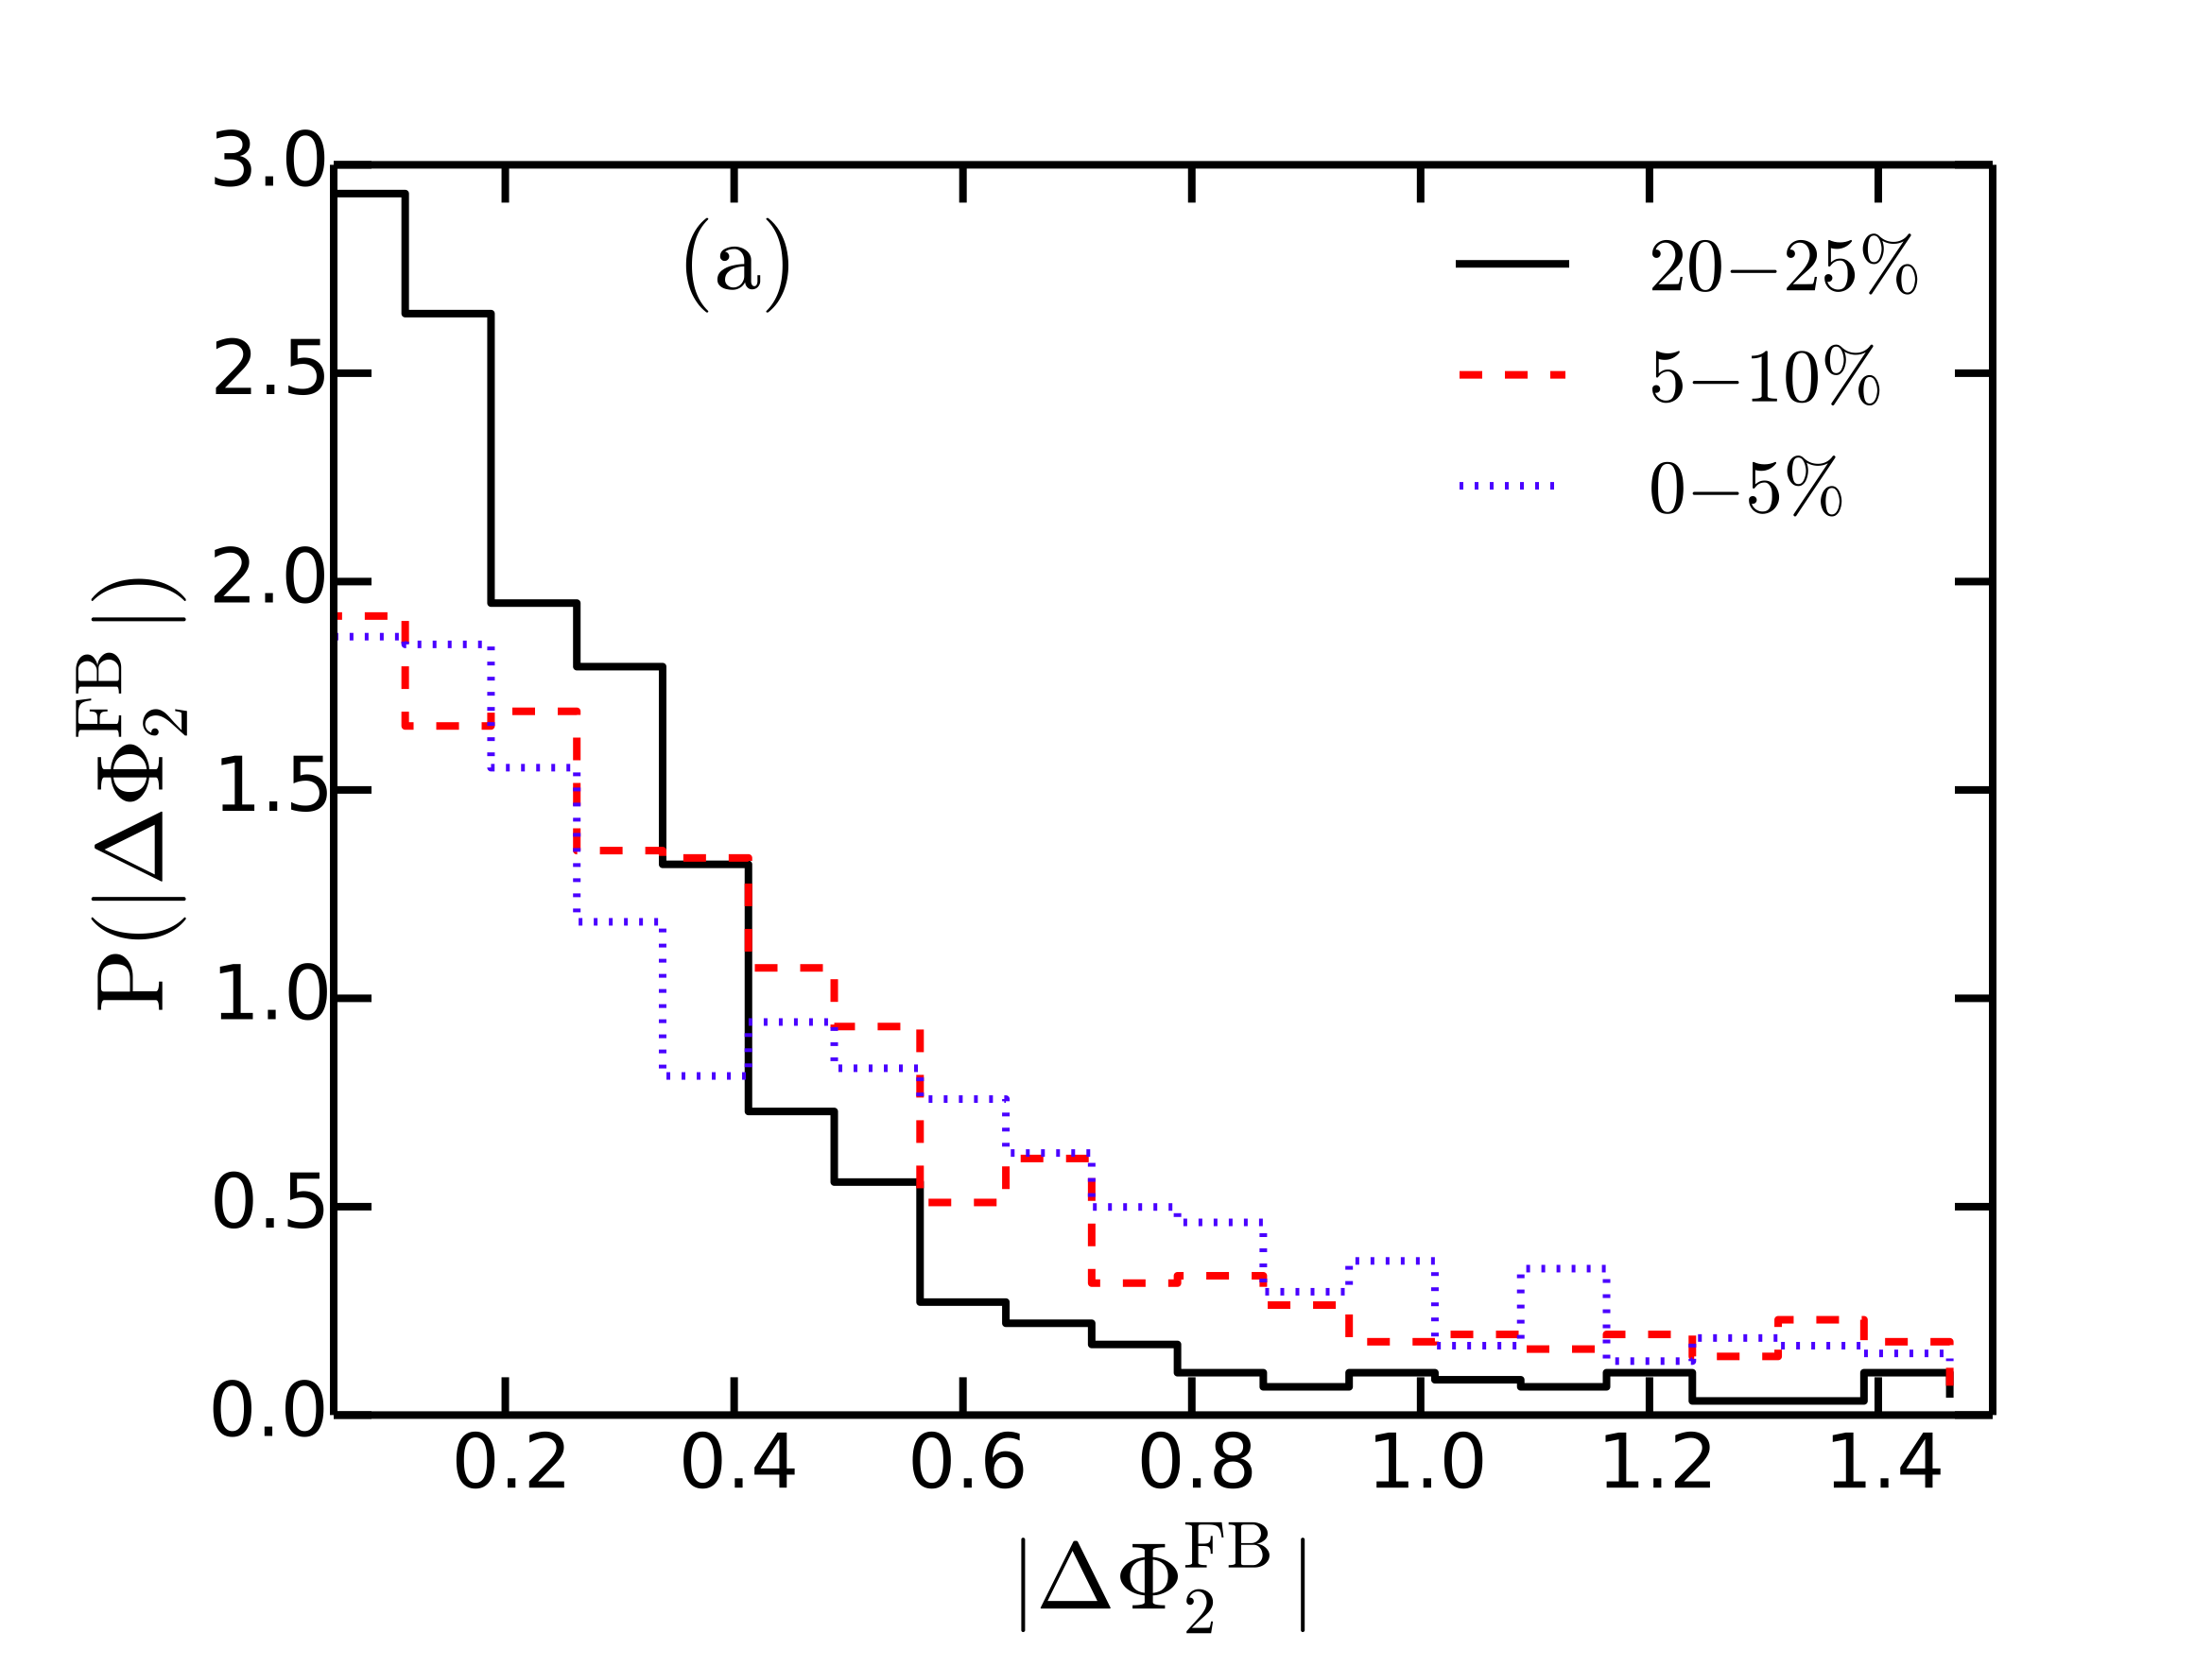
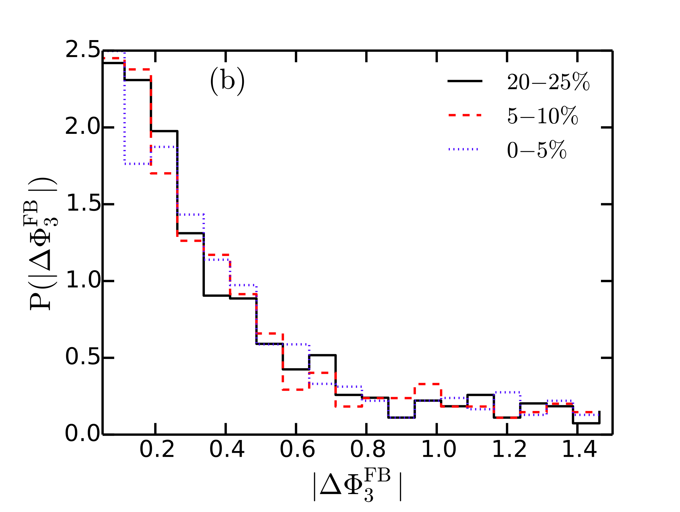
Result: Event distribution of twist angel in ideal hydro
Second order event plane
Third order event plane
Narrower for 20-25%
Geometrical contribution
Independent of centrality
Fluctuating nature of

Slide 19
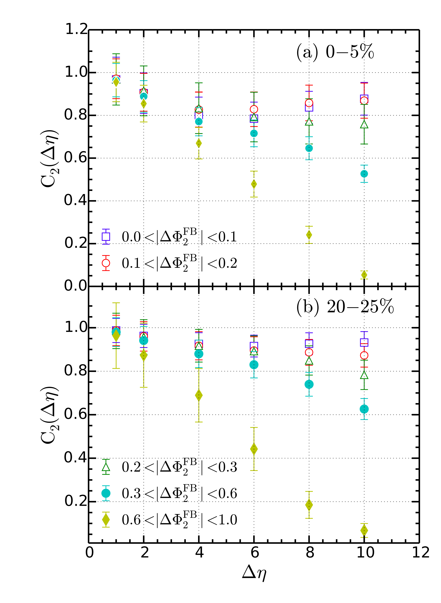
Result: separating de-correlation & twist in ideal hydro
C₂(Δη)
Twist angle between Forward Backward
rapidity
η=+5
η=-5
In the limit de-correlation
is due to pure longitudinal fluctuation.

Slide 20
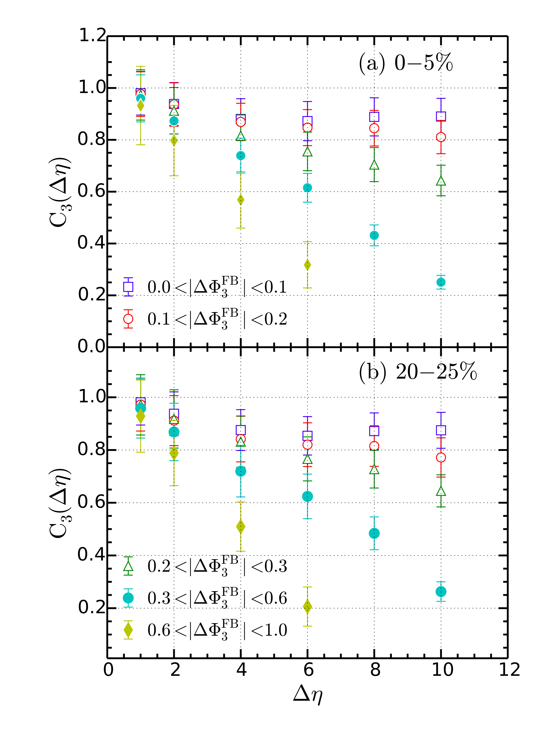
Result: separating de-correlation & twist in ideal hydro
C₃(Δη)
→ similar correlation for 0-5% & 20-25%
Noticeable contribution in de-correlation
due to longitudinal fluctuation!

Slide 21
Conclusions & Outlook
Anisotropic flows at different pseudo-rapidities are de-correlated due to
longitudinal fluctuations in the initial energy density.
De-correlation is caused by the combination of longitudinal fluctuation &
gradual twist of event planes at different rapidities
Correlation of 2nd order flow → depends on centrality of collisions
3rd order flow → independent of collision centrality
AMPT model → De-correlation depends on shear viscosity of the early stage
but almost insensitive to late stage hadronic evolution.
Considering longitudinal fluctuation is important for accurate estimation of
shear viscosity from hydrodynamic model study
OUTLOOK:
Use of a viscous 3+1D hydrodynamics model to study the dependency on
Shear viscosity.
We can also study different systems (p+p, p+Au) and different initial condition
with longitudinal fluctuation

Slide 22
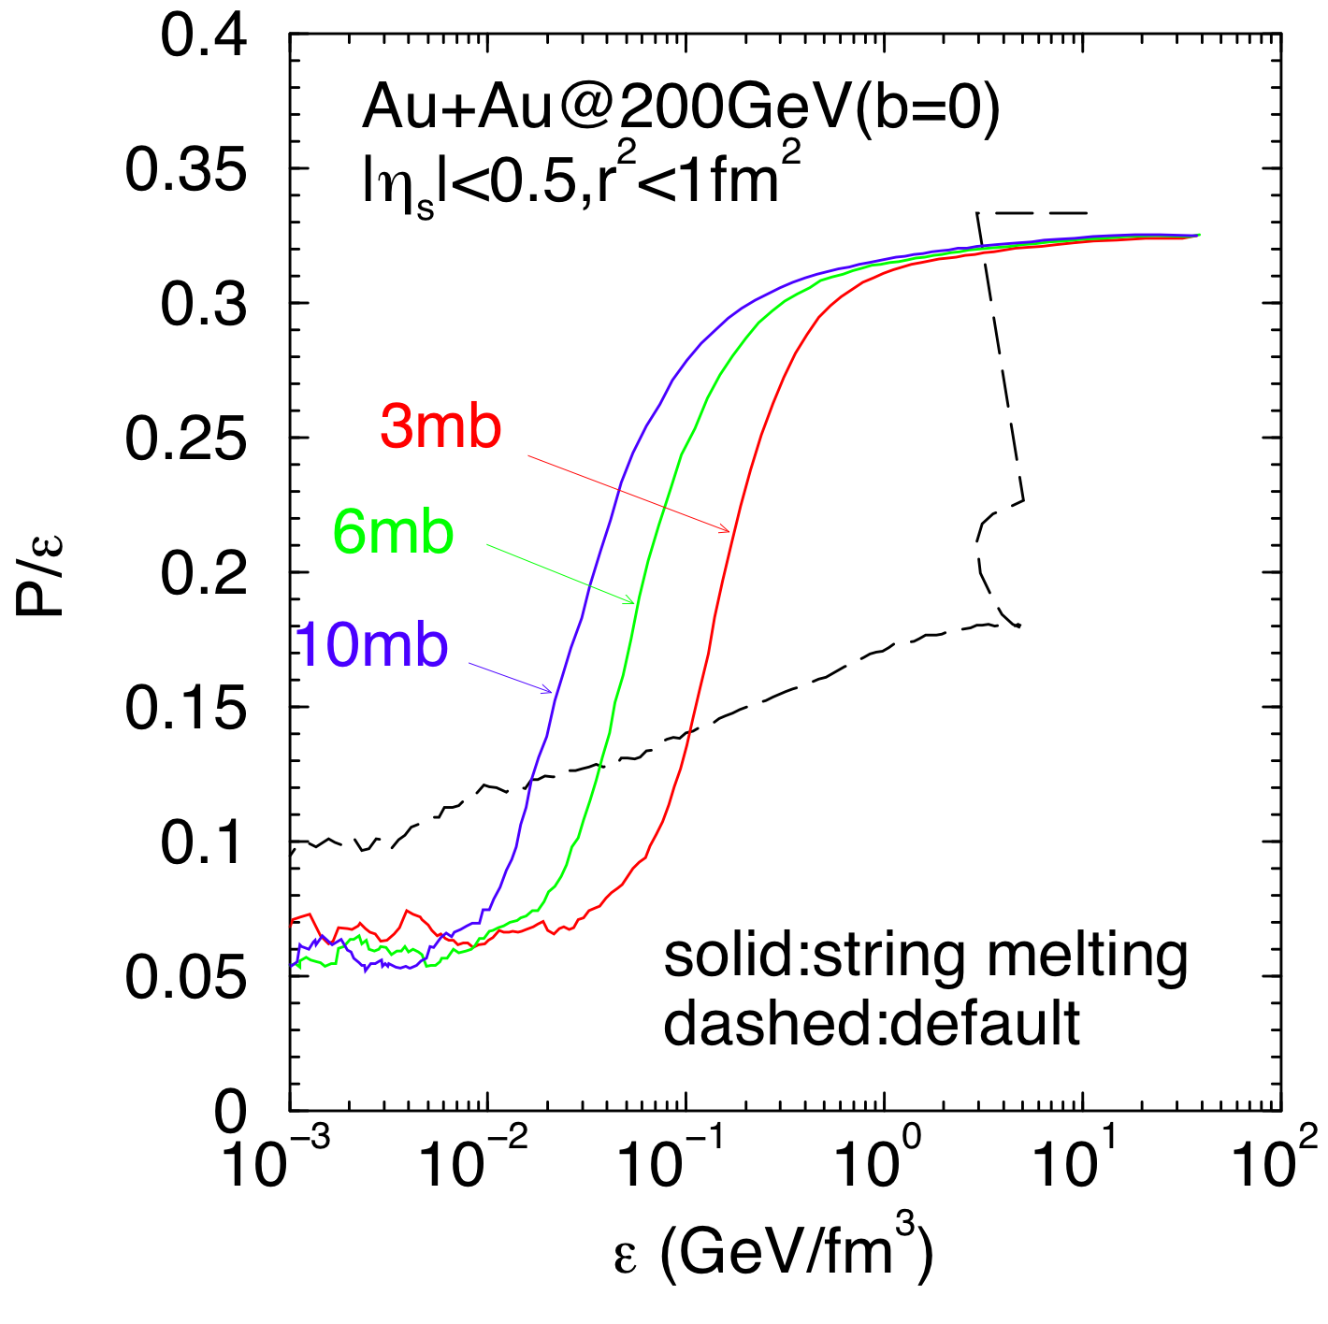
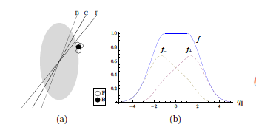
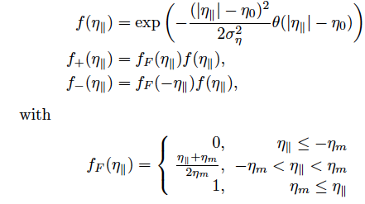
Extra
Equation of State in AMPT

