Slide 1
Rate equation approach to J/ψ equilibration

Slide 2
Rate equation approach to J/ψ equilibration
SHM+J/ψ
Processes
Rate equation
Results
Outline
$J/ψ$ in the statistical hadronization model
Production and dissociation processes
Rate equation approach
Results

Slide 3
Rate equation approach to J/ψ equilibration
SHM+J/ψ
Processes
Rate equation
Results
Statistical hadronization
Multiplicity given by T, µ, V:
$$N_{i}^{th}=\frac{d_{i}VT}{2π^{2}}m_{i}\sum_{n=1}^{∞}{{\left(∓1\right)}^{n+1}\frac{λ_{i}^{n}}{n}K_{2}\left(\frac{nm_{i}}{T}\right)}$$
T, µ: ratio fits V: charged hadron multiplicity

Slide 4
Rate equation approach to J/ψ equilibration
SHM+J/ψ
Processes
Rate equation
Results
Exact charm conservation (hadron picture)
Balance equation:
$$N_{c\overline{c}}^{dir}=\frac{1}{2}g_{c}N_{oc}^{th}\frac{I_{1}\left(g_{c}N_{oc}^{th}\right)}{I_{0}\left(g_{c}N_{oc}^{th}\right)}+g_{c}^{2}N_{ψ}^{th}$$
$g_{c}$: charm fugacity (hadronic picture)
$$N_{J/ψ}^{}=g_{c}^{2}\frac{d_{J/ψ}VT}{2π^{2}}m_{J/ψ}\sum_{n=1}^{∞}{\frac{λ_{J/ψ}^{n}}{n}K_{2}\left(\frac{nm_{J/ψ}}{T}\right)}$$

Slide 5
Rate equation approach to J/ψ equilibration
SHM+J/ψ
Processes
Rate equation
Results
Exact charm conservation (QGP picture)
Balance equation:
$$N_{c\overline{c}}^{dir}=λ_{c\overline{c}}N_{c}^{th}=λ_{c\overline{c}}^{}\frac{d_{c}VT}{2π^{2}}m_{c}\sum_{n=1}^{∞}{{\left(−1\right)}^{n+1}\frac{λ_{c}^{n}}{n}K_{2}\left(\frac{nm_{c}}{T}\right)}$$
$λ_{c\overline{c}}$: charm fugacity (QGP picture)
$$N_{J/ψ}^{}=λ_{c\overline{c}}^{2}\frac{d_{J/ψ}VT}{2π^{2}}m_{J/ψ}\sum_{n=1}^{∞}{\frac{λ_{J/ψ}^{n}}{n}K_{2}\left(\frac{nm_{J/ψ}}{T}\right)}$$

Slide 6
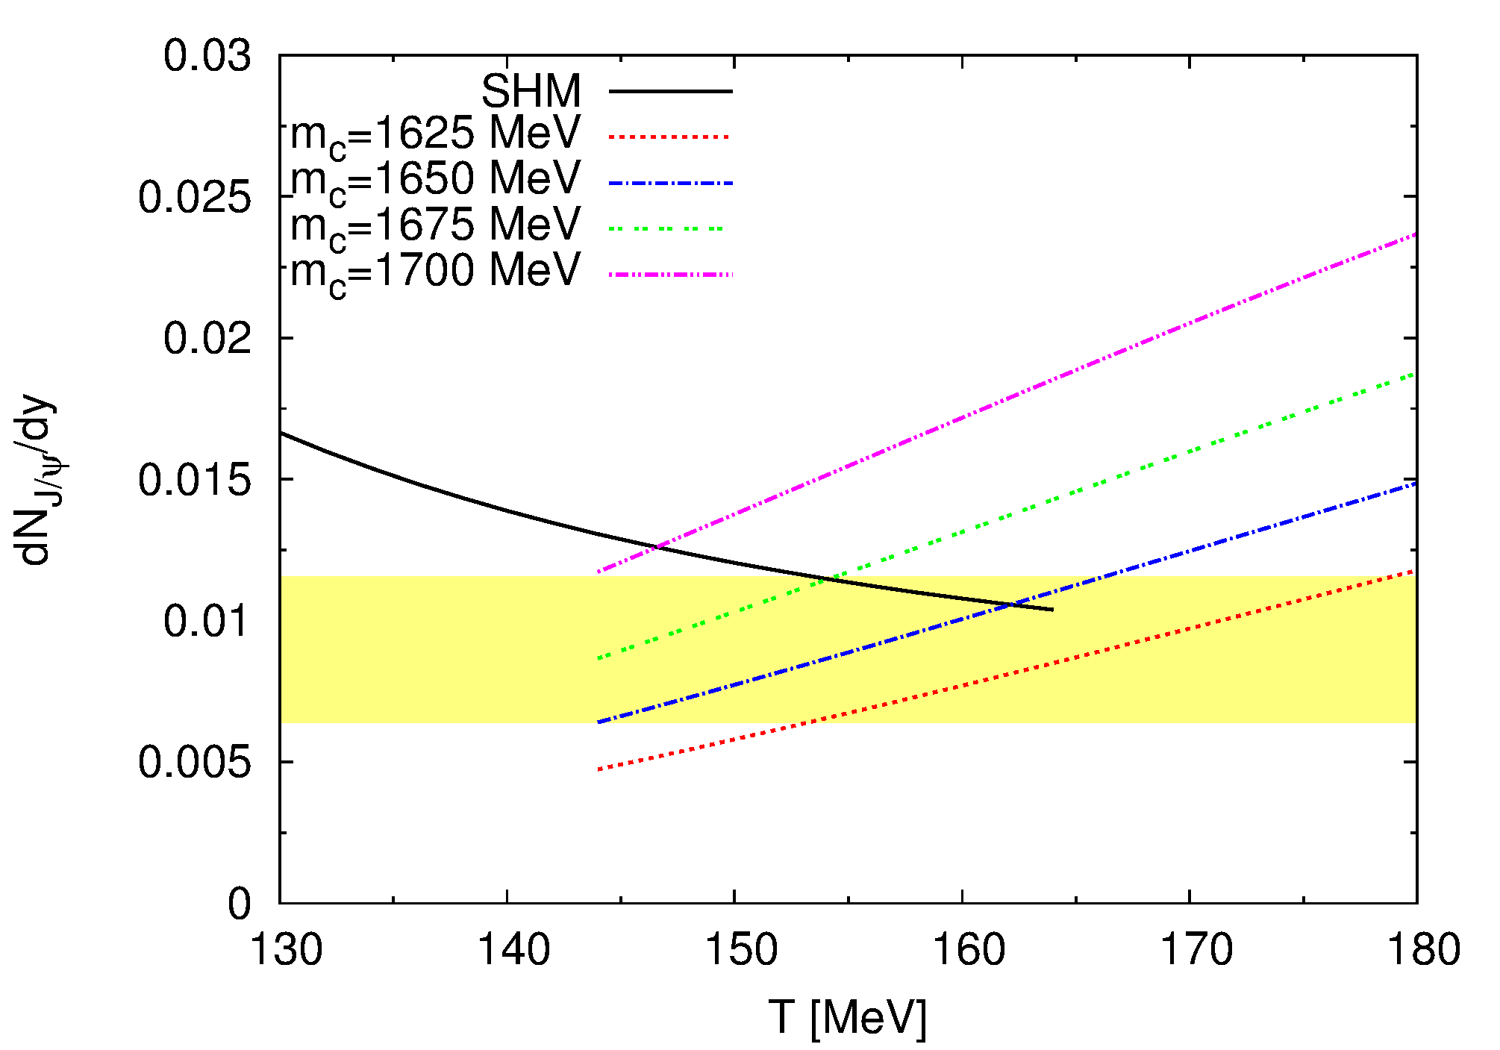
Rate equation approach to J/ψ equilibration
SHM+J/ψ
Processes
Rate equation
Results
Production equivalency
$g_{c}$ and $λ_{c\overline{c}}$ are connected measures of chemical equilibrium
Strong dependence on $m_{c}$!
PB, Uphoff, Greiner: PRC 90 (2014) 6, 061901

Slide 7
Rate equation approach to J/ψ equilibration
SHM+J/ψ
Processes
Rate equation
Results
Motivation
Simultaneous production of hadrons fits $J/ψ$
$T_{dis}>T_{FO}$: QGP picture should hold
Can QGP scatterings produce statistical $J/ψ$ multiplicities?

Slide 8
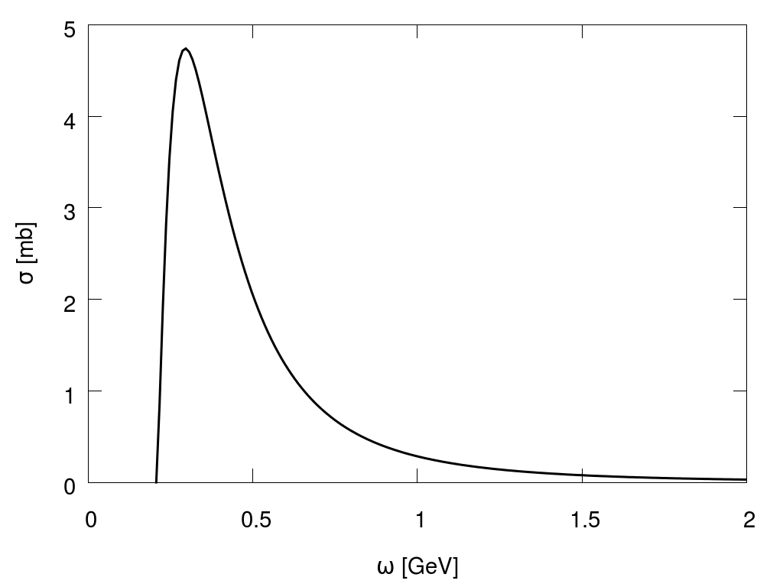
Rate equation approach to J/ψ equilibration
SHM+J/ψ
Processes
Rate equation
Results
Processes
Bhanot-Peskin gluon dissociation
$$\frac{2^{11}}{27}\frac{1}{\sqrt{m_{c}^{3}ε}}\frac{{\left(ω/{ω_{0}}−1\right)}^{3/2}}{{\left(ω/{ω_{0}}\right)}^{5}}$$
Bhanot, Peskin: Nucl. Phys. B 156 (1979) 391

Slide 9
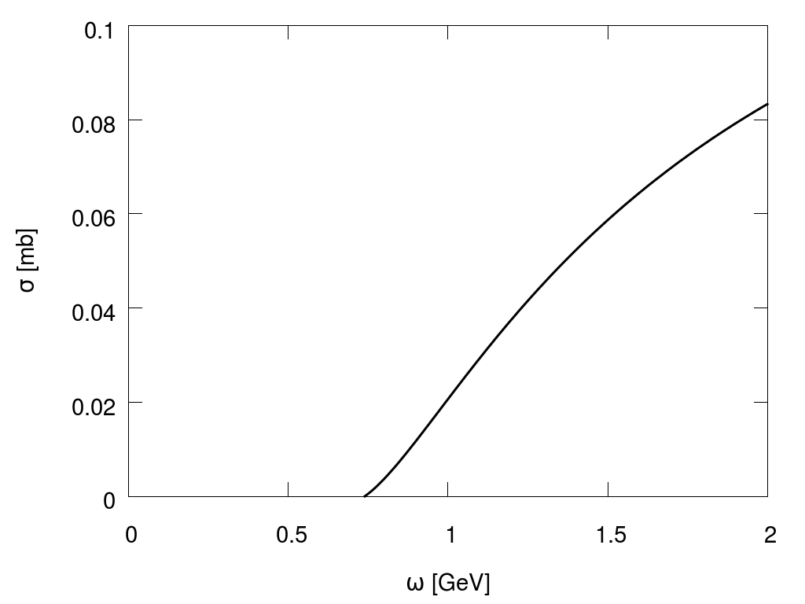
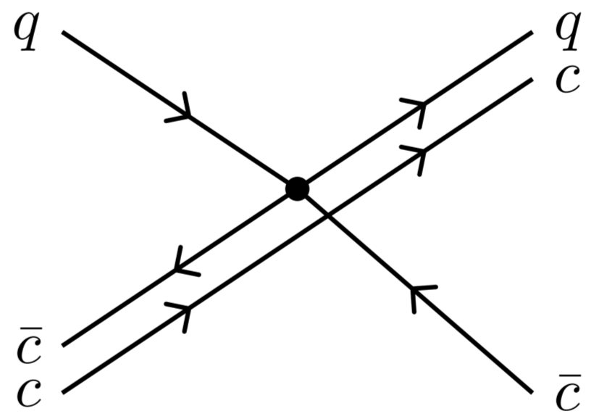
Rate equation approach to J/ψ equilibration
SHM+J/ψ
Processes
Rate equation
Results
Processes
Quasi-free quark dissociation
$$\frac{4πα^{2}}{9{\left(2m_{c}ω\right)}^{2}}\left[\begin{aligned}\left(1+\frac{2\left(2m_{c}ω+m_{c}^{2}\right)}{Q_{0}^{2}}\right)\left(\frac{{\left(2m_{c}ω\right)}^{2}}{2m_{c}ω+m_{c}^{2}}−Q_{0}^{2}\right) \\ −2(2m_{c}ω+m_{c}^{2})\log{\frac{{\left(2m_{c}ω\right)}^{2}}{{\left(2m_{c}ω+m_{c}^{2}\right)Q}_{0}^{2}}} \end{aligned}\right]$$
Combridge: Nucl. Phys. B 151 (1979) 429

Slide 10
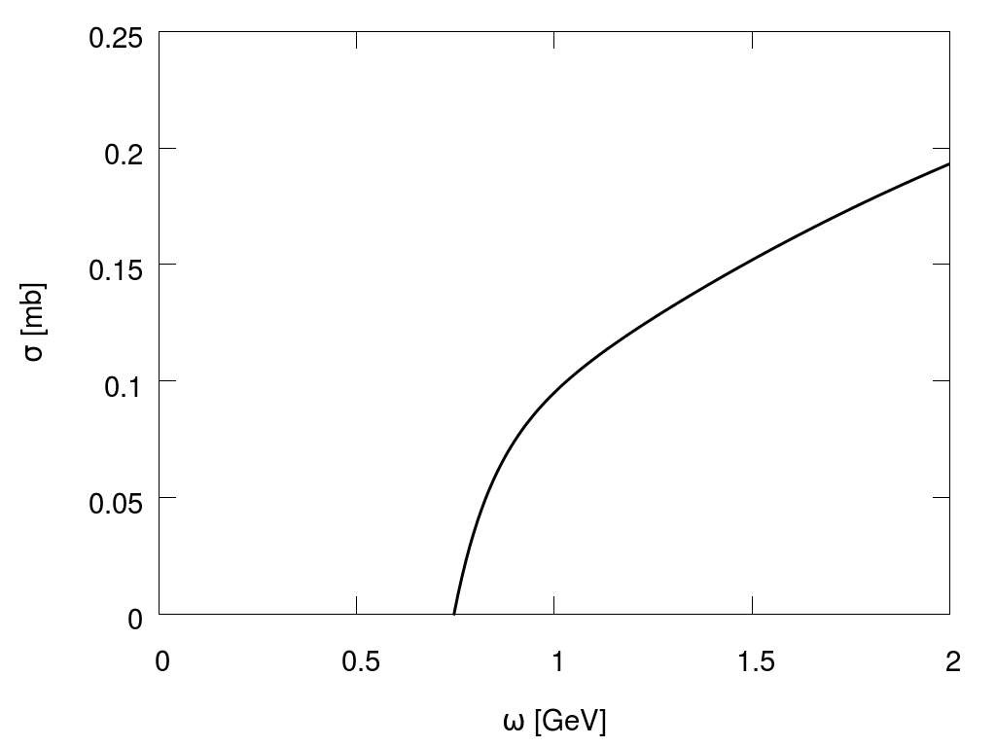
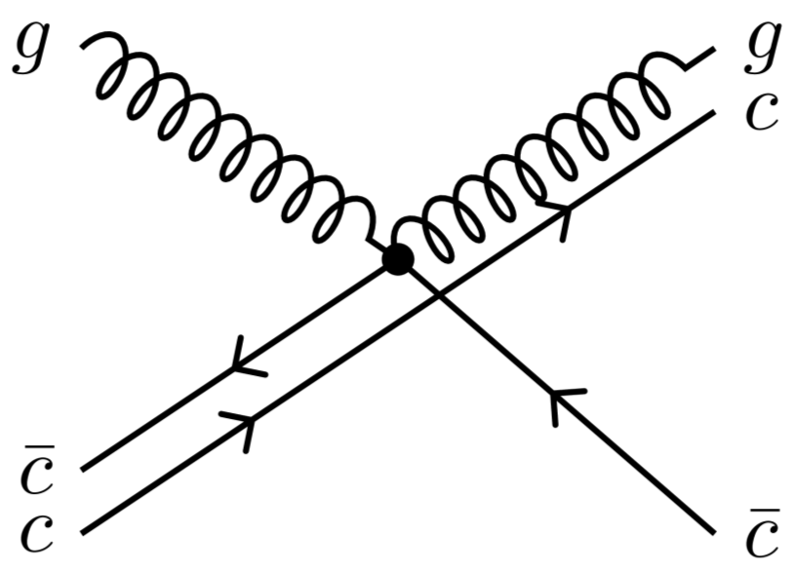
Rate equation approach to J/ψ equilibration
SHM+J/ψ
Processes
Rate equation
Results
Processes
Quasi-free gluon dissociation
$$\frac{2πα^{2}}{{\left(2m_{c}ω\right)}^{2}}$$
$$\left[\frac{a^{2}}{b^{2}}\right]$$
$$\left(1+\frac{4}{9}{\left(\frac{m_{c}+ω}{ω}\right)}^{2}\right)\left(L{−Q}_{0}^{2}\right)+\frac{Q_{0}^{4}−L^{2}}{9m_{c}ω}+4m_{c}\left(m_{c}+ω\right)\log{\frac{Q_{0}^{2}}{L}}$$
$$+\frac{2}{9}\frac{m_{c}^{3}−5m_{c}^{2}ω}{ω} \log{\frac{2m_{c}ω−Q_{0}^{2}}{2m_{c}ω−L}}+8m_{c}^{2}ω^{2}\left(\frac{1}{Q_{0}^{2}}−\frac{1}{L}\right)+\frac{16m_{c}^{4}}{9}\left(\frac{1}{2m_{c}ω−L}−\frac{1}{2m_{c}ω−Q_{0}^{2}}\right)$$
$$\left[\frac{a^{2}}{b^{2}}\right]$$
Combridge: Nucl. Phys. B 151 (1979) 429

Slide 11
Rate equation approach to J/ψ equilibration
SHM+J/ψ
Processes
Rate equation
Results
Potential model
Binding radius from screened potential:
$V=−\frac{4}{3}\frac{α}{r}e^{−m_{D}r}+\frac{σ}{m_{D}}(1−e^{−m_{D}r}$)
$E=2m_{c}+\frac{b}{m_{c}r^{2}}−\frac{4}{3}\frac{α}{r}e^{−m_{D}r}+\frac{σ}{m_{D}}(1−e^{−m_{D}r}$)
$$−\frac{2b}{m_{c}r^{3}}+\left(σ+\frac{4}{3}\frac{α}{r}\left(\frac{1}{r}+m_{D}\right)\right)e^{−m_{D}r}=0$$
Karsch, Mehr, Satz: Z. Phys. C 37, 617 (1988)

Slide 12
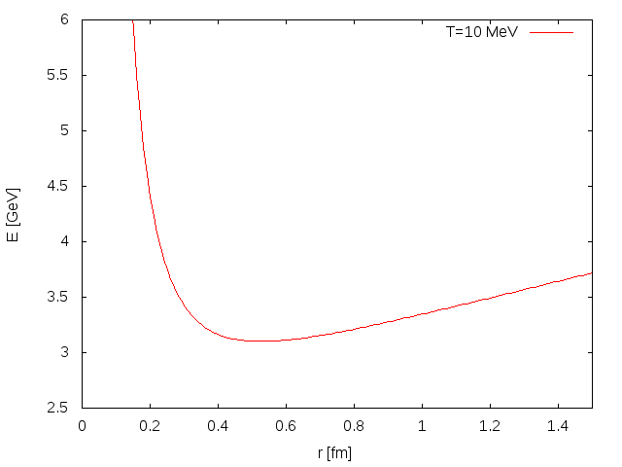
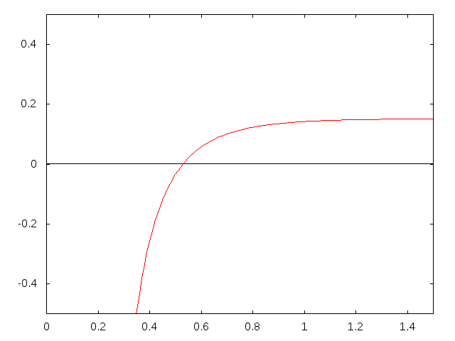
Rate equation approach to J/ψ equilibration
SHM+J/ψ
Processes
Rate equation
Results
Melting

Slide 13
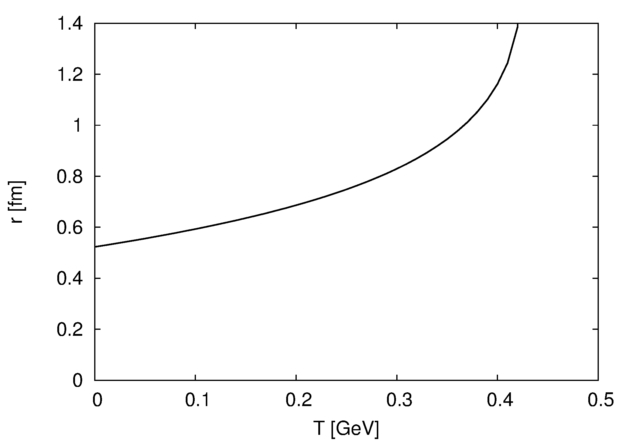
Rate equation approach to J/ψ equilibration
SHM+J/ψ
Processes
Rate equation
Results
Modifications
Cross sections increase with radius
$$σ\left(T\right)=σ\left(0\right)\frac{\left\langle r^{2}\right\rangle \left(T\right)}{\left\langle r^{2}\right\rangle (0)}$$

Slide 14
Rate equation approach to J/ψ equilibration
SHM+J/ψ
Processes
Rate equation
Results
Dissociation rate
$$Γ=\int{\frac{{\text{d}}^{3}p}{{\left(2π\right)}^{3}}d_{g}f_{g}σ_{gJ/ψ}}v_{rel} \\ Γ\left(u_{r},T\right)= \frac{d_{g}T}{{\left(2π\right)}^{2}\left|u_{r}\right|}\int_{ω_{0}}^{∞}{\text{d}ω ω_{gJ/ψ}}\log{\frac{1−e^{−\left(\sqrt{{\left|u_{r}\right|}^{2}+1}+\left|u_{r}\right|\right)ω/T}}{1−e^{−\left(\sqrt{{\left|u_{r}\right|}^{2}+1}−\left|u_{r}\right|\right)ω/T}}}$$
$$Γ\left(T\right)=\frac{d_{g}}{2π^{2}}\int_{ω_{0}}^{∞}{\text{d}ω \frac{ω^{2}σ_{gJ/ψ}}{e^{ω/T}−1}} \text{for} \left|u_{r}\right|=0$$

Slide 15
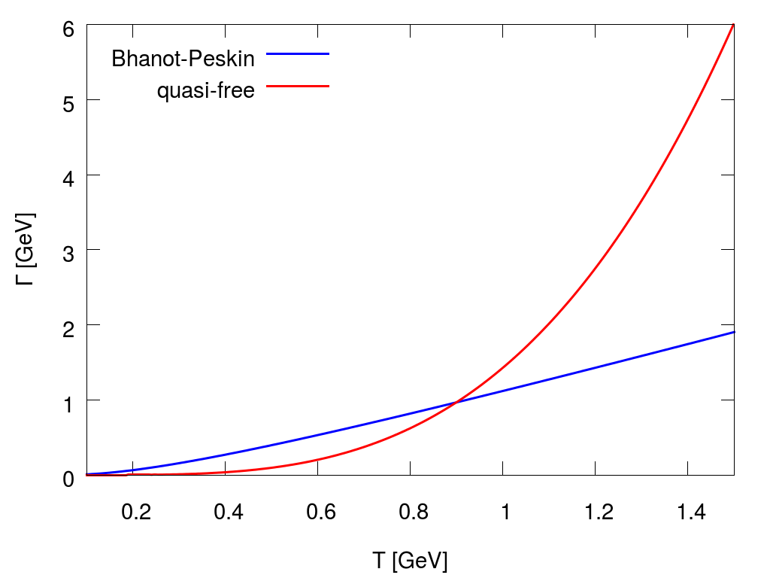
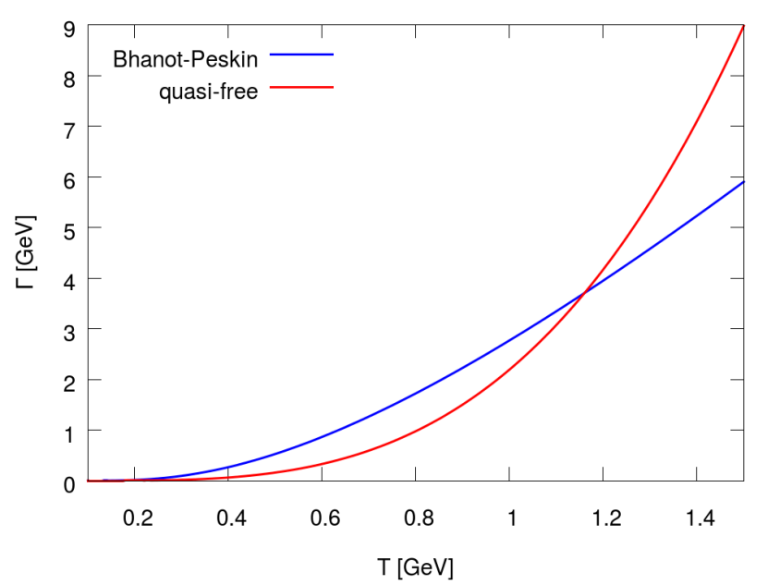
Rate equation approach to J/ψ equilibration
SHM+J/ψ
Processes
Rate equation
Results
Rates
$m_{c}=1.65$GeV
$m_{c}=1.87$GeV

Slide 16
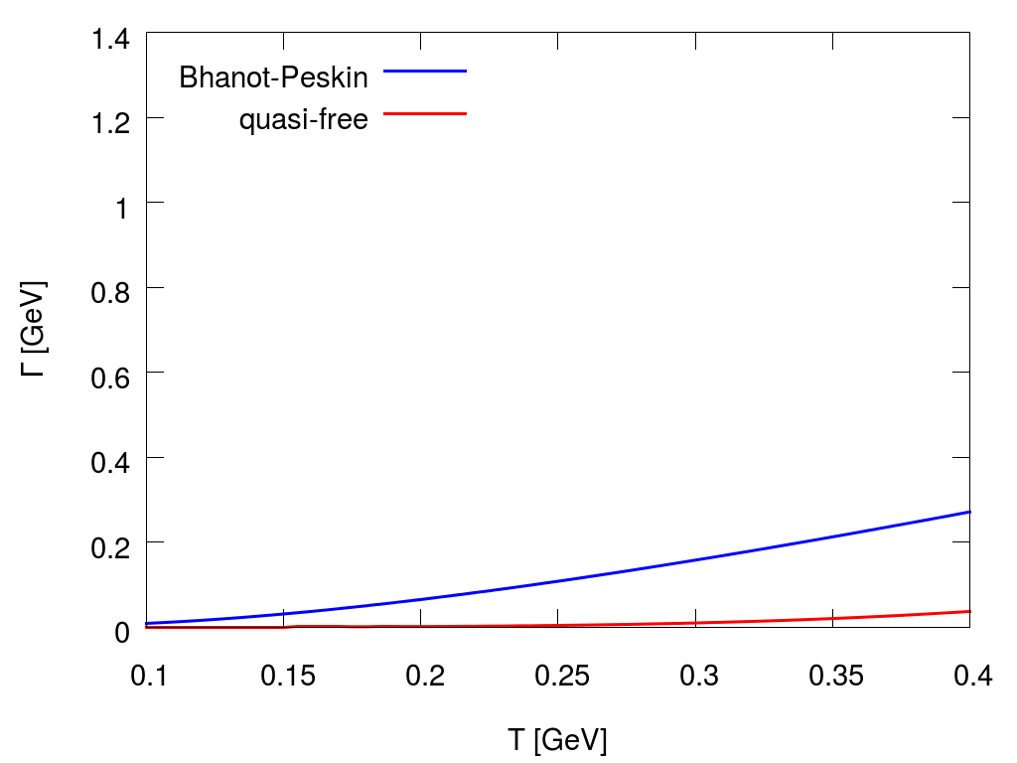
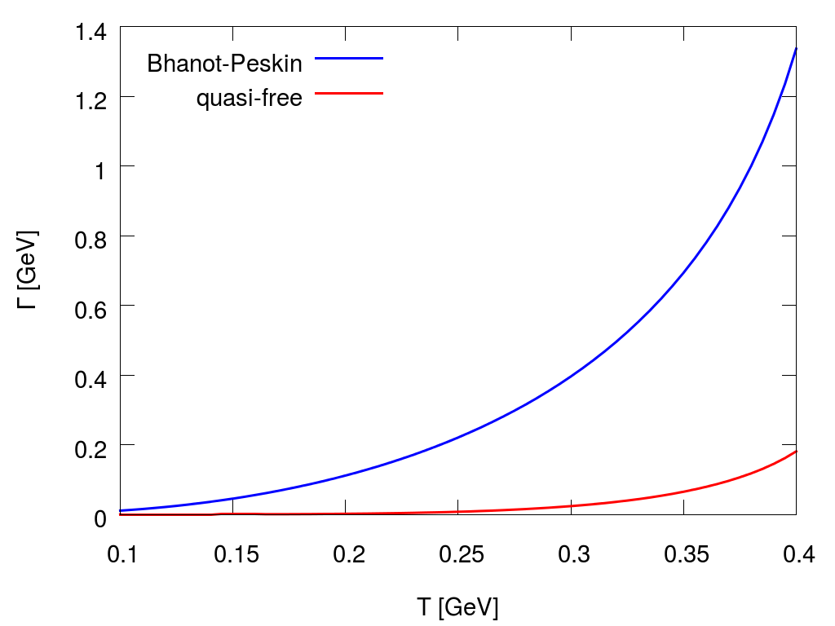
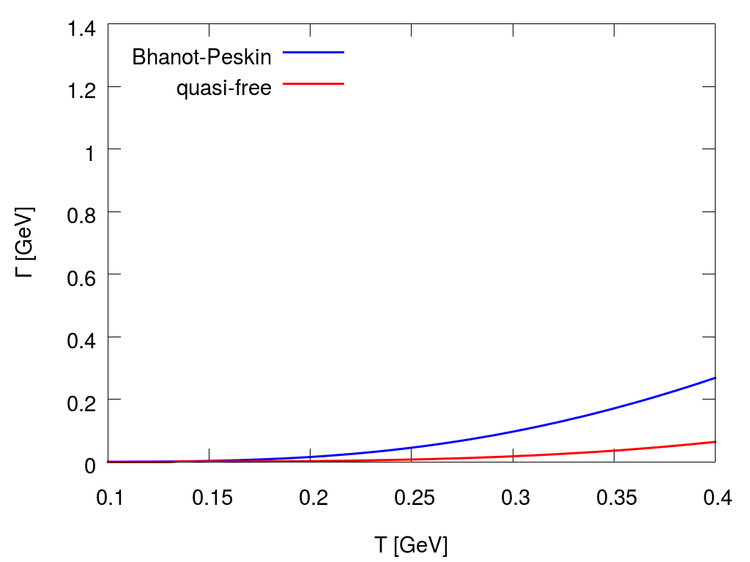
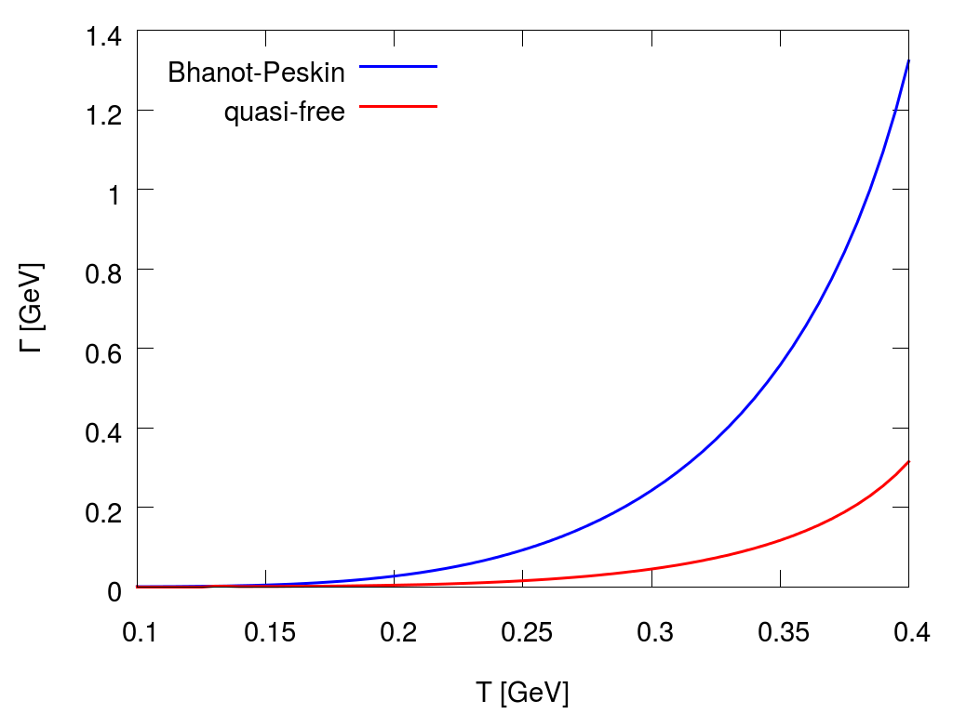
Rate equation approach to J/ψ equilibration
SHM+J/ψ
Processes
Rate equation
Results
Rates
$m_{c}=1.65$GeV
$$×\frac{\left\langle r^{2}\right\rangle \left(T\right)}{\left\langle r^{2}\right\rangle (0)}=$$
$m_{c}=1.87$GeV

Slide 17
Rate equation approach to J/ψ equilibration
SHM+J/ψ
Processes
Rate equation
Results
Rate equation
$$\text{d}N=\text{gain} \text{rate} − \text{loss} \text{rate}$$
loss $↔ΓN\left(t\right)$
$$N=N_{eq}↔dN=0↔\text{gain}=ΓN_{eq}$$
$$\frac{dN}{dt}=−Γ \left(N\left(t\right)−N_{eq}\right)$$

Slide 18
Rate equation approach to J/ψ equilibration
SHM+J/ψ
Processes
Rate equation
Results
Explicit form
$$N_{c}=λ_{c\overline{c}}^{}\left(T\right) V\left(T\right) n_{c}^{th}\left(T\right)=const.$$
$$N_{eq}=λ_{c\overline{c}}^{2}N_{J/ψ}^{th}=\frac{1}{Vn_{c}^{2}}N_{c}^{2} n_{ψ}^{th}$$
$\frac{dN}{dt}=−Γ\left(T\right)\left(N−\frac{N_{c}^{2}}{V{\left(T\right)n}_{c}^{2}\left(T\right)}n_{ψ}^{th}\left(T\right)\right)$

Slide 19
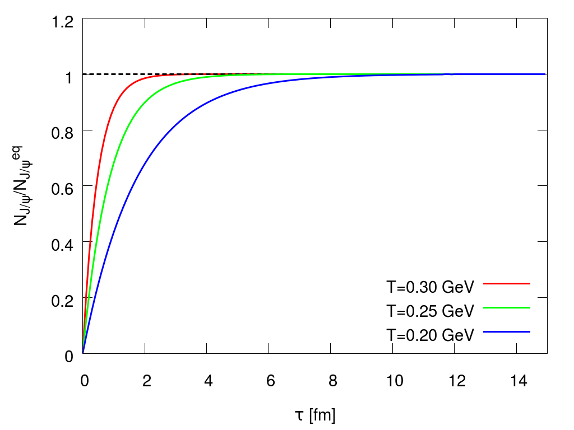
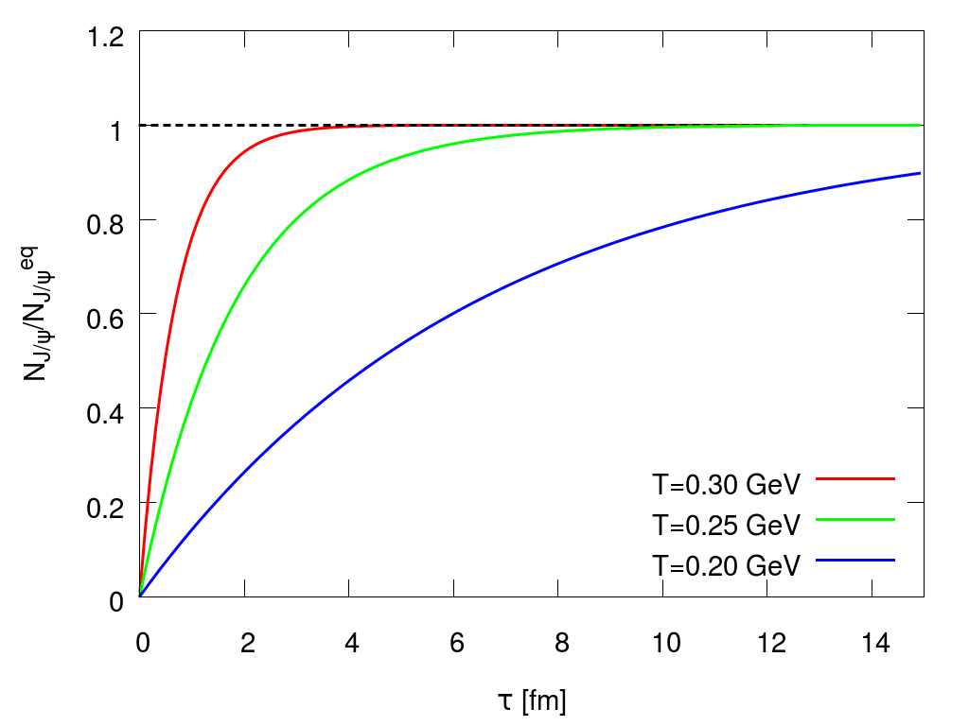
Rate equation approach to J/ψ equilibration
SHM+J/ψ
Processes
Rate equation
Results
Static box
$m_{c}=1.65$GeV
$m_{c}=1.87$GeV

Slide 20
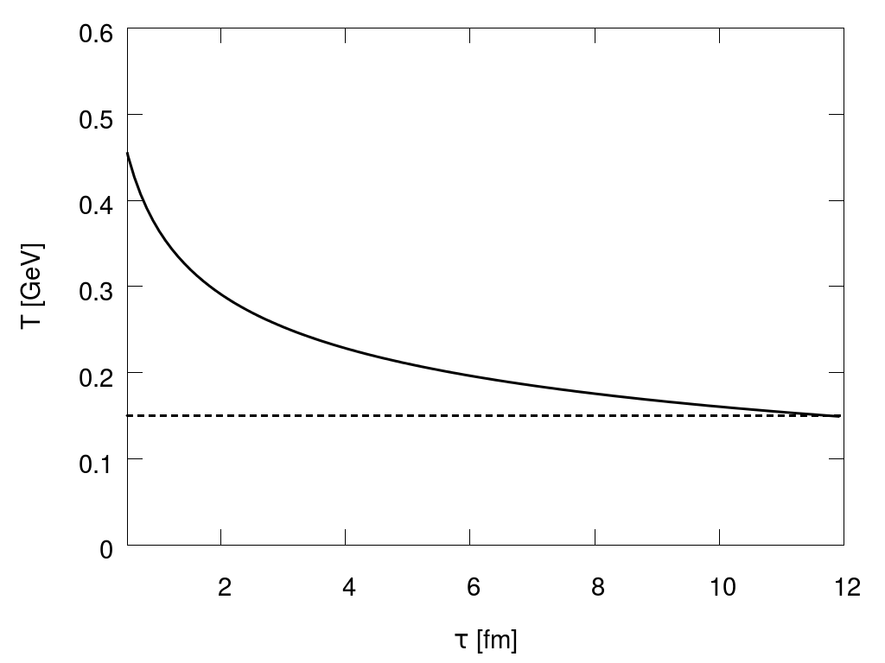
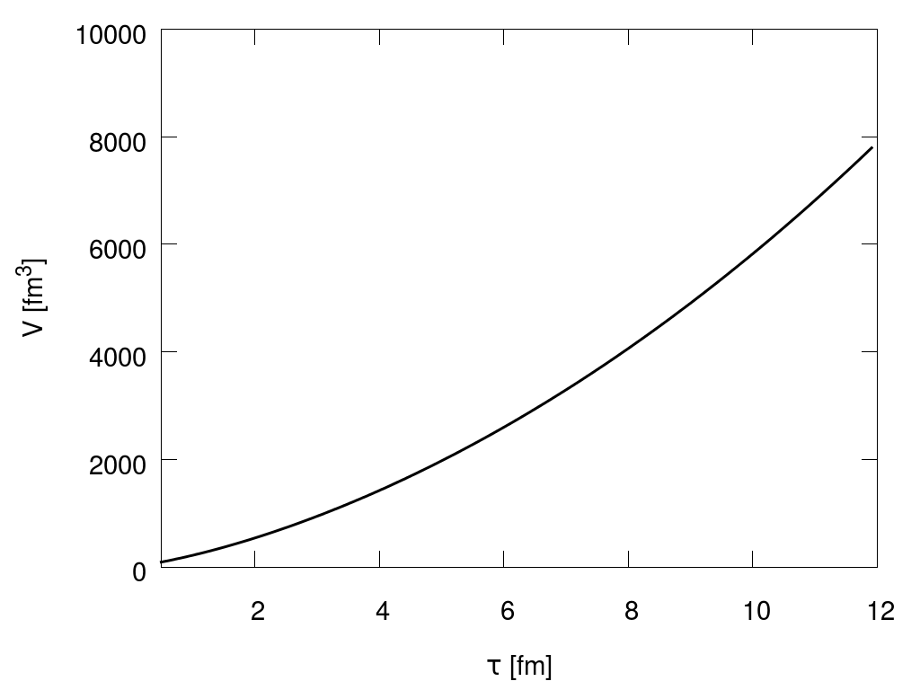
Rate equation approach to J/ψ equilibration
SHM+J/ψ
Processes
Rate equation
Results
Cooling and expanding
Schenke, Jeon, Gale: Phys. Lett. B 702 (2011) 59

Slide 21
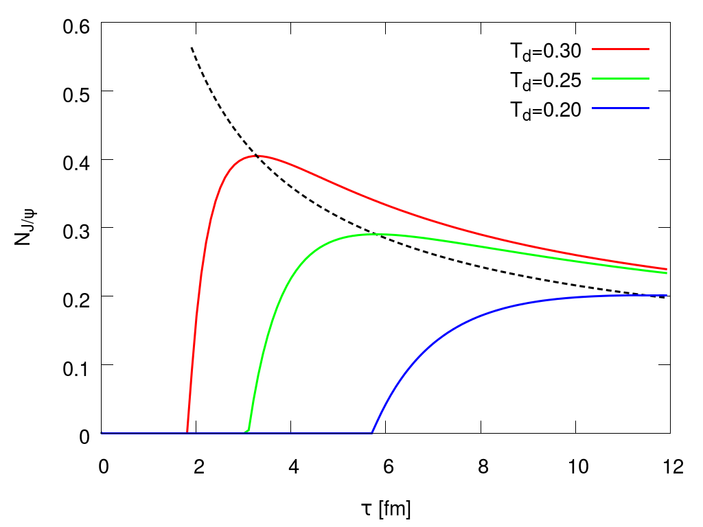
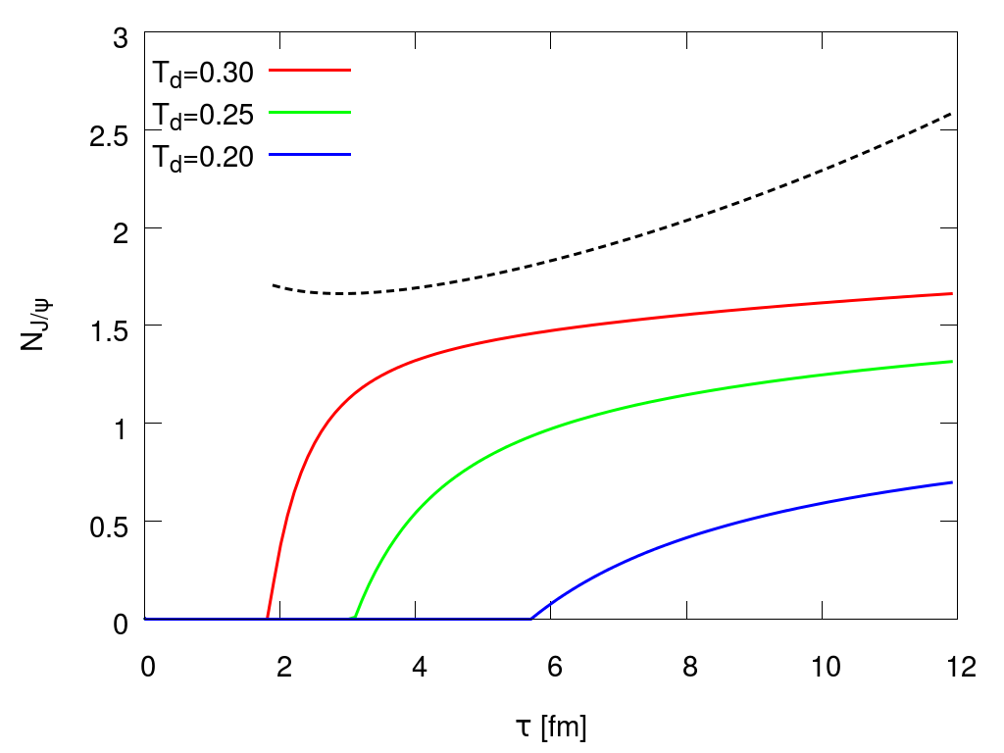
Rate equation approach to J/ψ equilibration
SHM+J/ψ
Processes
Rate equation
Results
Dynamic equilibration
$m_{c}=1.65$GeV
$m_{c}=1.87$GeV

Slide 22
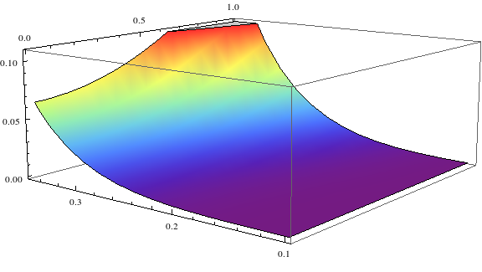
Rate equation approach to J/ψ equilibration
SHM+J/ψ
Processes
Rate equation
Results
Summary
Systematic approach cross sections $→$ equilibration times
External temperature profiles
Equilibration possible for $m_{c}=$ 1.65 GeV
To do: external flow profiles

